Slide 1
IT Security
Canon DP&S Practitioner
Andrew Pilbrow
PD Learning Consultant
Wednesday, 10 May 2023

Slide 2
01
Introduction.
02
CONTENTS
Why is IT Security Important
03
Language of IT Security
04
Risk and Risk Management
05
Vulnerability
06
Security Monitoring / Reporting secure concerns.
07
Secure by Design
08
Cloud Security Concepts – To be arranged

Slide 3
Introductions
Who are you and why are you here?
Name:
Job Role:
What to you expect from this training?

Slide 4
IT Security Introduction

Slide 5
Introduction IT Security Foundation
“It takes Canon years to build our reputation but could take only few minutes of cyber-incident to ruin it.”
“Security is always excessive until it’s not enough.”
Robbie Sinclair, Head of Security, Country Energy, NSW Australia
Why is IT Security Important?
Language of IT Security
Risk and Risk Management
Vulnerability
Security Monitoring / Reporting secure concerns.
Secure by Design / Zero Trust
Cloud Security Concepts

Slide 6
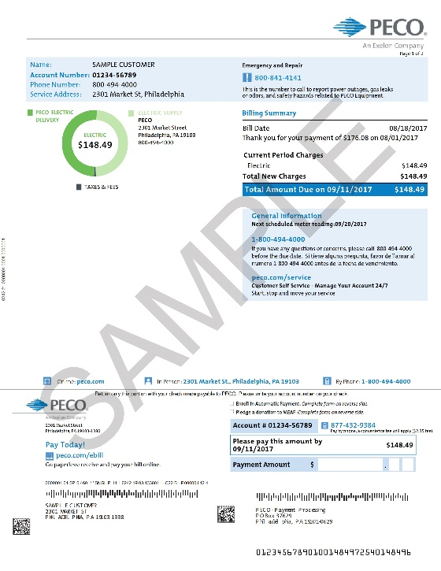
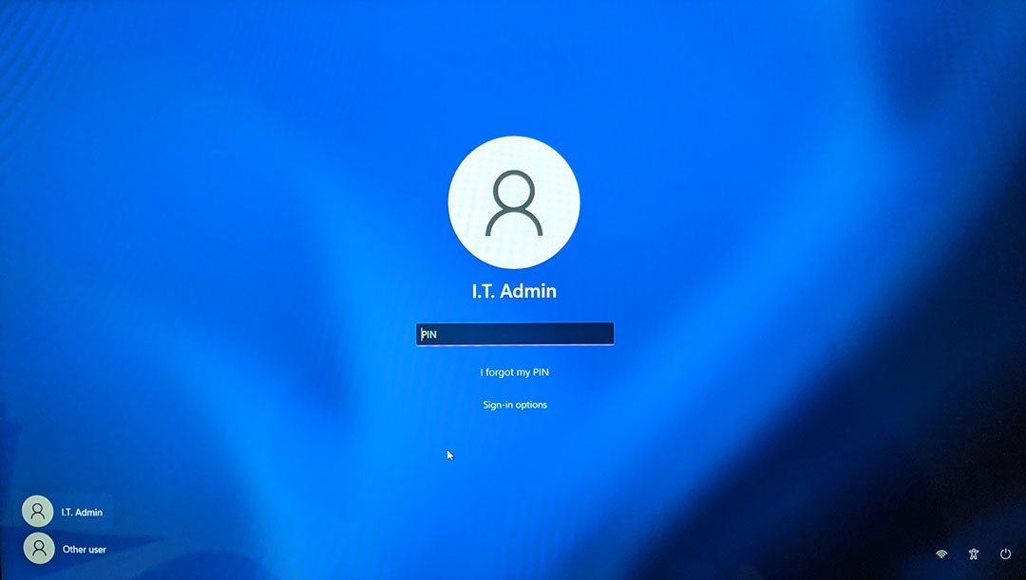
Information has value
Notes:
Information has value…therefore cyber criminals are interested in YOU!
Your information has value:
Personal Information has value:
Your password
Your login name
Your name
Your address
Your telephone number
Your passport
Wife’s name
# of children; children’s names; ages
Financial data (where you bank
Health data
Travel data
IoT Data (smart watches, phones, apps)
Work information has value:
Your login name
Your work email address
Manager’s name
Customer information
Customer addresses
Your work login password
Your work telephone number
Past employers

Slide 7
Protect Your Data
Policies
Procedures
Awareness
Physical
Perimeter
Network
Host
Application
Data

Slide 8
Reasons for a cyber attack
For Profit Attack / Ransomware
Identity Theft / Financial Theft
Destruction of Data
Attacker Motivation
Script Kiddie or Criminal Gangs
Disgruntled Employee
Accidental
Attacker
Motivation
Notes:
Harm to Operations
Inability to perform current missions/business functions
Inability, or limited ability, to perform missions/business functions in the future
Harms (e.g. financial costs, sanctions) due to noncompliance
Direct financial costs
Damage to image or reputation
Harm to assets
Harm to individuals
Harm to other organisations
Script kiddie
Noun DEROGATORY • INFORMAL
A person who uses existing computer scripts or codes to hack into computers, lacking the expertise to write their own.

Slide 9
Adversarial Risk Table
Likelihood (Threat Event Occurs and Results in Adverse Impact) | Level of Impact
 | Very Low | Low | Moderate | High | Very High
Very High | Very Low | Low | Moderate | High | Very High
High | Very Low | Low | Moderate | High | Very High
Moderate | Very Low | Low | Moderate | Moderate | High
Low | Very Low | Low | Low | Low | Moderate
Very Low | Very Low | Very Low | Very Low | Low | Low
Notes:
Identify threat event
Identify threat sources that could initiate the threat event
Assess threat source intent
Assess threat source targeting
Determine relevance of threat event
Determine likelihood that one or more of the threat sources initiates the threat event, taking into consideration capability, intent, and targeting
Identify vulnerabilities which could be exploited by threat sources initiating the threat event and the predisposing conditions which could increase the likelihood of adverse impacts
Assess severity of vulnerabilities and pervasiveness of predisposing conditions
Determine the likelihood that the threat event, once initiated, will result in adverse impact, taking into consideration threat source capability, vulnerabilities, and predisposing conditions
Determine the likelihood that the threat event will be initiated and result in adverse impact
Determine the adverse impact
Determine the level of risk as a combination of likelihood and impact

Slide 10
What are your Personal Challenges?
What made you sign up for this training?
Round table discussion about what challenges you face in your job role.

Slide 11
Understanding the Language of IT Security

Slide 12
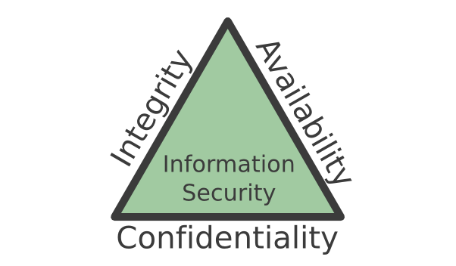
Confidentiality, Integrity and Availability (CIA triad)
Notes:
What is the CIA triad?
Confidentiality, integrity and availability, also known as the CIA triad, is a model designed to guide policies for information security within an organization. The model is also sometimes referred to as the AIC triad (availability, integrity and confidentiality) to avoid confusion with the Central Intelligence Agency. Although elements of the triad are three of the most foundational and crucial cybersecurity needs, experts believe the CIA triad needs an upgrade to stay effective.
In this context, confidentiality is a set of rules that limits access to information, integrity is the assurance that the information is trustworthy and accurate, and availability is a guarantee of reliable access to the information by authorized people.
Confidentiality, integrity, availability
The following is a breakdown of the three key concepts that form the CIA triad:
Confidentiality is roughly equivalent to privacy. Confidentiality measures are designed to prevent sensitive information from unauthorized access attempts. It is common for data to be categorized according to the amount and type of damage that could be done if it fell into the wrong hands. More or less stringent measures can then be implemented according to those categories.
Integrity involves maintaining the consistency, accuracy and trustworthiness of data over its entire lifecycle. Data must not be changed in transit, and steps must be taken to ensure data cannot be altered by unauthorized people (for example, in a breach of confidentiality).
Availability means information should be consistently and readily accessible for authorized parties. This involves properly maintaining hardware and technical infrastructure and systems that hold and display the information.

Slide 13
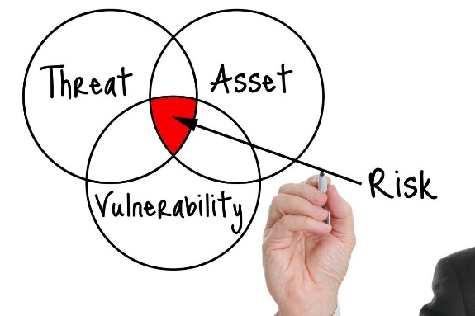
Security Policy
Laptops
Users
Computers
Printers
Servers
Monitor
RISK
Notes:
The customer security policy is the basis for the customers security design. Include all assets and known vulnerabilities take into account the likelihood of threat to build risk overview. A policy will cover both physical and IT security. Constant monitoring of both cyber and physical assets is vital to ensure the policy is enforced. The policy is built taking all the risk assessments into account as well as known vulnerabilities and threats.

Slide 14
Canon’s Information Classification System
Top Secret
R1
Sensitive
R2
Internal
R3
Public
R4
Only a limited group of people know, this information has very big impact on Canon’s business and operations
Sensitive information that we work with on a regular basis but is restricted to a certain group of people who are authorized to handle it.
Treated confidential with respect to external entities, can be widely known by employees
Authorized distribution to the public
https://canoneuropenv.sharepoint.com/teams/AppSec/SitePages/Classification%20of%20Information.aspx
Notes:
Data security classification allows companies to understand the risk of the data being disclosed outside the business. The Canon R rating system is a good example of this.

Slide 15
Threats to our customers:
Notes:
PSIRT Establishment
We have established the PSIRT (Product Security Incident Response Team) to handle vulnerability information relevant to the Products.
Vulnerability Management
We work continuously to identify and limit the risk associated with vulnerabilities in the Products. However, if you, as end user, partner, vendor, industry group or independent researcher, identify a vulnerability in the Products, we encourage you to report the problem immediately via the reporting form below. Timely reporting of vulnerabilities is critical to reducing the likelihood that they can be exploited in practice.
Canon Inc. Product Vulnerability Reporting Contact (Reporting Form)
We accept information only for undisclosed vulnerabilities in the Products.
Vulnerabilities related to open source software components should be addressed directly to the responsible entity. We may assess the open source software vulnerability to its relevance in the context of how we recommend deploying the Products.
We expect reporters agree with us on a disclosure process and a disclosure date.
The reporter can expect an acknowledgement of receipt from us within 3 business days after receiving the initial submission.

Slide 16
Biggest Security Risks: Home Office Workers
Q44: What are the biggest security risks for your company with an increase in remote workforce? (select up to 2)
N = 202 respondents who believe the pandemic will increase the number of home workers at their company
Source: WE OG IT DM 2020

Slide 17
Security Risks with Working from Home
Q44: What are the biggest security risks for your company with an increase in remote workforce?
N = 202 57 71 74
Respondents who believe the pandemic will increase the number of home workers at their company
Source: WE OG IT DM 2020

Slide 18
Top of Mind Features for Home Office Workers
Q40: What print device features are most important for home office workers?(up to 5 selections possible)
57% of small companies cited reliability and ease of use jointly as #1 criteria
46% of medium-sized companies cited reliability as #1 criteria, followed by ease of use at 37%
46% of large companies cited reliability as #1 criteria, followed by lower TCO at 34%
Improved device security was given at 21%
Number of responses = 299
Source: WE OG IT DM 2020

Slide 19
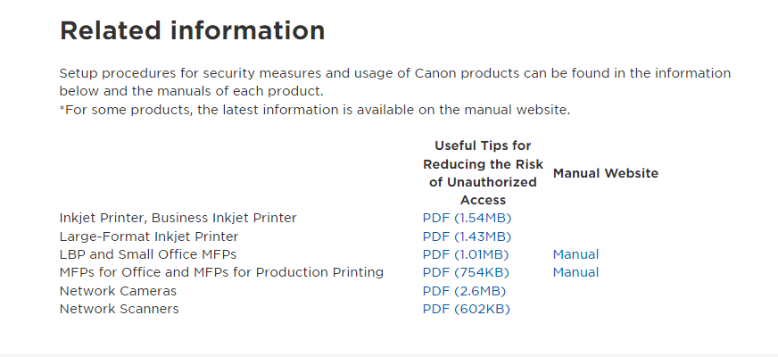
Where do Canon fit in?

Slide 20
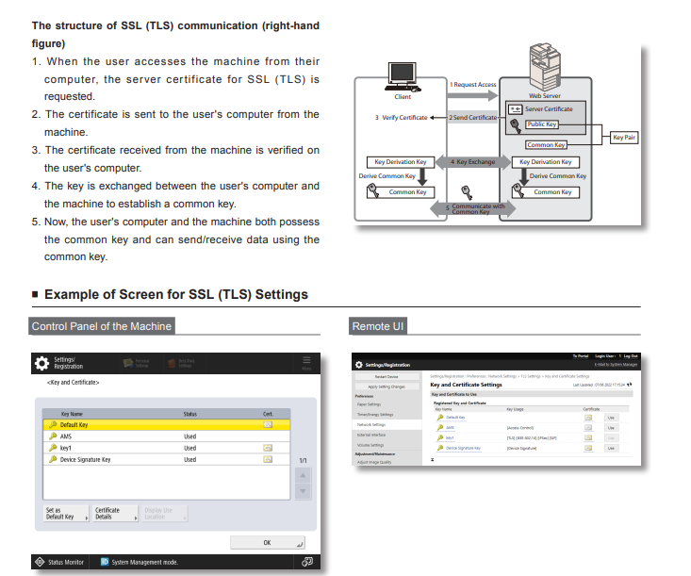
Where do Canon fit in?

Slide 21
Attack Timeline
Exfiltration of Data
Publicise to
Gain Kudos.
Research
Ransomware
Preparation
Change Data Integrity
Conceal Actions
Data Destruction
Trojan – re-entry
Notes:
The anatomy of an attack:
Perform Reconnaissance
Perform perimeter network reconnaissance/scanning
Perform network sniffing of exposed networks
Gather information using open-source discovery of organisational information
Perform reconnaissance and surveillance of targeted organisations
Perform malware-directed internal reconnaissance
Craft or Create Attack Tools
Craft phishing attacks
Craft spear phishing attacks
Craft attacks specifically based on deployed information technology environment
Create counterfeit/spoof website
Craft counterfeit certificates
Create and operate false front Organisations to inject malicious components into the supply chain
Deliver, insert, install malicious capabilities
Deliver known malware to internal organisational information systems (e.g. virus via email)
Deliver modified malware to internal organisational information systems
Deliver targeted malware for control of internal systems and exfiltration of data
Insert untargeted malware into downloadable software and/or into commercial information technology products
Exploit and Compromise
Exploit physical access of authorised staff to gain access to organisational facilities
Exploit poorly configured or unauthorised information systems exposed to the Internet
Exploit recently discovered vulnerabilities
Exploit vulnerabilities using zero-day attacks
Compromise critical information systems via physical access
Compromise mission-critical information
Compromise design, manufacture, and/or distribution of information system components (including hardware, software, and firmware)
Compromise software of organisational critical information systems
Conduct an Attack
Conduct communications interception attacks
Conduct attacks using unauthorised ports, protocols and services
Conduct simple Denial of Service (DoS) attack
Conduct targeted Denial of Service (DoS) attacks
Conduct data scavenging attacks in a cloud environment
Conduct externally-based network traffic modification (man in the middle) attacks
Conduct outsider-based social engineering to obtain information
Conduct attacks targeting and compromising personal devices of critical employees
Conduct supply chain attacks targeting and exploiting critical hardware, software, or firmware
Obtain sensitive information through network sniffing of external networks
Cause degradation or denial of attacker-selected services or capabilities
Cause integrity loss by polluting or corrupting critical data
Cause unauthorised disclosure and/or unavailability by spilling sensitive information
Obtain unauthorised access

Slide 22
Research and Preparation
Attackers exploit any weakness
Attackers target information on any service or device
Attackers usually target IT administrator accounts
Physical information: Door codes, paperwork etc.
Collection of exploit tools: PRET for example
Collection of personal data: Social engineering
Network exploration and mapping: NMAP for example

Slide 23
Security Assertion Markup Language. (SAML)
Identity Provider (IdP)
www.peopledevelopment.canon-europe.com
Redirect
SAML response
Confirm SAML
Service Provider (SP)
Request
Principal
(User)
Redirect with SAML response
Notes:
The process below outlines what a typical web application looks like when using SAML SSO.
The user attempts to reach a web application at a service provider.
The service provider generates a SAML request and redirects the user to the IdP's SSO URL with the generated request.
The IdP authenticates the user and generates a SAML response.
The user is redirected back to the SP with the SAML response.
The SP verifies the SAML response.

Slide 24
Multi Factor Authentication (MFA)
Something You Have
Something You Know
Something You Are

Slide 25
Social Engineering / OSINT Open-source Intelligence

Slide 26
Exercise to understand Identity Theft and Phishing
Collect information about a famous person for 10 min using the internet.
Group discussion about how you can use the information you gained to attack an individual.

Slide 27
Elevation of Privilege
User Account
Administrator Account
Super User / Administrator
Notes:
An elevation-of-privilege occurs when an application gains rights or privileges that should not be available to them.

Slide 28
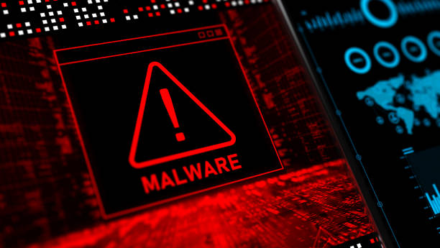
Attack Vectors
Applications and Infrastructure
Malware,
Viruses,
Social Engineering,
Text Messages
Notes:
In cybersecurity, an attack vector is a method of achieving unauthorised network access to launch a cyber attack. Common attack vectors include malware, viruses, email attachments, web pages, pop-ups, instant messages, text messages, and social engineering.

Slide 29
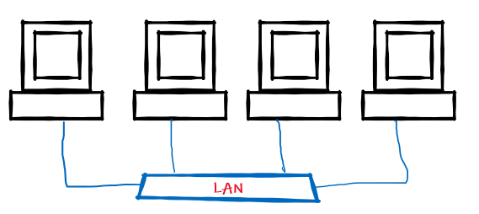
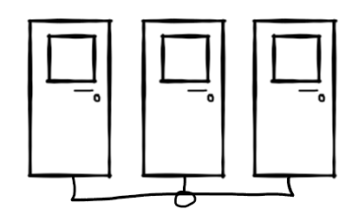
Exfiltration of Data
Data Flow

Slide 30
Hacker - Identification
Red hat hackers, also known as vigilante hackers, red hat hackers are motivated by a desire to fight back against black hat hackers
Gray hat hackers may not have the criminal or malicious intent, but they also don’t have the prior knowledge or consent.
Black hat hackers are cybercriminals.
White hat hackers are ethical security hackers.
Blue hat hackers are white hat hackers who are actually employed by an organisation
Green hat hackers are “green” in the sense that they’re inexperienced.

Slide 31
V
Cyber Security – Penetration V Defence
RED Team
Blue Team

Slide 32
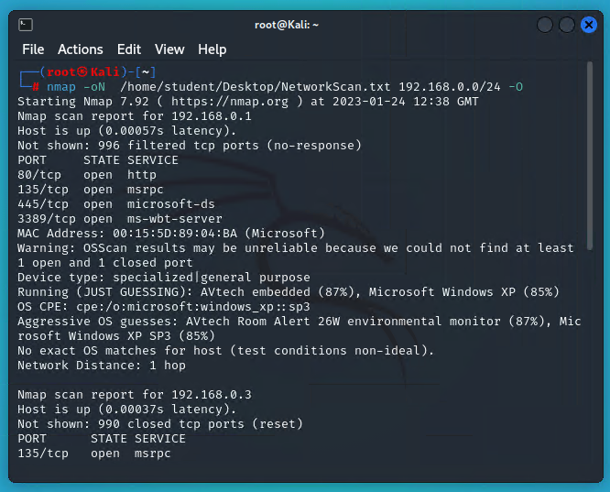
Demo Kali Linux
Password Cracking / Windows / Zip file
Metasploit - Windows Exploit

Slide 33
Assume Breach Philosophy
Think…. How can I….
Protect this resource from external compromise?
Protect other resources if this resource is compromised?
Protect this resource if other protected resources are compromised?
Protect this resource if it is compromised?
Notes:
An Assume Breach refers to the act of designing cyber security assuming a breach has occurred or will occur imminently. Your security design should not just consider hostile actors on the Internet side of the perimeter network, but also should provide protection against hostile actors on your protected internal network.

Slide 34
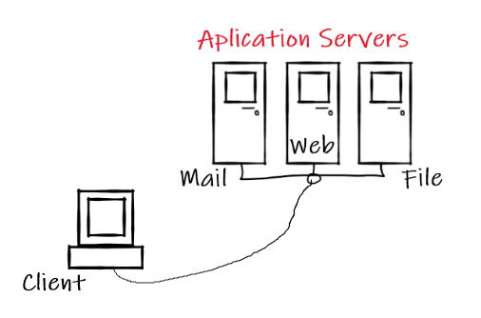
Understanding Assume Breach
Role of IT Security
Shield and Protect
Attack

Slide 35
Incident Lifecycle / Defence
Preparation
Detection & Analysis
(NIDS/NIPS/SIEM)
Containment
Eradication & Recovery
Post Incident Activities
Notes:
IT Security response and preparation

Slide 36
Incident Response Strategies
Should include:
Public announcements about breach
Inform law enforcement
Determine how to respond to technical issues:
Immediate actions
Long term strategy
Should be in place before a breach happens.

Slide 37
Zero Trust

Slide 38
Zero Trust
Always verify before trust.
Different entities have different security postures, which might differ from ours
example in case:
end users vs. employees vs. contractors.
As separate entities have very little influence over each other, better be safe than sorry and verify properly.

Slide 39
Governance and Legislation
What controls and guidance are in place?
What does the GDPR mean for cyber security?
The GDPR requires that personal data must be processed securely using appropriate technical and organisational measures.
The Regulation does not mandate a specific set of cyber security measures but rather expects you to take ‘appropriate’ action. In other words you need to manage risk.
ISO/IEC 27001 is widely known, providing requirements for an information security management system (ISMS), though there are more than a dozen standards in the ISO/IEC 27000 family.
ISO 27001 enables organisations of any kind to manage the security of assets such as financial information, intellectual property, employee details or information entrusted by third parties.
Freedom of Information
Privacy and Electronic Communications Regulations
Copyright, Designs and Patents
Computer Misuse
Human Rights
Equality
GDPR
ISO 27001
Others

Slide 40
Compliance (GDPR and others)
Often determined by legislation, dictates which controls must be in place:
Data storage, encryption, signing and protection
Access control and AAA (Authentication, Authorisation and Accounting)
Auditing
Extra legislation applies to certain industries
Special rules applied to:
Payment card data handling
Working with medical data
Working with financial data
Storing personal data
Notes:
Legislation drives a minimum level of cyber security

Slide 41
ISO 270001
A list of controls
Internationally recognised information security system
A series of best practices
Policies and Procedures
To address and avoid risks
ISO/IEC 27001 Standards
Notes:
SO/IEC 27001 family of standards

Slide 42
Other Resources

Slide 43
CVEs

Slide 44
Vulnerabilities

Slide 45
Vulnerabilities IT Security Foundation
In cyber security, a vulnerability is a weakness which can be exploited by a cyber attack to gain unauthorised access to or perform unauthorised actions on a computer system.
What is a vulnerability?
How can vulnerabilities be exploited?
Zero Day
Ports and Services

Slide 46
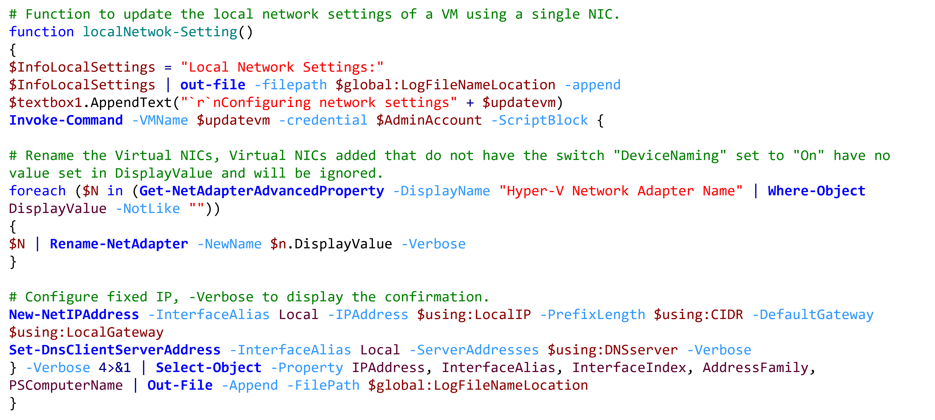
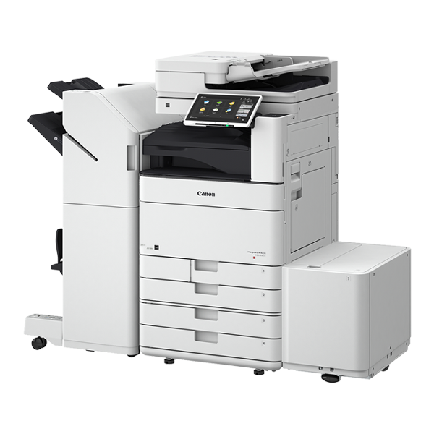
Exploit a Vulnerability.

Slide 47
Zero-Day Vulnerabilities
0
Trojan:W32/Petya.F Trojan.Ransom.WannaCryptor - Most of us have heard of this one. Trojan-Downloader:?OSX/Flashback.I Worm:W32/Downadup.A

Slide 48
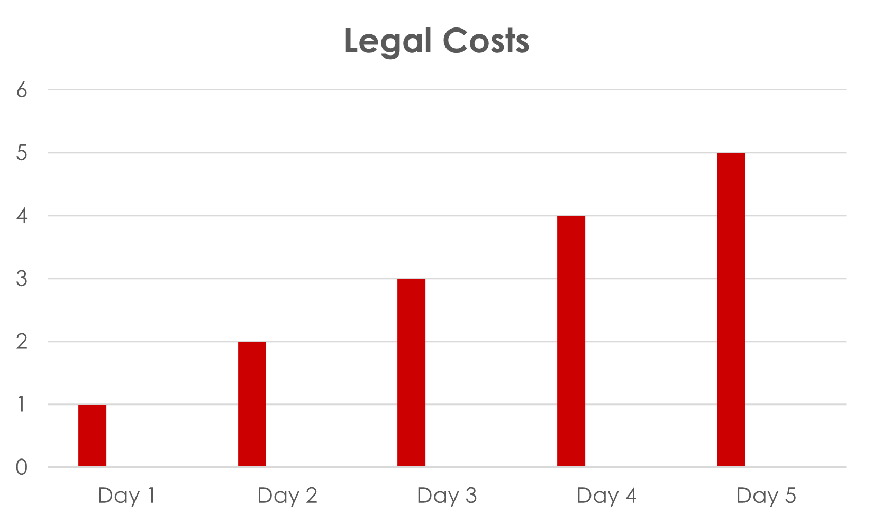
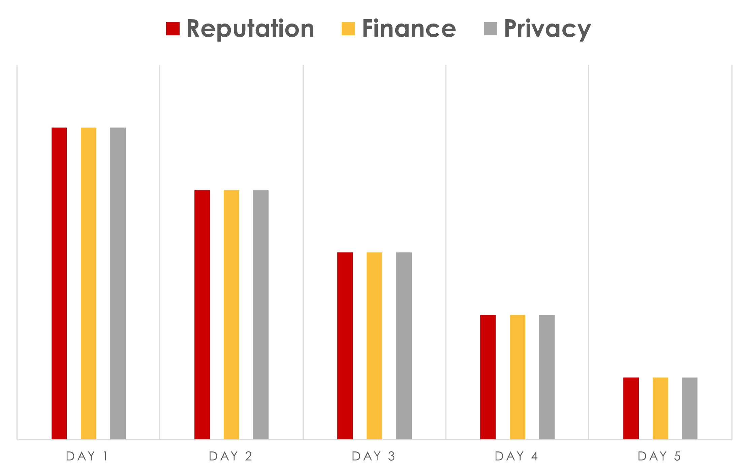
Impact and Consequences

Slide 49
Common Printer Vulnerabilities
Connect only when needed
Separate administrative accounts
Up-to-date anti-malware product
Use encryption
Latest device firmware
https://www.canon.co.uk/support/product-security/

Slide 50
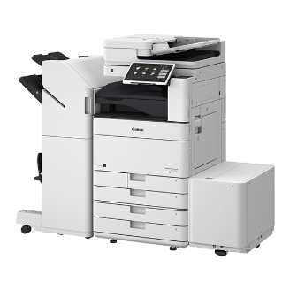
SIEM - Security Information and Event Management
b) Aggregate all the collected data
c) Discover defects or threats
d) Identify breaches and alerts
a) Collect Data from multiple sources
Data
Logs
SIEM
Server

Slide 51
Canon Printer – SIEM
Syslog A protocol that allows a machine to send event notification messages across an IP network to event message collectors.
SIEM

Slide 52
IWMC – Security Tool?
Key/CA certificate management
Device settings monitoring and management

Slide 53
Canon & 3rd Party Monitoring Solutions

Slide 54
Canon Printer – Device Hardening
Unrestricted Access
Intrusion
Exfiltration
Unsecured Data Storage

Slide 55
PKI – Public Key Infrastructure Overview
The Basic Idea
Bob wants to receive a secure / coded message from Alice.
EVERYBODY including Alice knows how to write the message in code given out by Bob.
Bob is the ONLY person who knows how to decode the coded message.
X
Bob
Alice
Bob
Alice
Private Key
Dave is pretending
to be Alice.
Public Key
Exchange of “Public Keys”

Slide 56
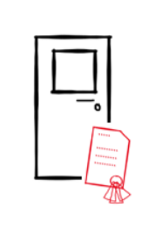
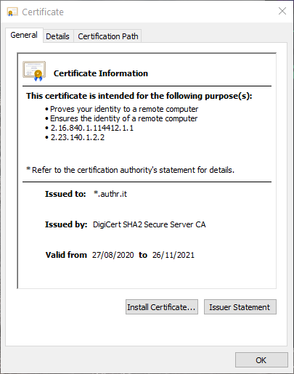
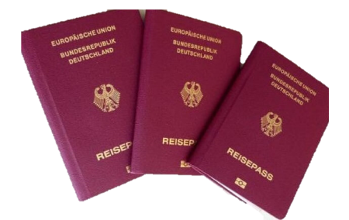
Certificates
X.509 Digital Certificates
Root Certificate: Issued by the Root CA
Chain of
Authority
Certificate: Issued by the Subordinate CA
Passport
Root Certificate
Visa
Subordinate Certificate

Slide 57
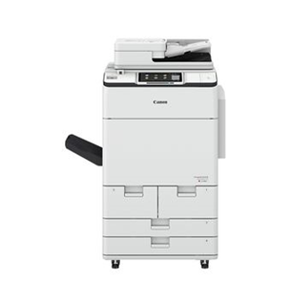
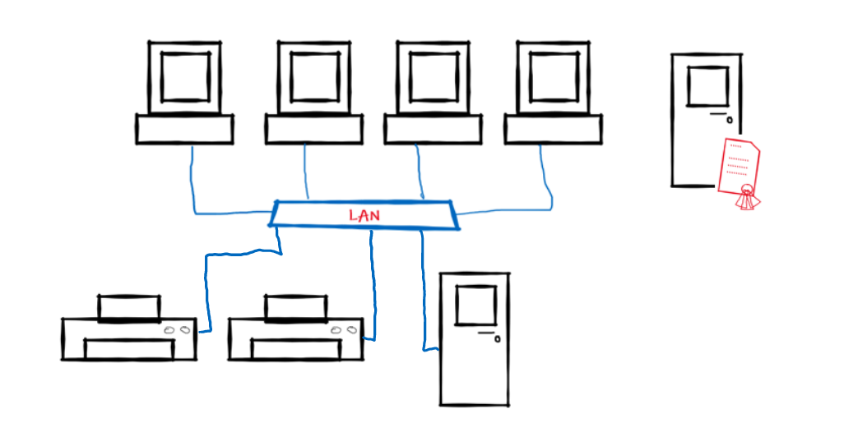
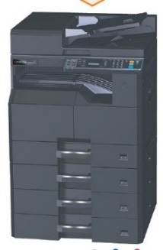
Overview - Network Access with IEEE802.1x
Target: Only authenticated devices will get a physical access to a network
IEEE802.1x concept:
Certificate Server
(Certification Authority [CA])
X
RADIUS:
Remote
Authentication
Dial-In
User
Service
Radius Server controls access of external devices to network
R3 | Network Security

Slide 58
Securing Network Access with IEEE802.1x
Certificate (= ID card) for IEEE802.1x is created
IEEE802.1x Process:
Certificate Server
(Certification Authority [CA])
Machine starts, certificate for IEEE802.1 is sent
Certificate OK!
Machine starts DHCP process
Radius Server
R3 | Network Security

Slide 59
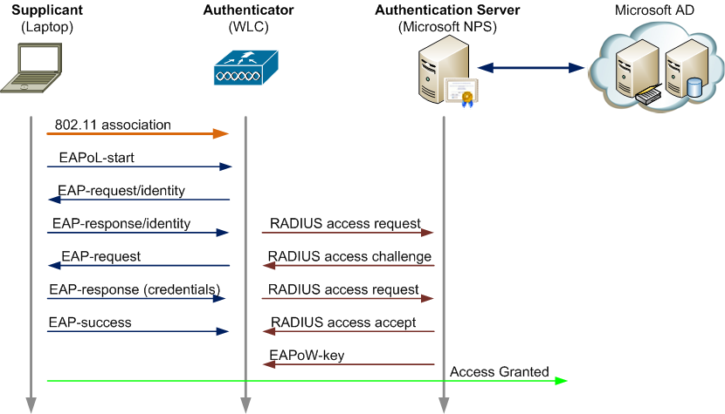
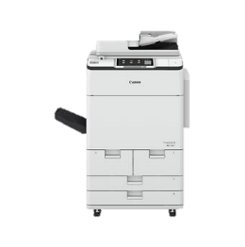
IEEE 802.1x Process (protocol sequence)

Slide 60
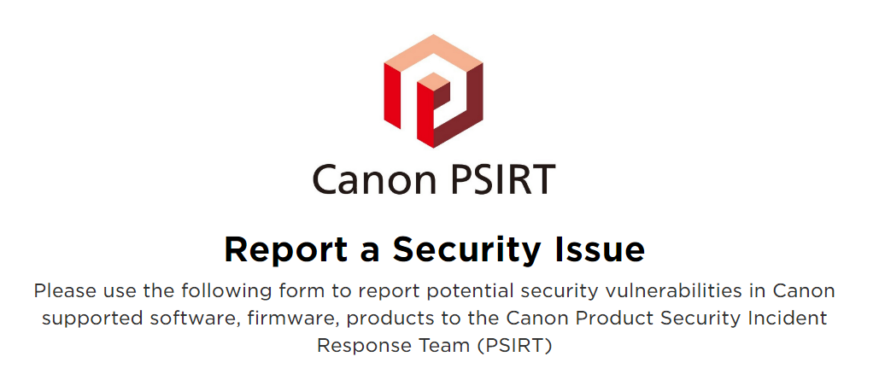

Slide 61
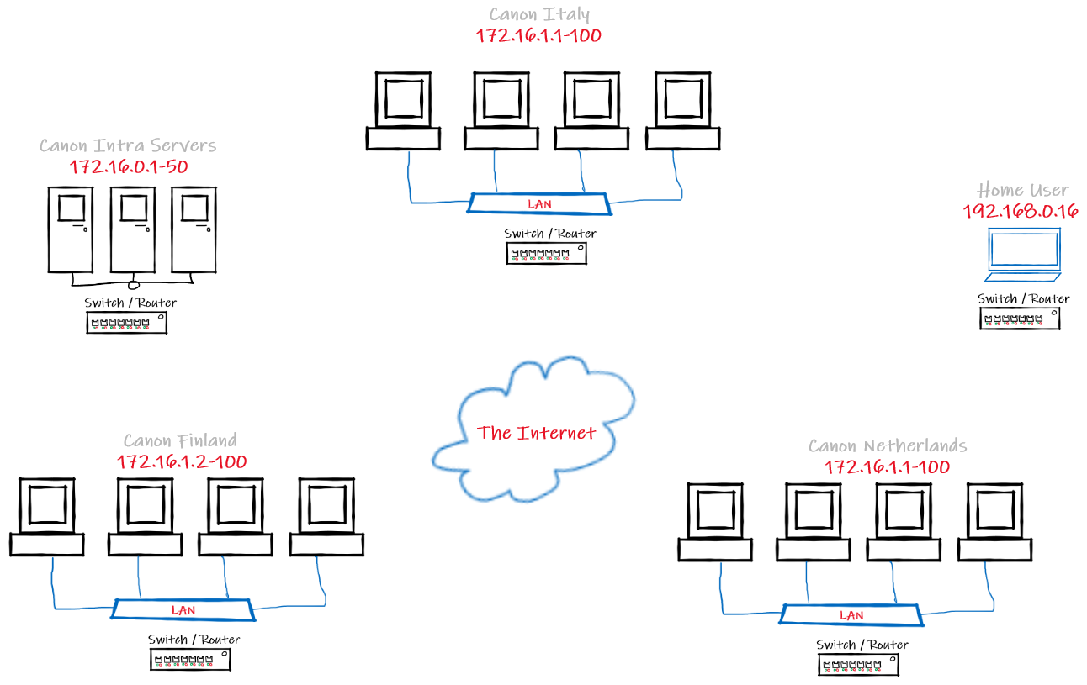
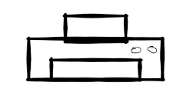
Secure by Design
VPN

Slide 62
Discuss – How to advise a customer using security by design?

Slide 63
Micro Segmentation – Vnets and Vlans

Slide 64
Cloud Security Monitoring
Service | Use case
Microsoft Defender for Cloud | Strengthens the security posture of your data centres, and provides advanced threat protection across your workloads in the cloud (whether they're in Azure or not) and on-premises. Get a unified view into the infrastructure and resources provisioned for the workload.
Microsoft Sentinel | Use the native security information event management (SIEM) and security orchestration automated response (SOAR) solution on Azure. Receive intelligent security analytics and threat intelligence across the enterprise.
Azure DDoS Protection | Defend against distributed denial of service (DDoS) attacks.
Azure Rights Management (RMS) | Protect files and emails across multiple devices.
Microsoft Purview Information Protection | Secure email, documents, and sensitive data that you share outside your company.
Azure Governance Visualizer | Gain granular insight into policies, Azure role-based access control (Azure RBAC), Azure Blueprints, subscriptions, and more.
PSRule for Azure | Scans Azure Infrastructure as Code (IaC) artifacts for issues across Azure Well-Architected pillars.
https://learn.microsoft.com/en-us/azure/well-architected/security/monitor-tools

Slide 65
Thanks for you attendance.
You mission now is to continue to use the internet to learn more about Cyber Security.
You never stop learning new things come along everyday.
Please fill in the feedback form in the course site.

