Slide 1
Section 06:
Additional Services

Slide 2

Section 06 – Outline
You will learn the following concepts:
Implement virtual network traffic routing
Configure internet access with Azure Virtual NAT
Azure Virtual WANs
Azure Traffic Manager
Azure Application Gateway
Azure Front Door
Microsoft Defender for Cloud
Azure Firewall
Web App Firewall
Notes:
Implement virtual network traffic routing
https://learn.microsoft.com/en-us/training/modules/introduction-to-azure-virtual-networks/9-implement-virtual-network-traffic-routing
Configure internet access with Azure Virtual NAT
https://learn.microsoft.com/en-us/training/modules/introduction-to-azure-virtual-networks/10-configure-internet-access-azure-virtual-nat
Azure Virtual WANs
https://learn.microsoft.com/en-us/training/modules/design-implement-hybrid-networking/6-connect-remote-resources-by-using-azure-virtual-wans
Azure Traffic Manager
https://learn.microsoft.com/en-us/training/modules/load-balancing-non-https-traffic-azure/5-explore-azure-traffic-manager
Azure Application Gateway
https://learn.microsoft.com/en-us/training/modules/load-balancing-https-traffic-azure/2-design-azure-application-gateway
Azure Front Door
https://learn.microsoft.com/en-us/training/modules/load-balancing-https-traffic-azure/5-design-configure-azure-front-door
Microsoft Defender for Cloud
https://learn.microsoft.com/en-us/training/modules/design-implement-network-security-monitoring/2-secure-your-virtual-networks-azure-portal
Azure Firewall
https://learn.microsoft.com/en-us/training/modules/design-implement-network-security-monitoring/6-azure-firewall
Web App Firewall
https://learn.microsoft.com/en-us/training/modules/design-implement-network-security-monitoring/10-implement-web-application-firewall-on-azure-front-door

Slide 3
Implement virtual network traffic routing

Slide 4
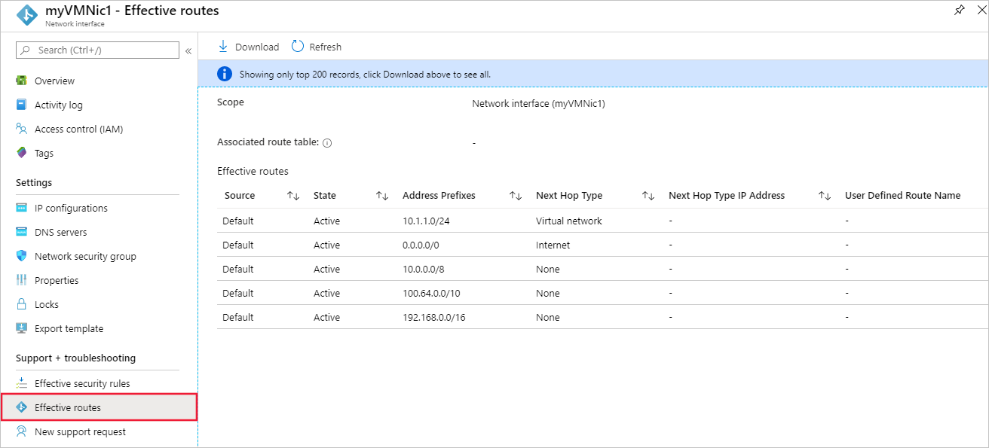
Virtual network traffic routing
System routes
Default routes
Custom routes
Notes:
Azure virtual network traffic routing | Microsoft Docs https://docs.microsoft.com/azure/virtual-network/virtual-networks-udr-overview
System routes
Azure automatically creates system routes and assigns the routes to each subnet in a virtual network. You can't create system or remove routes, but you can override some system routes with custom routes. Azure creates default system routes for each subnet, and adds additional optional default routes to specific subnets, or every subnet, when you use specific Azure capabilities.
Default routes
Each route contains an address prefix and next hop type. When traffic leaving a subnet is sent to an IP address within the address prefix of a route, the route that contains the prefix is the route Azure uses. Whenever a virtual network is created, Azure automatically creates the following default system routes for each subnet within the virtual network.
In routing terms, a hop is a waypoint on the overall route. Therefore, the next hop is the next waypoint that the traffic is directed to on its journey to its ultimate destination. The next hop types listed in the previous table represent how Azure routes traffic destined for the address prefix listed. The next hop types are defined as follows:
Virtual network: Routes traffic between address ranges within the address space of a virtual network. Azure creates a route with an address prefix that corresponds to each address range defined within the address space of a virtual network. Azure automatically routes traffic between subnets using the routes created for each address range.
Internet: Routes traffic specified by the address prefix to the Internet. The system default route specifies the 0.0.0.0/0 address prefix. Azure routes traffic for any address not specified by an address range within a virtual network to the Internet, unless the destination address is for an Azure service. Azure routes any traffic destined for its service directly to the service over the backbone network, rather than routing the traffic to the Internet. You can override Azure's default system route for the 0.0.0.0/0 address prefix with a custom route.
None: Traffic routed to the None next hop type is dropped, rather than routed outside the subnet. Azure automatically creates default routes for the following address prefixes:
10.0.0.0/8, 172.16.0.0/12 and 192.168.0.0/16: Reserved for private use in RFC 1918.
100.64.0.0/10: Reserved in RFC 6598.
If you assign any of the previous address ranges within the address space of a virtual network, Azure automatically changes the next hop type for the route from None to Virtual network. If you assign an address range to the address space of a virtual network that includes, but isn't the same as, one of the four reserved address prefixes, Azure removes the route for the prefix and adds a route for the address prefix you added, with Virtual network as the next hop type.

Slide 5
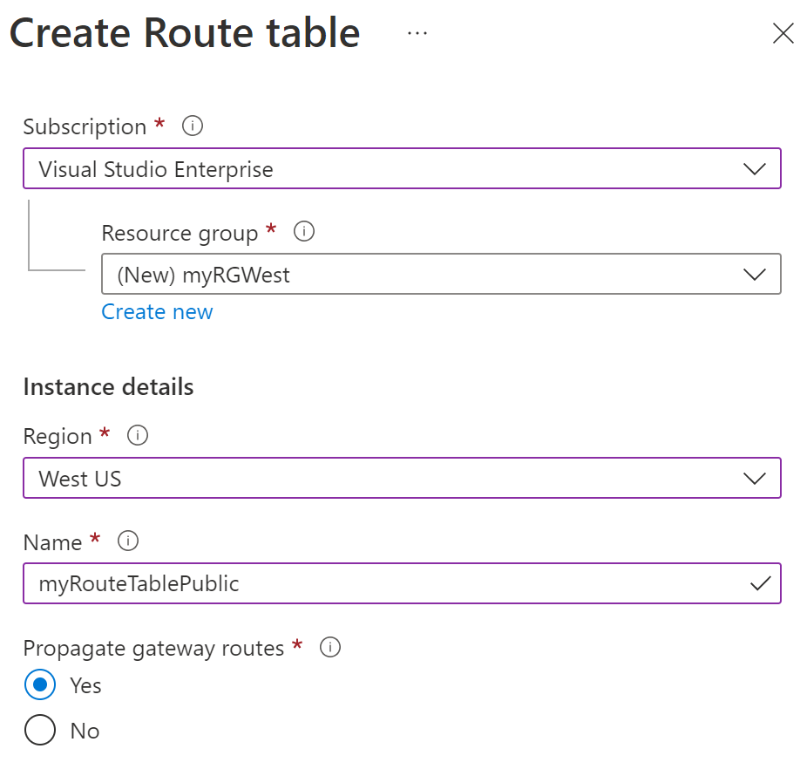
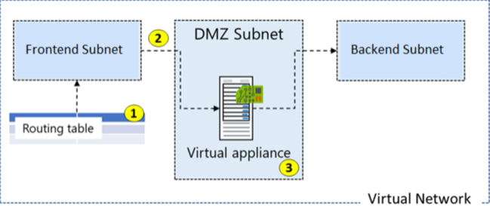
Configure User-defined routes
Notes:
design and implement user-defined routes (UDRs)
• associate a route table with a subnet
• configure forced tunneling
Here is an example where you have a virtual network that includes three subnets.
The subnets are Private, DMZ, and Public. In the DMZ subnet, there is a network virtual appliance (NVA). NVAs are VMs that help with network functions like routing and firewall optimization.
You want to ensure all traffic from the Public subnet goes through the NVA to the Private subnet.

Slide 6
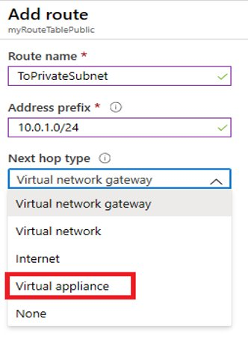
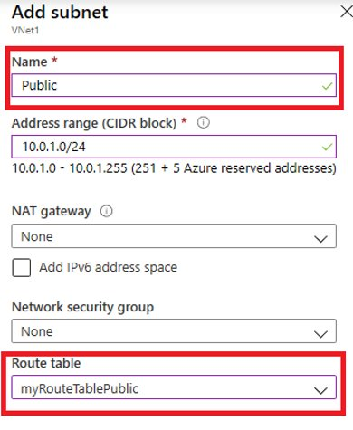
Create a Custom Route and associate route table to subnet
Notes:
The new route is named ToPrivateSubnet.
The Private subnet is at 10.0.1.0/24.
The route uses a virtual appliance. Notice the other choices for Next hop type: virtual network gateway, virtual network, internet, and none.
The virtual appliance is located at 10.0.2.4.

Slide 7
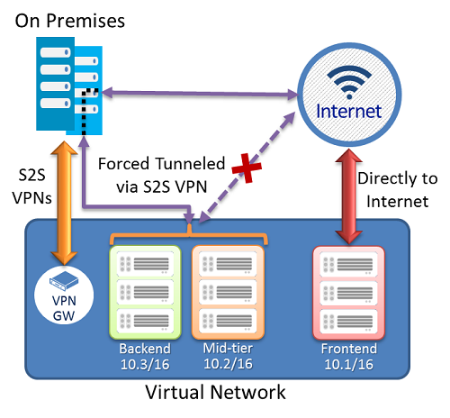
Configure forced tunneling
Each virtual network subnet has a built-in, system routing table. The system routing table has the following three groups of routes:
Local VNet routes: Route directly to the destination VMs in the same virtual network.
On-premises routes: Route to the Azure VPN gateway.
Default route: Route directly to the Internet. Packets destined to the private IP addresses not covered by the previous two routes are dropped.
To configure forced tunnelling, you must:
Create a routing table.
Add a user-defined default route to the VPN Gateway.
Associate the routing table to the appropriate VNet subnet(s).
Forced tunneling must be associated with a VNet that has a route-based VPN gateway.
You must set a default site connection among the cross-premises local sites connected to the virtual network.
The on-premises VPN device must be configured using 0.0.0.0/0 as traffic selectors.
Notes:
Forced tunneling lets you redirect or "force" all Internet-bound traffic back to your on-premises location via a Site-to-Site VPN tunnel for inspection and auditing. This is a critical security requirement for most enterprise IT policies. If you don't configure forced tunneling, Internet-bound traffic from your VMs in Azure always traverses from the Azure network infrastructure directly out to the Internet, without the option to allow you to inspect or audit the traffic. Unauthorized Internet access can potentially lead to information disclosure or other types of security breaches. Forced tunneling can be configured by using Azure PowerShell. It can't be configured using the Azure portal.
In the following example, the Frontend subnet is not force tunneled. The workloads in the Frontend subnet can continue to accept and respond to customer requests from the Internet directly. The Mid-tier and Backend subnets are forced tunneled. Any outbound connections from these two subnets to the Internet will be forced or redirected back to an on-premises site via one of the Site-to-site (S2S) VPN tunnels.
Each virtual network subnet has a built-in, system routing table. The system routing table has the following three groups of routes:
Local VNet routes: Route directly to the destination VMs in the same virtual network.
On-premises routes: Route to the Azure VPN gateway.
Default route: Route directly to the Internet. Packets destined to the private IP addresses not covered by the previous two routes are dropped.
To configure forced tunnelling, you must:
Create a routing table.
Add a user-defined default route to the VPN Gateway.
Associate the routing table to the appropriate VNet subnet(s).
Forced tunneling must be associated with a VNet that has a route-based VPN gateway.
You must set a default site connection among the cross-premises local sites connected to the virtual network.
The on-premises VPN device must be configured using 0.0.0.0/0 as traffic selectors.

Slide 8
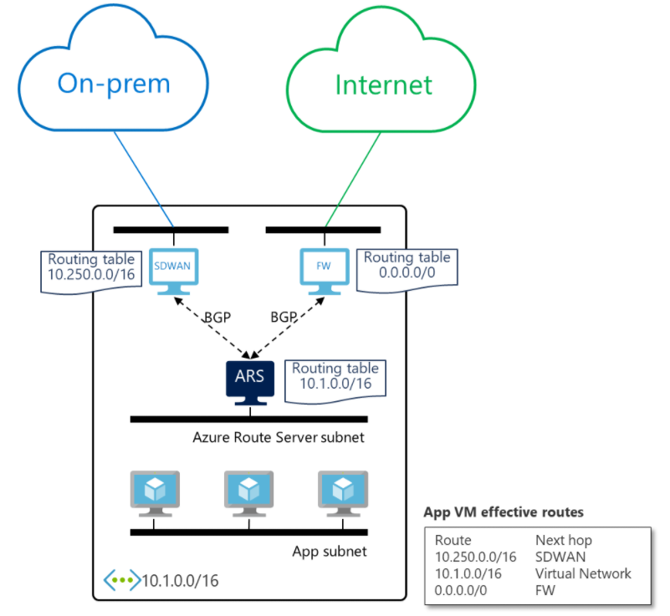
Configure Azure Route Server
Fully managed service
Simplifies dynamic routing between NVA and the VNet
NVA needs to support BGP
You no longer need to manually update the routing table on your NVA whenever your virtual network addresses are updated.
You no longer need to update User-Defined Routes manually whenever your NVA announces new routes or withdraw old ones.
Needs a RouteServerSubnet
Notes:
https://docs.microsoft.com/azure/route-server/overview

Slide 9
Demonstration – Custom Routing Tables
Create a route table
Add a route
Associate a route table to a subnet
Use PowerShell to view your routing information
Notes:
✔ Always consider having students walk-through the demonstrations themselves. Also, consider the overlap with the formal labs and your best use of time.
In this demonstration, we will learn how to create a route table, define a custom route, and associate the route with a subnet.
Note: This demonstration requires a virtual network with at least one subnet.
Create a routing table
Access the Azure portal.
Navigate to Route tables.
Select + Create.
Name: myRouteTablePublic
Subscription: select your subscription
Resource group: create or select a resource group
Region: select your location
Virtual network gateway route propagation: Enabled
Select Create.
Wait for the new routing table to be deployed.
Add a route
Select your new routing table, and then select Routes.
Select + Add.
Name: ToPrivateSubnet
Address prefix: 10.0.1.0/24
Next hop type: Virtual appliance
Next hop address: 10.0.2.4
Read the information and ensure you have IP forwarding enabled on your virtual appliance. You can enable this by navigating to the respective network interface's IP address settings.
Select Create.
Wait for the new route to be deployed.
Associate a route table to a subnet
Navigate to the subnet you want to associate with the routing table.
Select Route table.
Select your new routing table, myRouteTablePublic.
Save your changes.
Use PowerShell to view your routing information
Open the Cloud Shell.
View information about your new routing table.
Get-AzRouteTable
Verify the Routes and Subnet information is correct

Slide 10
Configure internet access with Azure Virtual NAT

Slide 11
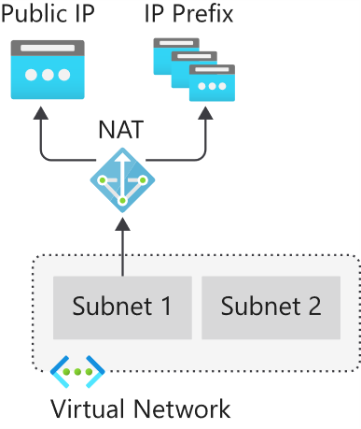
Azure Virtual NAT
Virtual Network NAT (network address translation) simplifies outbound-only Internet connectivity for virtual networks
NAT is fully managed and highly resilient. Support dynamic workloads by scaling NAT
When configured on a subnet, all outbound connectivity uses your specified static public IP addresses
Outbound connectivity is possible without load balancer or public IP addresses directly attached to virtual machines
Notes:
NAT services provide mappings for a single IP address, a range of IP addresses defined by an IP Prefix, and a range of ports associated with an IP address. NAT is compatible with standard SKU public IP address resources or public IP prefix resources or a combination of both. You can use a public IP prefix directly or distribute the public IP addresses of the prefix across multiple NAT gateway resources. NAT will map all traffic to the range of IP addresses of the prefix. NAT allows flows to be created from the virtual network to the Internet. Return traffic from the Internet is only allowed in response to an active flow.
The following diagram shows outbound traffic flow from Subnet 1 through the NAT gateway to be mapped to a Public IP address or a Public IP prefix.
You define the NAT configuration for each subnet within a VNet to enable outbound connectivity by specifying which NAT gateway resource to use. After NAT is configured, all UDP and TCP outbound flows from any virtual machine instance will use NAT for internet connectivity. No further configuration is necessary, and you don’t need to create any user-defined routes. NAT takes precedence over other outbound scenarios and replaces the default Internet destination of a subnet.

Slide 12
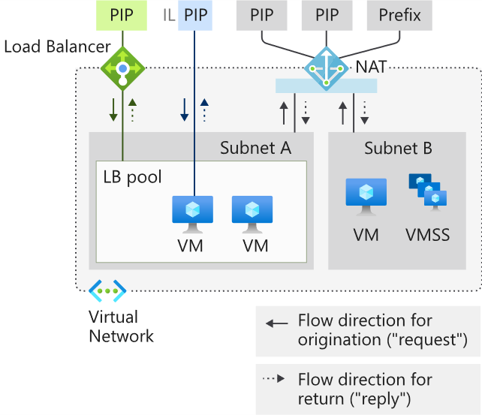
Coexistence of inbound and outbound
NAT and compatible Standard SKU features are aware of the direction the flow was started.
Inbound and outbound scenarios can coexist.
These scenarios will receive the correct network address translations because these features are aware of the flow direction.
Notes:
PIP – Public IP
IL – Instance level Public IP
VMSS – VM Scale Set
Virtual Network NAT and VM with instance-level public IP and public Load Balancer
Inbound - VM with instance-level public IP and public Load Balancer
Outbound - NAT gateway

Slide 13
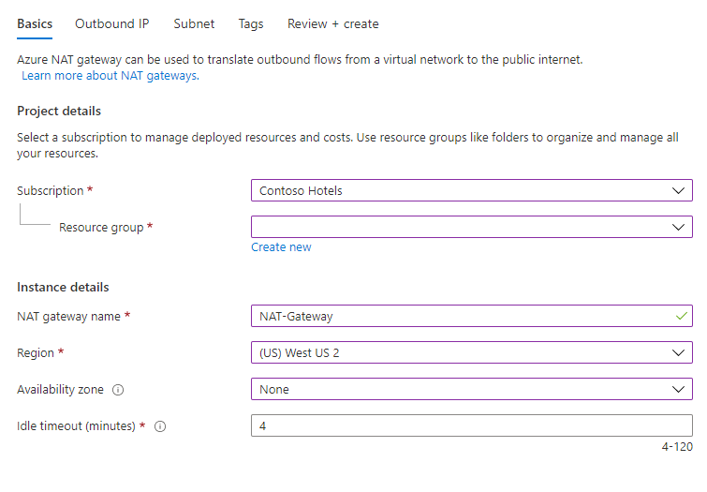
How to deploy NAT
NAT gateway resource:
Create regional or zonal (zone-isolated) NAT gateway resource
Assign IP addresses
If necessary, modify TCP idle timeout
Virtual network:
Configure virtual network subnet to use a NAT gateway.
User-defined routes are not necessary.

Slide 14
Demonstration – NAT Gateway
Create a virtual network
Create a virtual machine
Create a NAT gateway and associate with the virtual network
Connect to virtual machine and verify NAT IP address
Notes:
Tutorial: Create a NAT gateway - Azure portal | Microsoft Docs
https://docs.microsoft.com/azure/virtual-network/nat-gateway/tutorial-create-nat-gateway-portal
Create a virtual network.
Create a virtual machine.
Create a NAT gateway and associate with the virtual network.
Connect to virtual machine and verify NAT IP address.

Slide 15
Azure Virtual WANs

Slide 16
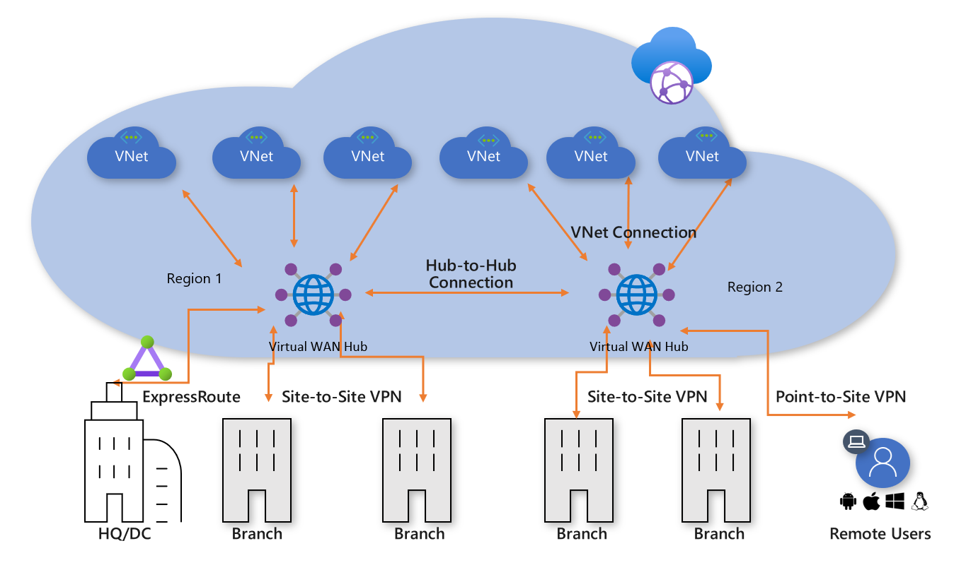
What is Azure Virtual WAN?
Brings together S2S, P2S, and ExpressRoute
Integrated connectivity using a hub-and-spoke connectivity model
Connect virtual networks and workloads to the Azure hub automatically
Visualize the end-to-end flow within Azure
Two types: Basic and Standard
Notes:
About Azure Virtual WAN - https://docs.microsoft.com/en-us/Azure/virtual-wan/virtual-wan-about
A virtual network gateway VPN is limited to 30 tunnels. For connections, you should use Virtual WAN for large-scale VPN. You can connect up to 1,000 branch connections per region (virtual hub) with aggregate of 20 Gbps per hub. A connection is an active-active tunnel from the on-premises VPN device to the virtual hub. You can have one hub per region, which means you can connect more than 1,000 branches across hubs.
Tutorial: Create a Site-to-Site connection using Azure Virtual WAN - https://docs.microsoft.com/en-us/Azure/virtual-wan/virtual-wan-site-to-site-portal
The following diagram shows an organization with a single Virtual WAN hub connecting the spokes. VNets, Site-to-site and point-to-site VPNs, SD WANs, and ExpressRoute connectivity are all supported .

Slide 17
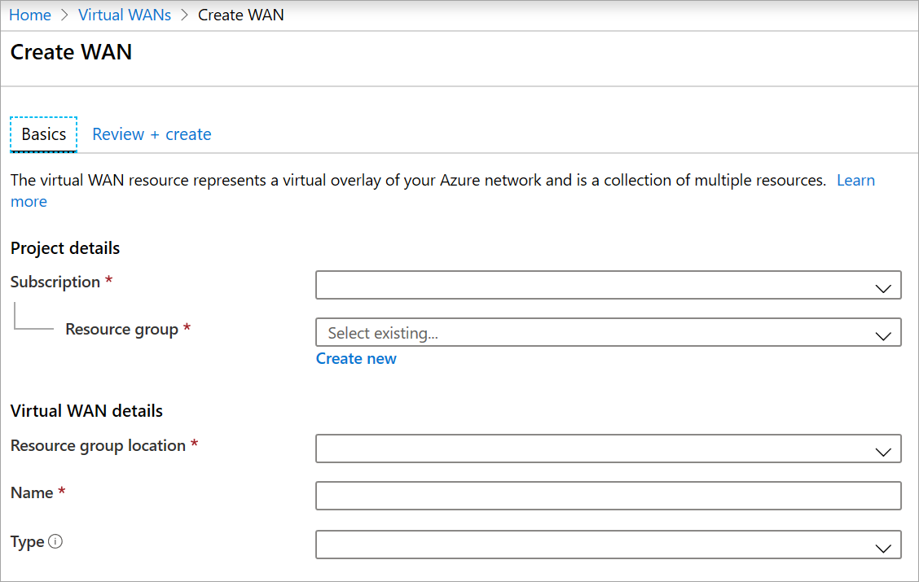
Choose Virtual WAN SKU
Virtual WAN type | Hub type | Available configuration
Basic | Basic | Site-to-site VPN only
Standard | Standard | ExpressRoute User VPN (P2S) VPN (Site-to-site) Inter-hub and VNet-to-VNet transiting through the virtual hub
Notes:
Subscription - Select the subscription that you want to use.
Resource group - Create new or use existing.
Resource group location - Choose a resource location from the dropdown. A WAN is a global resource and does not live in a particular region. However, you must select a region in order to manage and locate the WAN resource that you create.
Name - Type the Name that you want to call your WAN.
Type - Basic or Standard. Select Standard. If you select Basic VWAN, understand that Basic VWANs can only contain Basic hubs, which limits your connection type to site-to-site.

Slide 18
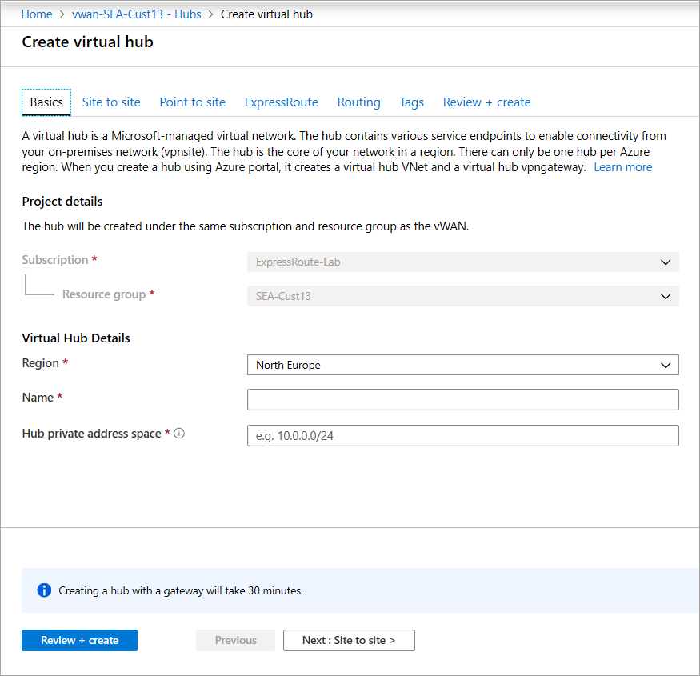
Hub private address space
Minimum address space is /24 to create a hub
No need to explicitly plan the subnet address space for the services in the virtual hub
Azure Virtual WAN is a managed service, it creates the appropriate subnets in the virtual hub for the different gateways/services
For example, VPN gateways, ExpressRoute gateways, User VPN Point-to-site gateways, Firewall, routing, etc.
Notes:
On the Create virtual hub page Basics tab, complete the following fields:
Project details
Region (previously referred to as Location)
Name
Hub private address space. The minimum address space is /24 to create a hub, which implies anything range from /25 to /32 will produce an error during creation. Azure Virtual WAN, being a managed service by Microsoft, creates the appropriate subnets in the virtual hub for the different gateways/services. (For example: Network Virtual Appliances, VPN gateways, ExpressRoute gateways, User VPN/Point-to-site gateways, Firewall, Routing, etc.). There is no need for the user to explicitly plan for subnet address space for the services in the Virtual hub because Microsoft does this as a part of the service.

Slide 19
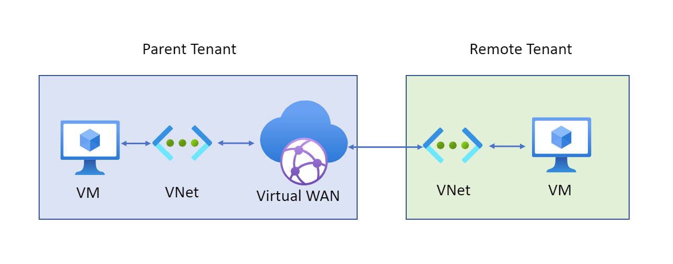
Connect cross-tenant VNets to a Virtual WAN hub
A Virtual WAN and virtual hub in the parent subscription
A virtual network configured in a subscription in the remote tenant
Non-overlapping address spaces in the remote tenant and address spaces within any other VNets already connected to the parent virtual hub
Notes:
You can use Virtual WAN to connect a VNet to a virtual hub in a different tenant. This architecture is useful if you have client workloads that must be connected to be the same network but are on different tenants. For example, as shown in the following diagram, you can connect a non-Contoso VNet (the Remote Tenant) to a Contoso virtual hub (the Parent Tenant).
Before you can connect a cross-tenant VNet to a Virtual WAN hub, you must have the following configuration already set up:
A Virtual WAN and virtual hub in the parent subscription.
A virtual network configured in a subscription in the remote tenant.
Non-overlapping address spaces in the remote tenant and address spaces within any other VNets already connected to the parent virtual hub.
For the parent subscription with the virtual hub to modify and access the virtual networks in the remote tenant, you need to assign Contributor permissions to your parent subscription from the remote tenant subscription.
Add the Contributor role assignment to the parent account (the one with the virtual WAN hub). You can use PowerShell or the Azure portal to assign this role.
Add the remote tenant subscription and the parent tenant subscription to the current session of PowerShell by running the Add-AzAccount command. If you are signed into the parent, you only need to run the command for the remote tenant.
Verify that the role assignment is successful by logging into Azure PowerShell using the parent credentials and running the Get-AzSubscription command. If the permissions have successfully propagated to the parent and have been added to the session, the output of the command will list the subscription owned by the remote tenant.

Slide 20
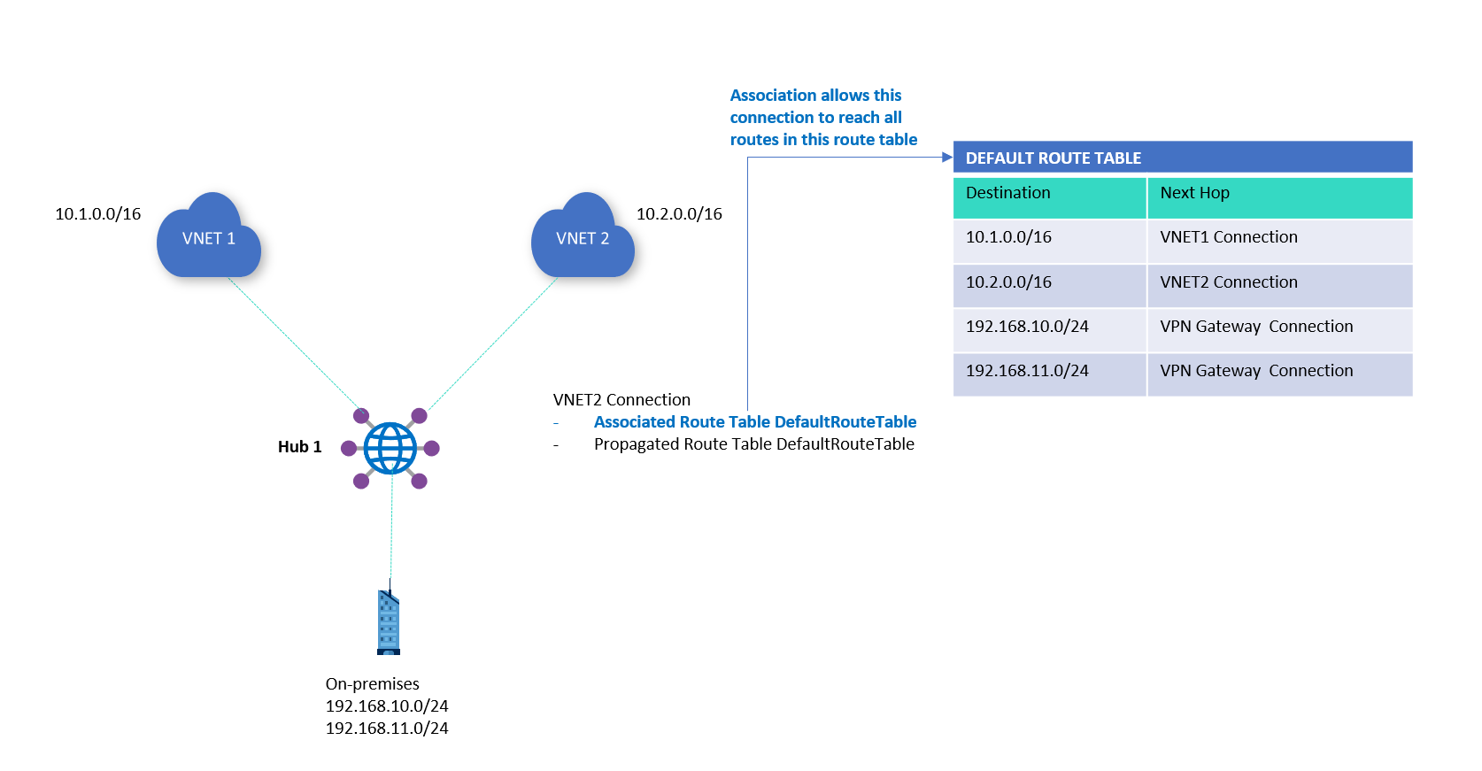
Virtual Hub Routing
Hub route table
Connections
Association
Propagation
Labels
Static routes
Notes:
The routing capabilities in a virtual hub are provided by a router that manages all routing between gateways using Border Gateway Protocol (BGP). A virtual hub can contain multiple gateways such as a Site-to-site VPN gateway, ExpressRoute gateway, Point-to-site gateway, Azure Firewall. This router also provides transit connectivity between virtual networks that connect to a virtual hub and can support up to an aggregate throughput of 50 Gbps. These routing capabilities apply to Standard Virtual WAN customers.
Hub route table
A virtual hub route table can contain one or more routes. A route includes its name, a label, a destination type, a list of destination prefixes, and next hop information for a packet to be routed. A Connection typically will have a routing configuration that associated or propagates to a route table.
Connections
Connections are Resource Manager resources that have a routing configuration. The four types of connections are:
VPN connection: Connects a VPN site to a virtual hub VPN gateway.
ExpressRoute connection: Connects an ExpressRoute circuit to a virtual hub ExpressRoute gateway.
P2S configuration connection: Connects a User VPN (Point-to-site) configuration to a virtual hub User VPN (Point-to-site) gateway.
Hub virtual network connection: Connects virtual networks to a virtual hub.
You can set up the routing configuration for a virtual network connection during setup. By default, all connections associate and propagate to the Default route table.
Association
Each connection is associated to one route table. Associating a connection to a route table allows the traffic to be sent to the destinations indicated as routes in the route table. The routing configuration of the connection will show the associated route table. Multiple connections can be associated to the same route table. All VPN, ExpressRoute, and User VPN connections are associated to the same (default) route table.
By default, all connections are associated to a Default route table in a virtual hub. Each virtual hub has its own Default route table, which can be edited to add a static route(s). Routes added statically take precedence over dynamically learned routes for the same prefixes.

Slide 21
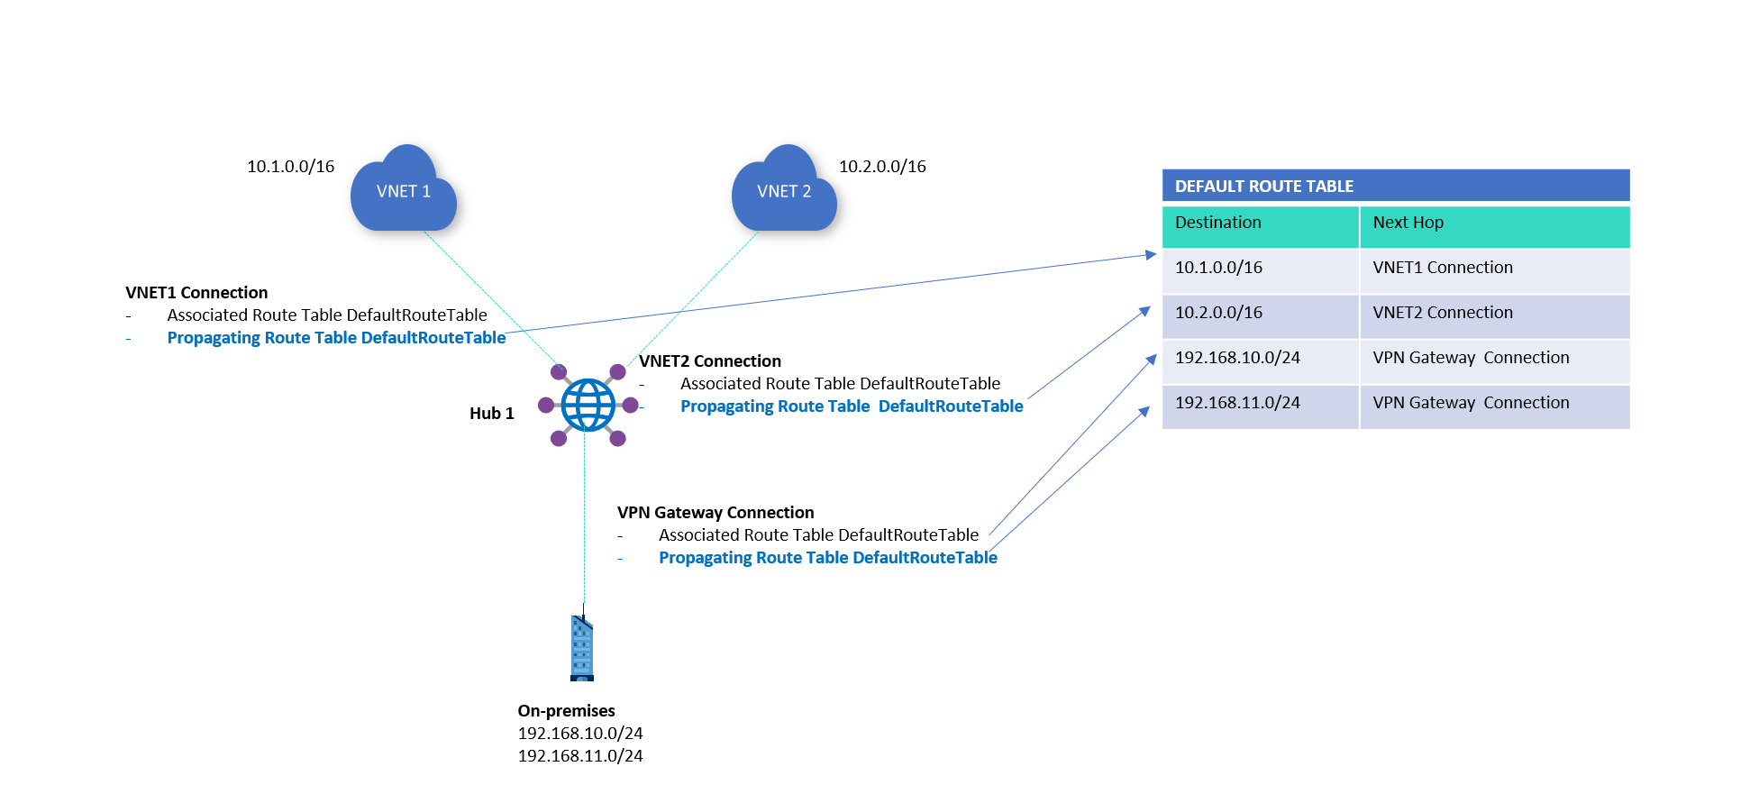
Virtual Hub Routing – continued
Notes:
Propagation - default routing table.

Slide 22
Demonstration – route to shared services using an ARM template
Review and deploy the ARM template
Complete the hybrid configuration
Notes:
Consider demonstrating this to the students:
Quickstart: Route to shared services using an ARM template - Azure Virtual WAN | Microsoft Docs
This quickstart describes how to use an Azure Resource Manager template (ARM template) to set up routes to access a shared service VNet with workloads that you want every VNet and Branch (VPN/ER/P2S) to access. Examples of these shared workloads might include virtual machines with services like domain controllers or file shares, or Azure services exposed internally through Azure Private Endpoint.
An ARM template is a JavaScript Object Notation (JSON) file that defines the infrastructure and configuration for your project. The template uses declarative syntax. In declarative syntax, you describe your intended deployment without writing the sequence of programming commands to create the deployment.
If your environment meets the prerequisites and you're familiar with using ARM templates, select the Deploy to Azure button. The template will open in the Azure portal.

Slide 23
Azure Traffic Manager

Slide 24
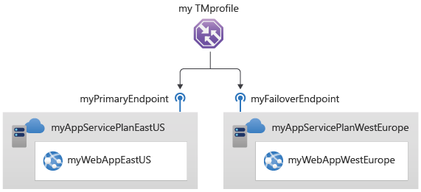
Use cases for Azure Traffic Manager
Increase application availability
Improve application performance
Service maintenance without downtime
Combine hybrid applications
Distribute traffic for complex deployments
Notes:
Feature
Increase application availability: Traffic Manager delivers high availability for your critical applications by monitoring your endpoints and providing automatic failover when an endpoint goes down.
Improve application performance: Azure allows you to run cloud services and websites in datacenters located around the world. Traffic Manager can improve the responsiveness of your website by directing traffic to the endpoint with the lowest latency.
Service maintenance without downtime: You can have planned maintenance done on your applications without downtime. Traffic Manager can direct traffic to alternative endpoints while the maintenance is in progress.
Combine hybrid applications: Traffic Manager supports external, non-Azure endpoints enabling it to be used with hybrid cloud and on-premises deployments, including the burst-to-cloud, migrate-to-cloud, and failover-to-cloud scenarios.
Distribute traffic for complex deployments: Using nested Traffic Manager profiles, multiple traffic-routing methods can be combined to create sophisticated and flexible rules to scale to the needs of larger, more complex deployments.
Azure Traffic Manager is a DNS-based traffic load balancer. This service allows you to distribute traffic to your public facing applications across the global Azure regions. Traffic Manager also provides your public endpoints with high availability and quick responsiveness.
Traffic Manager uses DNS to direct the client requests to the appropriate service endpoint based on a traffic-routing method. Traffic manager also provides health monitoring for every endpoint. The endpoint can be any Internet-facing service hosted inside or outside of Azure. Traffic Manager provides a range of traffic-routing methods and endpoint monitoring options to suit different application needs and automatic failover models. Traffic Manager is resilient to failure, including the failure of an entire Azure region.

Slide 25
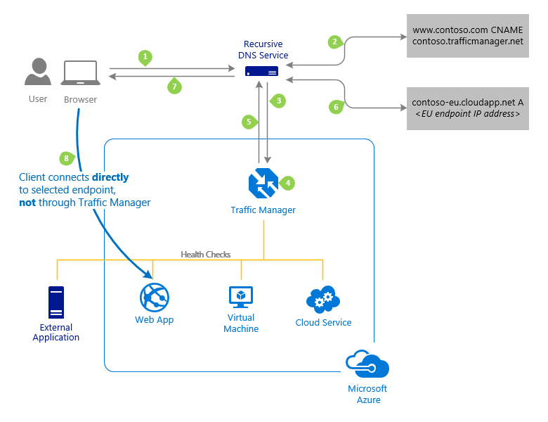
How Traffic manager works
The Traffic Manager name servers receive the request. They choose an endpoint based on:
The configured state of each endpoint
The current health of each endpoint, as determined by the Traffic Manager health checks
The chosen traffic-routing method
Final connection is not going through Traffic Manager
Notes:
The client sends a DNS query to its configured recursive DNS service to resolve the name 'partners.contoso.com'. A recursive DNS service, sometimes called a 'local DNS' service, does not host DNS domains directly. Rather, the client off-loads the work of contacting the various authoritative DNS services across the Internet needed to resolve a DNS name.
To resolve the DNS name, the recursive DNS service finds the name servers for the 'contoso.com' domain. It then contacts those name servers to request the 'partners.contoso.com' DNS record. The contoso.com DNS servers return the CNAME record which points to contoso.trafficmanager.net.
Next, the recursive DNS service finds the name servers for the 'trafficmanager.net' domain, which are provided by the Azure Traffic Manager service. It then sends a request for the 'contoso.trafficmanager.net' DNS record to those DNS servers.
The Traffic Manager name servers receive the request. They choose an endpoint based on:
The configured state of each endpoint (disabled endpoints are not returned).
The current health of each endpoint, as determined by the Traffic Manager health checks (see Endpoint Monitoring Options).
The chosen traffic-routing method (see Traffic Routing Methods).
The chosen endpoint is returned as another DNS CNAME record. In this case, let us suppose contoso-eu.cloudapp.net is returned.
Next, the recursive DNS service finds the name servers for the 'cloudapp.net' domain. It contacts those name servers to request the 'contoso-eu.cloudapp.net' DNS record. A DNS 'A' record containing the IP address of the EU-based service endpoint is returned.
The recursive DNS service consolidates the results and returns a single DNS response to the client.
The client receives the DNS results and connects to the given IP address. The client connects to the application service endpoint directly, not through Traffic Manager. Since it is an HTTPS endpoint, the client performs the necessary SSL/TLS handshake, and then makes an HTTP GET request for the '/login.aspx' page.

Slide 26
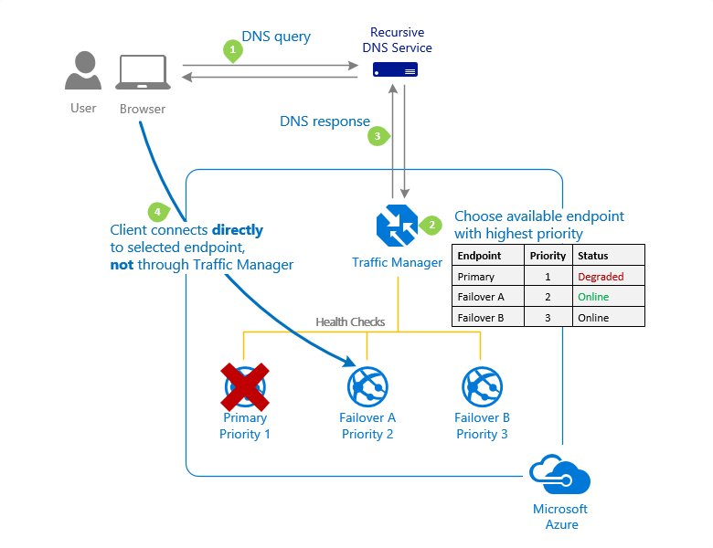
Traffic routing methods – Priority
Notes:
Azure Traffic Manager supports six traffic-routing methods to determine how to route network traffic to the various service endpoints. For any profile, Traffic Manager applies the traffic-routing method associated to it to each DNS query it receives. The traffic-routing method determines which endpoint is returned in the DNS response.
The following traffic routing methods are available in Traffic Manager:
Routing method
Priority
Select this routing method when you want to have a primary service endpoint for all traffic. You can provide multiple backup endpoints in case the primary or one of the backup endpoints is unavailable.
Weighted
Select this routing method when you want to distribute traffic across a set of endpoints based on their weight. Set the weight the same to distribute evenly across all endpoints.
Performance
Select the routing method when you have endpoints in different geographic locations, and you want end users to use the "closest" endpoint for the lowest network latency.
Geographic
Select this routing method to direct users to specific endpoints (Azure, External, or Nested) based on where their DNS queries originate from geographically. With this routing method, it enables you to be compliant with scenarios such as data sovereignty mandates, localization of content & user experience and measuring traffic from different regions.
MultiValue
Select this routing method for Traffic Manager profiles that can only have IPv4/IPv6 addresses as endpoints. When a query is received for this profile, all healthy endpoints are returned.
Subnet
Select this routing method to map sets of end-user IP address ranges to a specific endpoint. When a request is received, the endpoint returned will be the one mapped for that request’s source IP address.

Slide 27
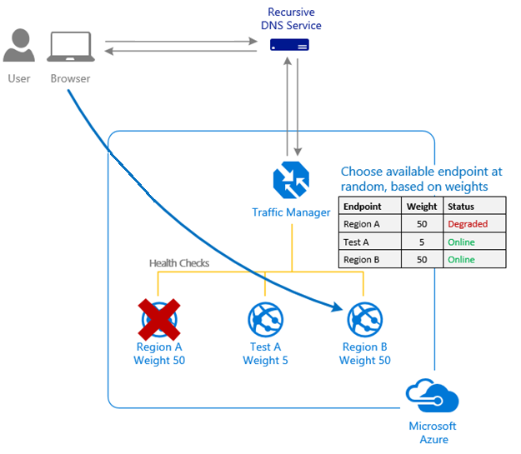
Traffic routing methods – Weighted
Notes:
Weighted
Select this routing method when you want to distribute traffic across a set of endpoints based on their weight. Set the weight the same to distribute evenly across all endpoints.
You want to distribute traffic across endpoints, either evenly or using different weights.

Slide 28
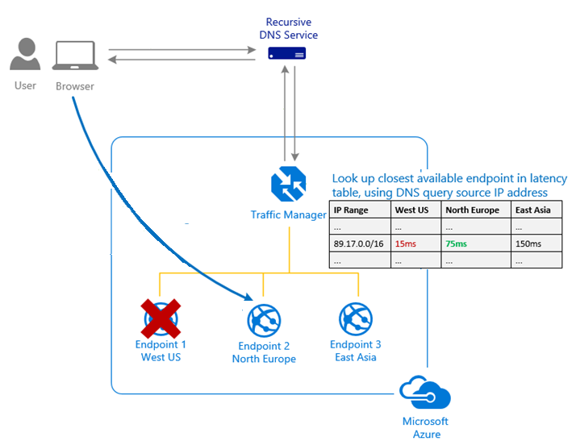
Traffic routing methods – Performance
Notes:
Performance
Select the routing method when you have endpoints in different geographic locations, and you want end users to use the "closest" endpoint for the lowest network latency.

Slide 29
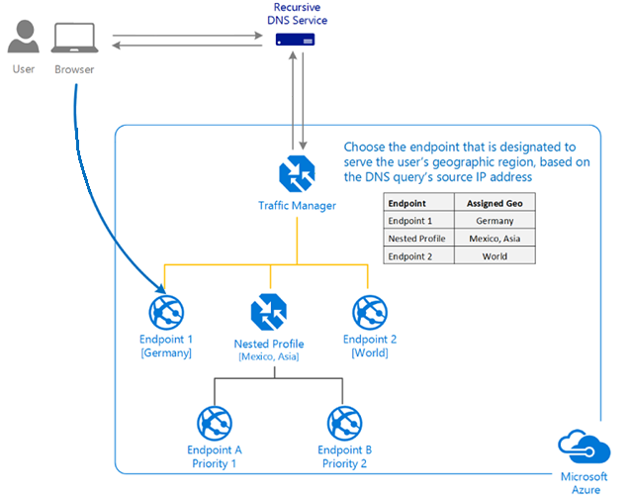
Traffic routing methods - Geographic
Notes:
Geographic
Select this routing method to direct users to specific endpoints (Azure, External, or Nested) based on where their DNS queries originate from geographically. With this routing method, it enables you to be compliant with scenarios such as data sovereignty mandates, localization of content & user experience and measuring traffic from different regions.

Slide 30
Azure Application Gateway

Slide 31
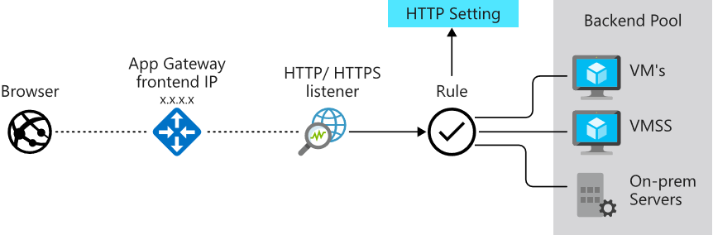
Application Gateway features
Manages web
app requests
Routes traffic to a pool of web servers based on the URL of a request
The web servers can be Azure virtual machines, Azure virtual machine scale sets, Azure App Service, and even
on-premises servers
Notes:
Application Gateway configuration overview - https://docs.microsoft.com/en-us/azure/application-gateway/configuration-overview
Support for the HTTP, HTTPS, HTTP/2 and WebSocket protocols.
A web application firewall to protect against web application vulnerabilities.
End-to-end request encryption.
Autoscaling, to dynamically adjust capacity as your web traffic load change.
Redirection: Redirection can be used to another site, or from HTTP to HTTPS.
Rewrite HTTP headers: HTTP headers allow the client and server to pass parameter information with the request or the response.
Custom error pages: Application Gateway allows you to create custom error pages instead of displaying default error pages. You can use your own branding and layout using a custom error page.

Slide 32
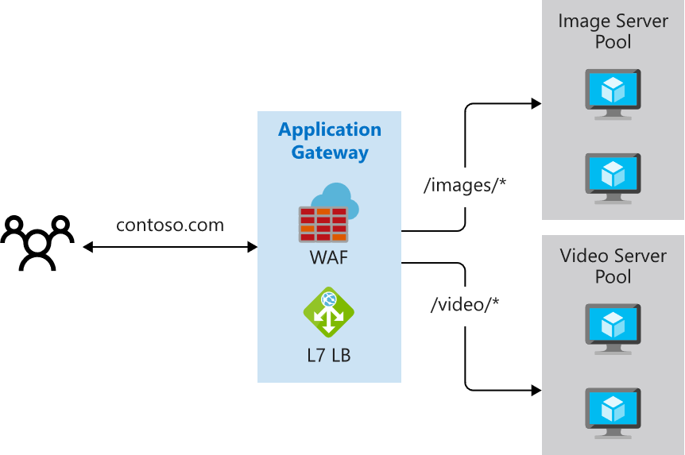
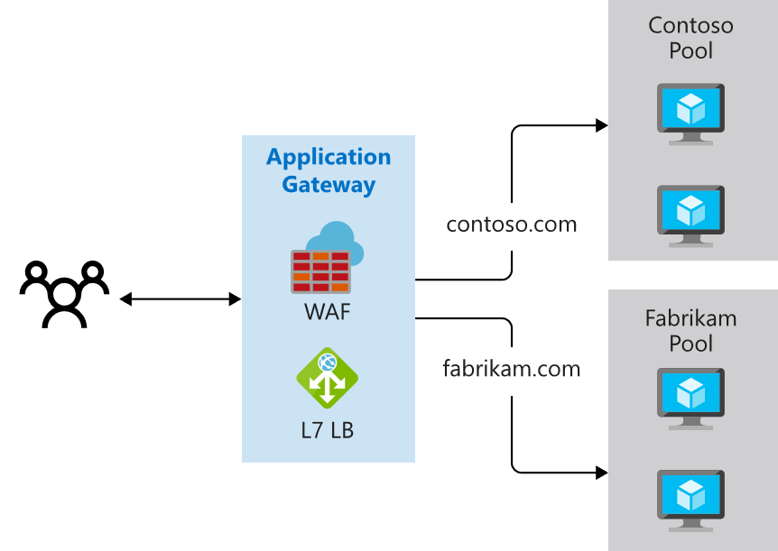
Determine Application Gateway Routing
Path-based routing
Multiple-site routing
Notes:
QuickStart: Direct web traffic with Azure Application Gateway - Azure portal - https://docs.microsoft.com/en-us/azure/application-gateway/quick-create-portal
Path-based routing sends requests with different URL paths different pools of back-end servers. For example, you could direct requests with the path /video/* to a back-end pool containing servers that are optimized to handle video streaming, and direct /images/* requests to a pool of servers that handle image retrieval.
Multiple site routing configures more than one web application on the same application gateway instance. In a multi-site configuration, you register multiple DNS names (CNAMEs) for the IP address of the Application Gateway, specifying the name of each site. Application Gateway uses separate listeners to wait for requests for each site. Each listener passes the request to a different rule, which can route the requests to servers in a different back-end pool. For example, you could direct all requests for http://contoso.com to servers in one back-end pool, and requests for http://fabrikam.com to another back-end pool. The following diagram shows this configuration.

Slide 33
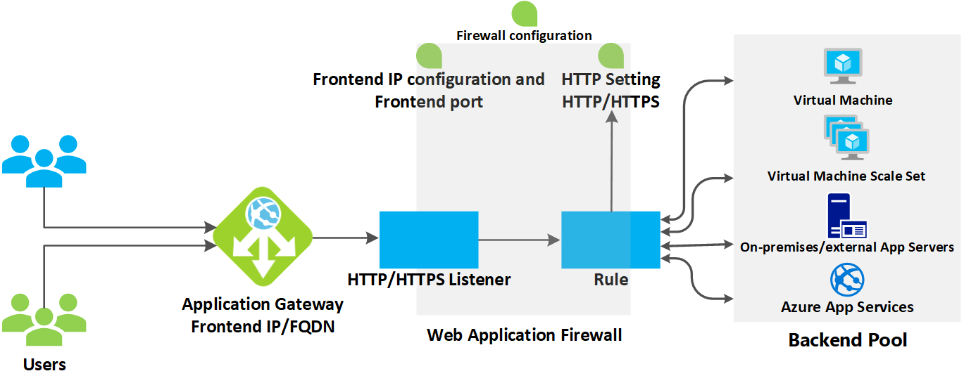
Application Gateway configuration planning
Notes:
Azure Application Gateway consists of several components that you can configure in various ways for different scenarios. Let's review what components you need to consider before configuration:
Infrastructure
The Application Gateway infrastructure includes the virtual network, subnets, network security groups, and user defined routes.
Front-end IP address
You can configure the application gateway to have a public IP address, a private IP address, or both. A public IP is required when you host a back end that clients must access over the Internet via an Internet-facing virtual IP (VIP).
Listeners
A listener is a logical entity that checks for incoming connection requests by using the port, protocol, host, and IP address. When you configure the listener, you must enter values for these that match the corresponding values in the incoming request on the gateway.
Request routing rules
When you create an application gateway by using the Azure portal, you create a default rule (rule1). This rule binds the default listener (appGatewayHttpListener) with the default back-end pool (appGatewayBackendPool) and the default back-end HTTP settings (appGatewayBackendHttpSettings). After you create the gateway, you can edit the settings of the default rule or create new rules.
HTTP settings
The application gateway routes traffic to the back-end servers by using the configuration that you specify here. After you create an HTTP setting, you must associate it with one or more request-routing rules.
Back-end pool
You can point a back-end pool to four types of backend members: a specific virtual machine, a virtual machine scale set, an IP address/FQDN, or an app service.
After you create a back-end pool, you must associate it with one or more request-routing rules. You must also configure health probes for each back-end pool on your application gateway. When a request-routing rule condition is met, the application gateway forwards the traffic to the healthy servers (as determined by the health probes) in the corresponding back-end pool.
Health probes
An application gateway monitors the health of all resources in its back end by default. But we strongly recommend that you create a custom probe for each back-end HTTP setting to get greater control over health monitoring.

Slide 34
Azure Front Door

Slide 35
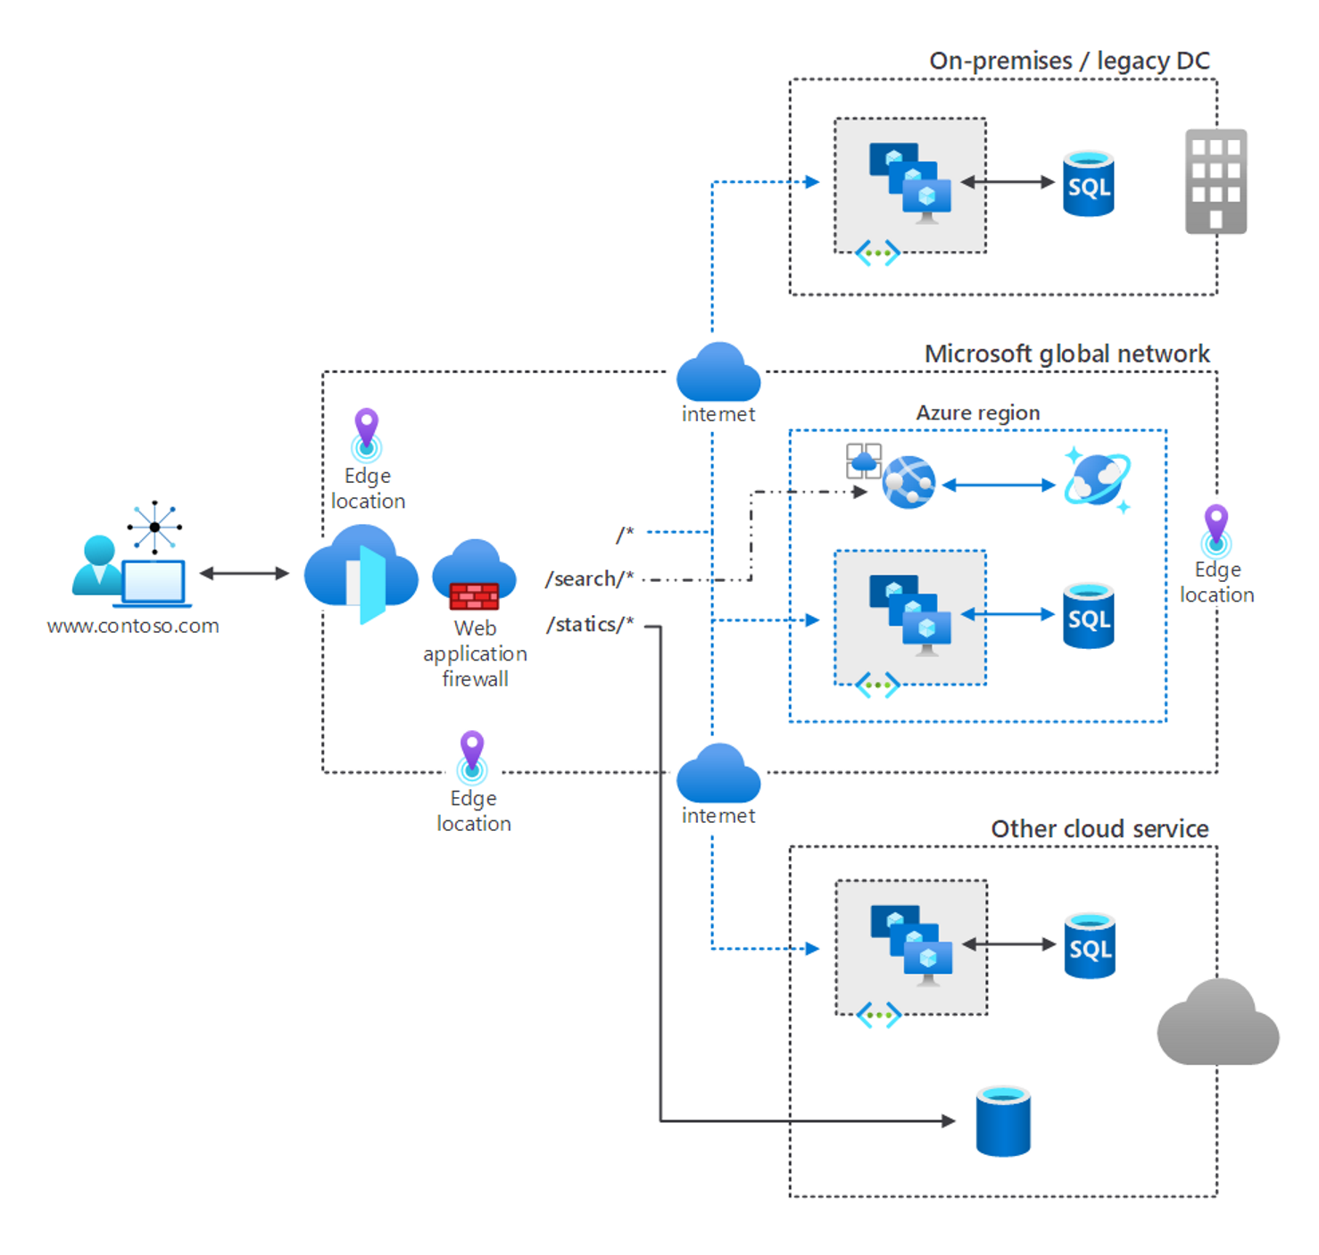
What is Azure Front Door
Global, scalable entry-point that uses the Microsoft global edge network to create fast, secure, and widely scalable web applications
Accelerated application performance by using split TCP-based anycast protocol
Intelligent health probe monitoring for backend resources
URL-path based routing for requests
Enables hosting of multiple websites for efficient application infrastructure
Notes:
Azure Front Door is a global, scalable entry-point that uses the Microsoft global edge network to create fast, secure, and widely scalable web applications. With Front Door, you can transform your global consumer and enterprise applications into robust, high-performing personalized modern applications with contents that reach a global audience through Azure.
Front Door works at Layer 7 (HTTP/HTTPS layer) using anycast protocol with split TCP and Microsoft's global network to improve global connectivity. Based on your routing method you can ensure that Front Door will route your client requests to the fastest and most available application backend. An application backend is any Internet-facing service hosted inside or outside of Azure. Front Door provides a range of traffic-routing methods and backend health monitoring options to suit different application needs and automatic failover scenarios. Like Traffic Manager, Front Door is resilient to failures, including failures to an entire Azure region.
Azure Front Door enables internet-facing application to:
Build and operate modern internet-first architectures that have dynamic, high-quality digital experiences with highly automated, secure, and reliable platforms.
Accelerate and deliver your app and content globally at scale to your users wherever they're creating opportunities for you to compete, weather change, and quickly adapt to new demand and markets.
Intelligently secure your digital estate against known and new threats with intelligent security that embrace a Zero Trust framework.
What is the difference between Azure Front Door and Azure Application Gateway?
While both Front Door and Application Gateway are layer 7 (HTTP/HTTPS) load balancers, the primary difference is that Front Door is a global service whereas Application Gateway is a regional service. Front Door can load balance between your different scale units/clusters/stamp units across regions, and Application Gateway allows you to load balance between your VMs/containers that is within the scale unit.

Slide 36



Azure Front Door Standard and Premium
Azure CDN
Azure Front Door
Azure Front Door Standard and Premium SKU
Azure WAF
Azure Front Door Standard SKU is:
Content delivery optimized
Offering both static and dynamic content acceleration
Global load balancing
SSL offload
Domain and certificate management
Enhanced traffic analytics
Basic security capabilities
Azure Front Door Premium SKU builds on capabilities of Standard SKU, and adds:
Extensive security capabilities across WAF
BOT protection
Private Link support
Integration with Microsoft Threat Intelligence and security analytics.
Notes:
Azure Front Door is offered in 2 different tiers, Azure Front Door Standard and Azure Front Door Premium. Azure Front Door Standard and Premium tier combines capabilities of Azure Front Door (classic), Azure CDN Standard from Microsoft (classic), and Azure WAF into a single secure cloud CDN platform with intelligent threat protection.
Azure Front Door tier comparison | Microsoft Docs https://docs.microsoft.com/azure/frontdoor/standard-premium/tier-comparison#feature-comparison-between-tiers
Azure Front Door Standard/Premium SKUs combines capabilities of Azure Front Door, Azure CDN Standard from Microsoft, Azure WAF into a single secure cloud CDN platform with intelligent threat protection.

Slide 37
Get network security recommendations with Microsoft Defender for Cloud

Slide 38
Network Security
NS-1: Establish network segmentation boundaries
NS-2: Secure cloud services with network controls
NS-3: Deploy firewall at the edge of enterprise network
NS-4: Deploy intrusion detection/intrusion prevention systems (IDS/IPS)
NS-5: Deploy DDOS protection
NS-6: Deploy web application firewall
NS-7: Simplify network security configuration
NS-8: Detect and disable insecure services and protocols
NS-9: Connect on-premises or cloud network privately
NS-10: Ensure Domain Name System (DNS) security
Notes:
Network Security covers controls to secure and protect Azure networks, including securing virtual networks, establishing private connections, preventing and mitigating external attacks, and securing DNS. Full description of the controls can be found at:
Azure Security Benchmark v3 - Network Security | Microsoft Docs
https://docs.microsoft.com/security/benchmark/azure/security-controls-v3-network-security

Slide 39
Azure Security benchmark
The Azure Security Benchmark (ASB) provides prescriptive best practices and recommendations to help improve the security of workloads, data, and services on Azure
Term | Description | Example
Control | A control is a high-level description of a feature or activity that needs to be addressed and is not specific to a technology or implementation. | Data Protection is one of the security controls. This control contains specific actions that must be addressed to help ensure data is protected.
Benchmark | A benchmark contains security recommendations for a specific technology, such as Azure. The recommendations are categorized by the control to which they belong. | The Azure Security Benchmark comprises the security recommendations specific to the Azure platform.
Baseline | A baseline is the implementation of the benchmark on the individual Azure service. Each organization decides benchmark recommendation and corresponding configurations are needed in the Azure implementation scope. | The Contoso company looks to enabling Azure SQL security features by following the configuration recommended in Azure SQL security baseline.
Security controls: These recommendations are generally applicable across your Azure tenant and Azure services. Each recommendation identifies a list of stakeholders that are typically involved in planning, approval, or implementation of the benchmark.
Service baselines: These apply the controls to individual Azure services to provide recommendations on that service’s security configuration.
Notes:
The Azure Security Benchmark includes a collection of high-impact security recommendations you can use to help secure the services you use in Azure:
Security controls: These recommendations are generally applicable across your Azure tenant and Azure services. Each recommendation identifies a list of stakeholders that are typically involved in planning, approval, or implementation of the benchmark.
Service baselines: These apply the controls to individual Azure services to provide recommendations on that service’s security configuration.
Implement the Azure Security Benchmark
Plan your Azure Security Benchmark implementation by reviewing the documentation for the enterprise controls and service-specific baselines to plan your control framework and how it maps to guidance like CIS (Controls v7.1) and NIST (SP 800-53) framework.
Monitor your compliance with Azure Security Benchmark status (and other control sets) using the Microsoft Defender for Cloud regulatory compliance dashboard.
Establish guardrails to automate secure configurations and enforce compliance with Azure Security Benchmark (and other requirements in your organization) with Azure Blueprints and Azure Policy.

Slide 40
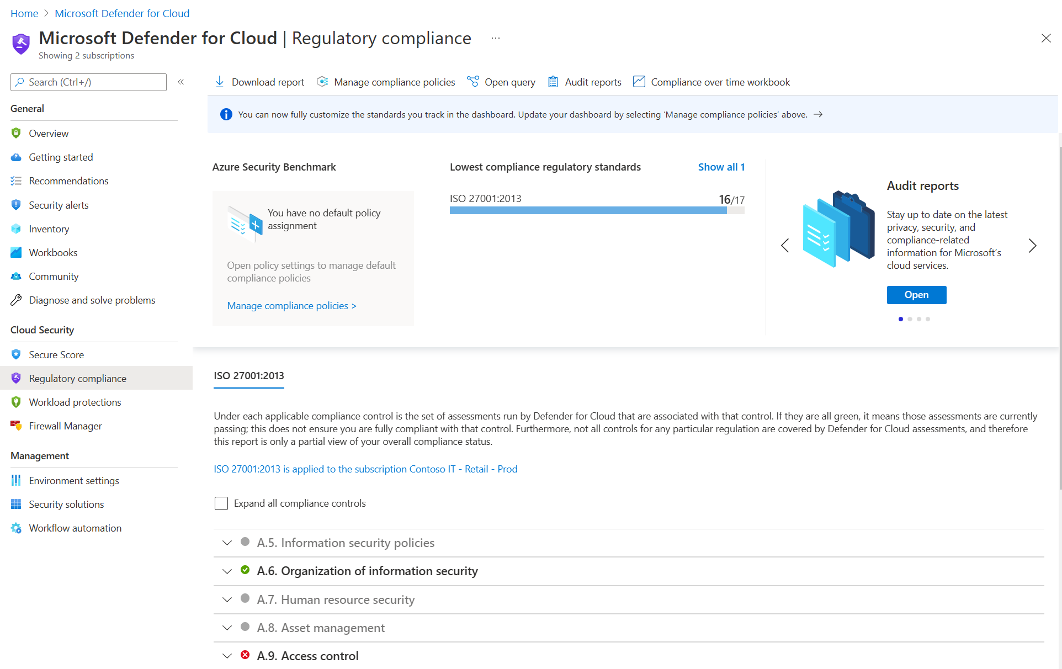
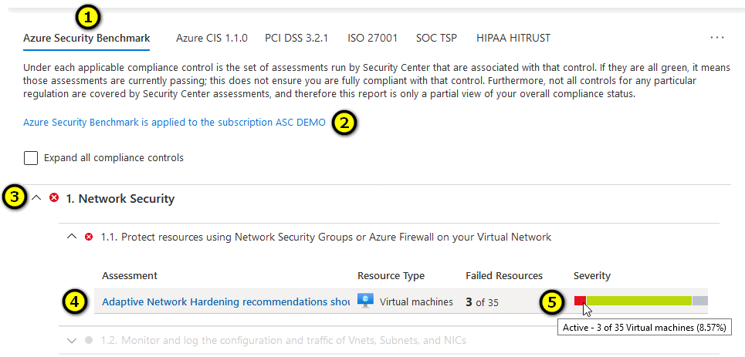
Using Microsoft Defender for Cloud for regulatory compliance
Microsoft Defender for Cloud helps streamline the process for meeting regulatory compliance requirements, using the regulatory compliance dashboard.

Slide 41
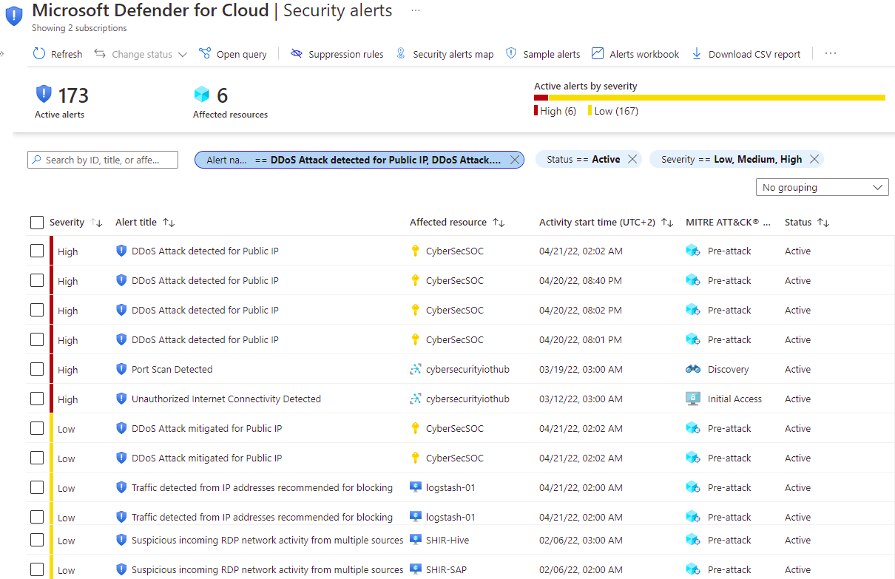
Alerts in Microsoft Defender for Cloud

Slide 42
Azure Firewall
Notes:
Design, implement, and manage an Azure Firewall deployment
• design an Azure Firewall deployment
• create and implement an Azure Firewall deployment
• configure Azure Firewall rules
• create and implement Azure Firewall Manager policies
• create a secure hub by deploying Azure Firewall inside an Azure Virtual WAN hub
• integrate an Azure Virtual WAN hub with a third-party NVA

Slide 43
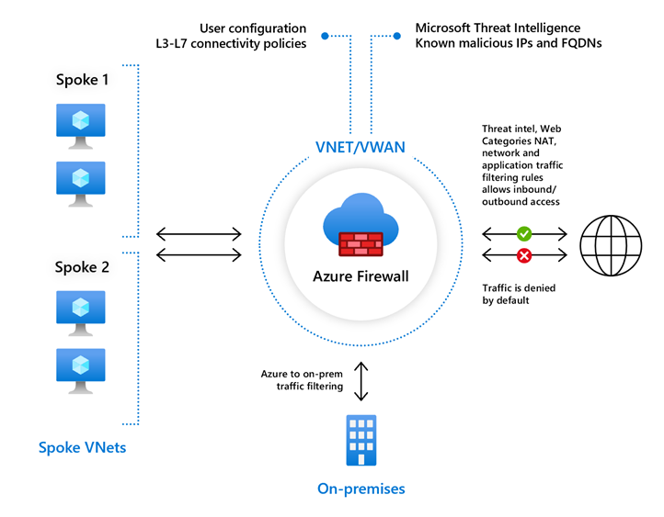
Azure Firewall features
Stateful firewall as a service
Built-in high availability with unrestricted cloud scalability
Create, enforce, and log application and network connectivity policies
Threat intelligence-based filtering for L3-L7
Fully integrated with Azure Monitor for logging and analytics
Support for hybrid connectivity through deployment behind VPN and ExpressRoute Gateways
Standard and Premium SKUs
Notes:
Azure Firewall documentation - https://docs.microsoft.com/en-us/azure/firewall/
Standard and Premium SKUs
Compare NSG and Firewall

Slide 44
Rule processing in Azure Firewall
NAT rules. Configure DNAT rules to allow incoming connections
Network rules. Configure rules that contain source addresses, protocols, destination ports, and destination addresses
Application rules. Configure fully qualified domain names (FQDNs) that can be accessed from a subnet
Notes:
In the Azure Firewall, you can configure NAT rules, network rules, and applications rules, and this can be done either by using classic rules or Firewall Policy. An Azure Firewall denies all traffic by default, until rules are manually configured to allow traffic.
With Firewall Policy, rules are organized inside Rule Collections which are contained in Rule Collection Groups. Rule Collections can be of the following types:
DNAT (Destination Network Address Translation)
Network
Application
You can define multiple Rule Collection types within a single Rule Collection Group, and you can define zero or more Rules in a Rule Collection, but the rules within a Rule Collection must be of the same type (i.e., DNAT, Network, or Application).

Slide 45
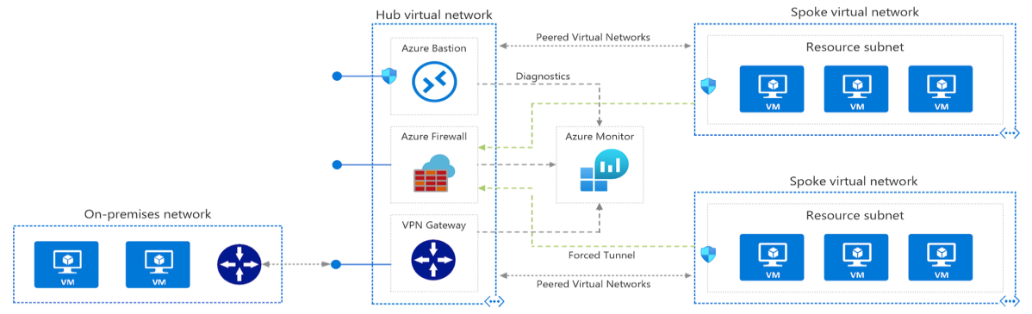
Deploying Azure Firewall in a Hub-Spoke network topology
A Hub-Spoke network topology is recommended
Shared services are placed in the hub virtual network
Each environment is deployed to a spoke to maintain isolation
Notes:
Hub-spoke network topology in Azure - https://docs.microsoft.com/en-us/azure/architecture/reference-architectures/hybrid-networking/hub-spoke
High level overview of Azure bastion: Azure Bastion is a service you deploy that lets you connect to a virtual machine using your browser and the Azure portal. The Azure Bastion service is a fully platform-managed PaaS service that you provision inside your virtual network. It provides secure and seamless RDP/SSH connectivity to your virtual machines directly from the Azure portal over TLS. When you connect via Azure Bastion, your virtual machines do not need a public IP address, agent, or special client software.
The key stages of deploying and configuring Azure Firewall are as follows:
Create a resource group
Create a virtual network and subnets
Create a workload VM in a subnet
Deploy the firewall and policy to the virtual network
Create a default outbound route
Configure an application rule
Configure a network rule
Configure a Destination NAT (DNAT) rule
Test the firewall
One of the major features of Azure Firewall is Availability Zones.
When deploying Azure Firewall, you can configure it to span multiple Availability Zones for increased availability. When you configure Azure Firewall in this way your availability increases to 99.99% uptime. The 99.99% uptime SLA is offered when two or more Availability Zones are selected.
You can also associate Azure Firewall to a specific zone just for proximity reasons, using the service standard 99.95% SLA.
For more information, see the Azure Firewall Service Level Agreement (SLA).
There's no additional cost for a firewall deployed in an Availability Zone. However, there are added costs for inbound and outbound data transfers associated with Availability Zones.
For more information, see Bandwidth pricing details.
Azure Firewall Availability Zones are only available in regions that support Availability Zones.
Availability Zones can only be configured during firewall deployment. You cannot configure an existing firewall to include Availability Zones.

Slide 46
Compare Azure Firewall to NSGs
 | NSG | Azure Firewall
Protocol based traffic filtering | Yes | Yes
Support Service Tags | Yes | Yes
Support Application FQDN Tags | No | Yes
Integrated with Azure Monitor for diagnostic logging | Yes | Yes
SNAT and DNAT support | No | Yes
Notes:
Azure Firewall FAQ | Microsoft Docs
The Azure Firewall service complements network security group functionality. Together, they provide better "defense-in-depth" network security. Network security groups provide distributed network layer traffic filtering to limit traffic to resources within virtual networks in each subscription. Azure Firewall is a fully stateful, centralized network firewall as-a-service, which provides network- and application-level protection across different subscriptions and virtual networks.

Slide 47
Web Application Firewall

Slide 48
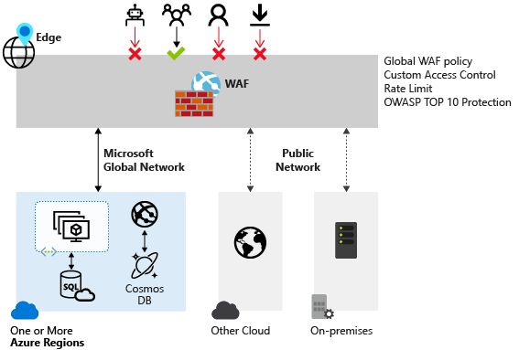
Web Application Firewall overview
Provides centralized protection of your web applications from common exploits and vulnerabilities
A centralized web application firewall helps make security management much simpler
A WAF also gives application administrators better assurance of protection against threats and intrusions
A WAF solution can react to a security threat faster by centrally patching a known vulnerability, instead of securing each individual web application
Notes:
Web Application Firewall (WAF) provides centralized protection of your web applications from common exploits and vulnerabilities. Web applications are increasingly targeted by malicious attacks that exploit commonly known vulnerabilities. SQL injection and cross-site scripting are among the most comm
Preventing such attacks in application code is challenging. It can require rigorous maintenance, patching, and monitoring at multiple layers of the application topology. A centralized web application firewall helps make security management much simpler. A WAF also gives application administrators better assurance of protection against threats and intrusions.
A WAF solution can react to a security threat faster by centrally patching a known vulnerability, instead of securing each individual web application.
Supported service
WAF can be deployed with Azure Application Gateway and Azure Front Door. WAF on Azure CDN is currently under public preview. WAF has features that are customized for each specific service.

Slide 49
Web Application Firewall with Azure services
WAF on Azure Application Gateway
WAF on Azure Front Door
You can create multiple policies, and they can be associated with an Application Gateway, to individual listeners, or to path-based routing rules on an Application Gateway
Customizable and separate policies for each site behind your Application Gateway if needed
Monitor attacks
Global and centralized solution
WAF enabled web applications inspect every incoming request delivered by Front Door at the network edge
WAF policy can be associated to one or more Front Door front-ends for protection
Notes:
Protection
Monitoring
Customization
What is Azure Web Application Firewall on Azure Application Gateway?
https://docs.microsoft.com/azure/web-application-firewall/ag/ag-overview#benefits
Azure Web Application Firewall on Azure Front Door:
https://docs.microsoft.com/azure/web-application-firewall/afds/afds-overview

