Slide 1
Section 04:
Virtual Networking
Notes:
Learn learning path: https://docs.microsoft.com/learn/paths/azure-fundamentals-describe-azure-architecture-services/

Slide 2

Section 04 – Outline
You will learn the following concepts:
Virtual Networks
Network Security Groups
Azure DNS
vNet Peering
Configure VPN Connections
Notes:
Virtual Networks
https://learn.microsoft.com/en-us/training/modules/configure-virtual-networks/
Network Security Groups
https://learn.microsoft.com/en-us/training/modules/configure-network-security-groups/
Azure DNS
https://learn.microsoft.com/en-us/training/modules/configure-azure-dns/
vNet Peering
https://learn.microsoft.com/en-us/training/modules/configure-vnet-peering/
Configure VPN Connections
https://learn.microsoft.com/en-us/training/modules/configure-vpn-gateway/

Slide 3
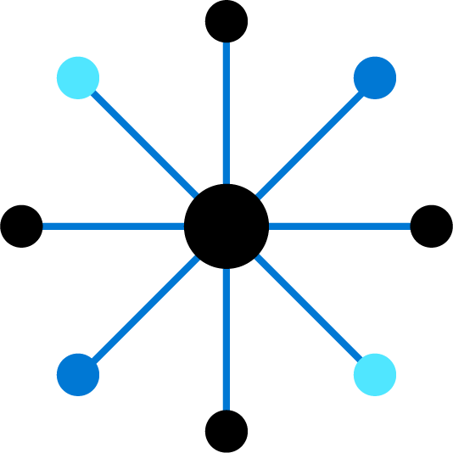
Configure Virtual Networks

Slide 4
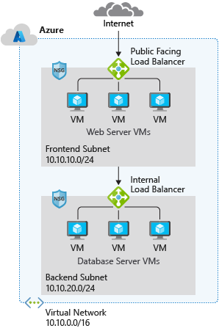
Capabilities of Azure Virtual Networks
Communication with the Internet
Communication between Azure resources
Communication between on-premises resources
Filtering network traffic
Routing network traffic
Notes:
Capabilities of Azure Virtual Networks
Azure VNet enables resources in Azure resources to securely communicate with each other, the internet, and on-premises networks.
Communication with the internet. All resources in a VNet can communicate outbound to the internet, by default. You can communicate inbound to a resource by assigning a public IP address or a public Load Balancer. You can also use public IP or public Load Balancer to manage your outbound connections.
Communication between Azure resources. There are three key mechanisms through which Azure resource can communicate: VNets, VNet service endpoints and VNet peering. Virtual Networks can connect not only VMs, but other Azure Resources, such as the App Service Environment, Azure Kubernetes Service, and Azure VM Scale sets. You can use service endpoints to connect to other Azure resource types, such as Azure SQL databases and storage accounts. When you create a VNet, your services and VMs within your VNet can communication directly and securely with each other in the cloud.
Communication between on-premises resources. Securely extend your data center. You can connect your on-premises computers and networks to a virtual network using any of the following options: Point-to-site virtual private network (VPN), Site-to-site VPN, Azure ExpressRoute.
Filtering network traffic. You can filter network traffic between subnets using any combination of network security groups and network virtual appliances like firewalls, gateways, proxies, and Network Address Translation (NAT) services.
Routing network traffic. Azure routes traffic between subnets, connected virtual networks, on-premises networks, and the Internet, by default. You can implement route tables or border gateway protocol (BGP) routes to override the default routes Azure creates.

Slide 5
Plan Virtual Networks
Virtual Network
Subnet
On-premises
NIC
NIC
Virtual Network(s)
Virtual Machines
Logical representation of your own network
Create a dedicated private cloud-only virtual network
Securely extend
your datacenter with virtual networks
Enable hybrid
cloud scenarios
Notes:
Azure Virtual Networks - https://azure.microsoft.com/services/virtual-network/
What is Azure Virtual Network? - https://docs.microsoft.com/azure/virtual-network/virtual-networks-overview

Slide 6
Virtual Network address space
RFC 1918
10.0.0.0 - 10.255.255.255 (10/8 prefix)
172.16.0.0 - 172.31.255.255 (172.16/12 prefix)
192.168.0.0 - 192.168.255.255 (192.168/16 prefix)
Azure reserves 5 IP addresses
x.x.x.0: Network address
x.x.x.1: Reserved by Azure for the default gateway
x.x.x.2, x.x.x.3: Reserved by Azure to map the Azure DNS IPs to the VNet space
x.x.x.255: Network broadcast address
Unavailable address ranges:
224.0.0.0/4 (Multicast)
255.255.255.255/32 (Broadcast)
127.0.0.0/8 (Loopback)
169.254.0.0/16 (Link-local)
168.63.129.16/32 (Internal DNS)
Logical representation of your own network
Create a dedicated private cloud-only virtual network
Securely extend
your datacenter with virtual networks
Enable hybrid
cloud scenarios
Notes:
Azure Virtual Networks - https://azure.microsoft.com/services/virtual-network/
What is Azure Virtual Network? - https://docs.microsoft.com/azure/virtual-network/virtual-networks-overview
Address space: When creating a VNet, you must specify a custom private IP address space using public and private (RFC 1918) addresses. Azure assigns resources in a virtual network a private IP address from the address space that you assign. For example, if you deploy a VM in a VNet with address space, 10.0.0.0/16, the VM will be assigned a private IP like 10.0.0.4.

Slide 7
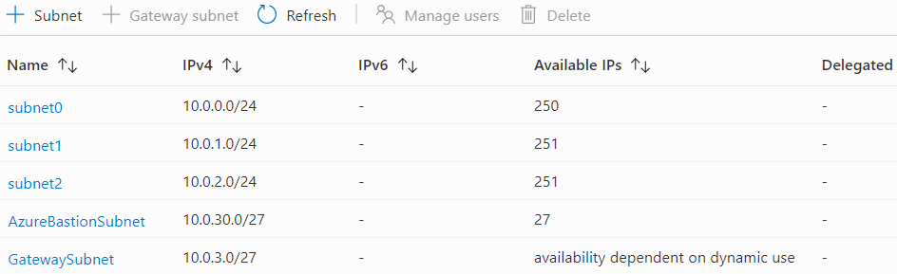
Create Subnets
A virtual network can be segmented into one or more subnets
Subnets provide logical divisions within your network
Subnets can help improve security, increase performance, and make it easier to manage the network
Each subnet must have a unique address range – cannot overlap with other subnets in the vnet in the subscription
Notes:
✔️ Azure reserves 5 IP addresses within each subnet.
x.x.x.0: Network address
x.x.x.1: Reserved by Azure for the default gateway
x.x.x.2, x.x.x.3: Reserved by Azure to map the Azure DNS IPs to the VNet space
x.x.x.255: Network broadcast address

Slide 8
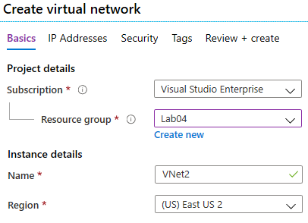
Create Virtual Networks
Create new virtual networks
at any time
Add virtual networks when
you create a virtual machine
Need to define the address space, and at least one subnet
Be careful with overlapping address spaces
Notes:
QuickStart: Create a virtual network using the Azure portal - https://docs.microsoft.com/azure/virtual-network/quick-create-portal
✔️ Always plan to use an address space that is not already in use in your organization, either on-premises or in other VNets. Even if you plan for a VNet to be cloud-only, you may want to make a VPN connection to it later. If there is any overlap in address spaces at that point, you will have to reconfigure or recreate the VNet. The next lesson will focus on IP addressing.

Slide 9
Plan IP Addressing
Azure
Resource
Internet, public-facing services
VNets, on-premises networks, VPN gateways, ExpressRoute
Private IP address
Public IP address
Private IP addresses - used within an
Azure virtual network (VNet), and your
on-premises network, when you use a VPN gateway or ExpressRoute circuit to extend your network to Azure
Public IP addresses - used for communication with the Internet, including Azure public-facing services
Notes:
Design an IP addressing schema for your Azure deployment – https://docs.microsoft.com/learn/modules/design-ip-addressing-for-azure
✔️ As a best practice you may decide to separate dynamically and statically assigned IP resources into different subnets. And, IP Addresses are never managed from within a virtual machine.

Slide 10
Choose the appropriate SKU for a public IP
Basic SKU
Assigned with the static or dynamic allocation method
Open by default. NSGs are recommended but optional
Assigned to network interfaces, VPN gateway, public load balancers, or Application Gateways
Don’t support availability zone scenarios
Standard SKU
Always use static allocation method
Secure by default and closed to inbound traffic
Allow inbound traffic with NSG
Assigned to network interfaces, standard public load balancers, or Application Gateways
Can be zone-redundant, zonal, or no-zone
Notes:
For public IP addresses, there are two types of SKUs to choose from: Basic and Standard. All public IP addresses created before the introduction of SKUs are Basic SKU public IP addresses. With the introduction of SKUs, you have the option to specify which SKU you would like the public IP address to be.
SKU. Basic SKU IPv4 addresses can be upgraded after creation to Standard SKU.. A standalone virtual machine, virtual machines within an availability set, or virtual machine scale sets can use Basic or Standard SKUs. Mixing SKUs between virtual machines within availability sets or scale sets or standalone VMs is not allowed.
Upgrade to Standard SKU public IP addresses in Azure by 30 September 2025—Basic SKU will be retired: https://azure.microsoft.com/updates/upgrade-to-standard-sku-public-ip-addresses-in-azure-by-30-september-2025-basic-sku-will-be-retired/
Basic SKU
Basic SKU public IPs can be assigned by using static or dynamic allocation methods. Basic IPs are open by default, so the use of Network security groups is recommended but optional for restricting inbound or outbound traffic.
Basic public IPs can be assigned to any Azure resource that can be assigned a public IP address, such as network interfaces, VPN gateways, application gateways, and internet-facing load balancers. They do not support availability zone scenarios. You must use a Standard SKU public IP for an availability zone scenario.
Standard SKU
Standard SKU public IP addresses always use the static allocation method. Standard IPs are secure by default and closed to inbound traffic. You must explicitly allow inbound traffic by using a network security group.
Standard IPs can be assigned to network interfaces, Standard public load balancers, application gateways, or VPN gateways. Standard IPs are zone-redundant by default and optionally zonal (they can be created zonal and guaranteed in a specific availability zone).

Slide 11
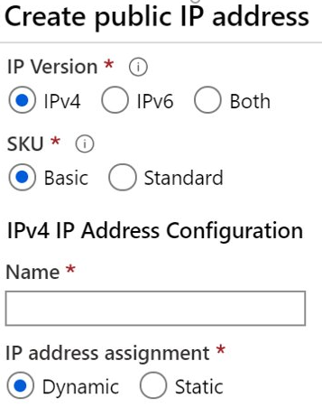
Create Public IP Addresses
Available in IPv4 or IPv6 or both
Basic vs Standard SKU
Dynamic vs Static
Zone redundant (Standard SKU)
Range of contiguous addresses available as a prefix
Notes:
Create, change, or delete IP addresses - https://docs.microsoft.com/azure/virtual-network/virtual-network-public-ip-address

Slide 12
Associate Public IP Addresses
Public IP addresses | IP address association | Dynamic | Static
Virtual Machine | NIC | Yes | Yes
Load Balancer | Front-end configuration | Yes | Yes
VPN Gateway | Gateway IP configuration | Yes | Yes*
Application Gateway | Front-end configuration | Yes | Yes*
A public IP address resource can be associated with virtual machine network interfaces, internet-facing load balancers, VPN gateways, and application gateways
*Static IP addresses only available on certain SKUs.
Notes:
Public IP addresses - https://docs.microsoft.com/azure/virtual-network/public-ip-addresses

Slide 13
Associate Private IP Addresses
Private IP Addresses | IP address association | Dynamic | Static
Virtual Machine | NIC | Yes | Yes
Internal Load Balancer | Front-end configuration | Yes | Yes
Application Gateway | Front-end configuration | Yes | Yes
Dynamic (default). Azure assigns the next available unassigned or unreserved IP address in the subnet’s address range
Static. You select and assign any unassigned or unreserved IP address in the subnet's address range
Notes:
Private IP addresses - https://docs.microsoft.com/azure/virtual-network/private-ip-addresses

Slide 14
Demonstration – Virtual Networks
Create a
virtual network
in the portal
Create a
virtual network
with PowerShell
Notes:
✔ Always consider having students walk-through the demonstrations themselves. Also, consider the overlap with the formal labs and your best use of time.

Slide 15
Configure Network Security Groups

Slide 16
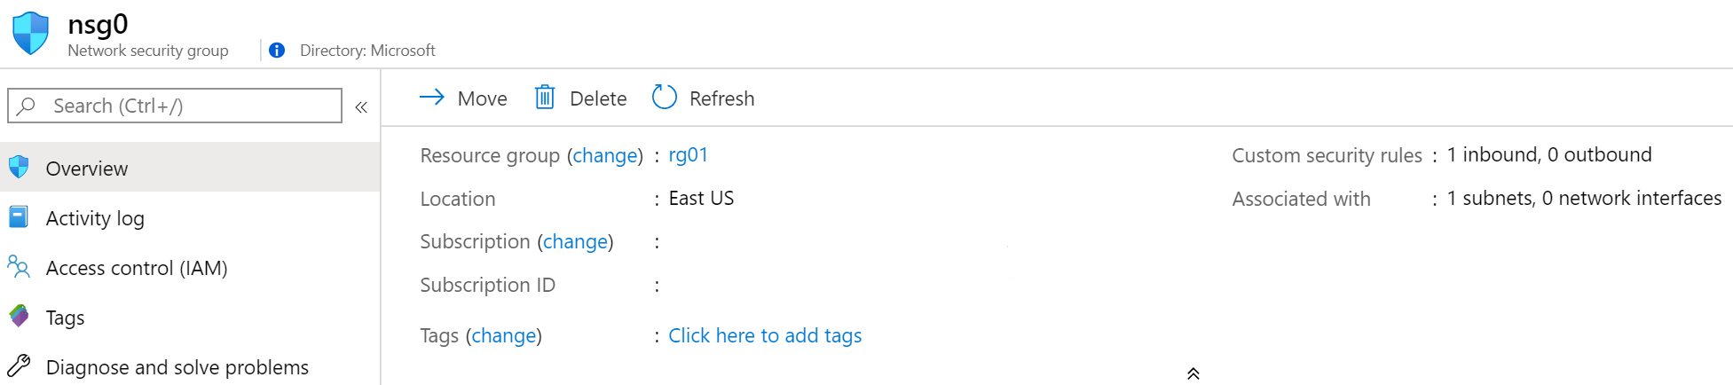
Implement Network Security Groups (NSGs)
Limits network traffic
to resources in a
virtual network
Lists the security rules that allow or deny inbound or outbound network traffic
Associated
to a subnet or a
network interface
Can be associated multiple times
Notes:
Network Security Groups - https://docs.microsoft.com/azure/virtual-network/security-overview#network-security-groups
✔️ To simplify management of security rules, it's recommended that you associate a network security group to individual subnets, rather than individual network interfaces within the subnet.

Slide 17
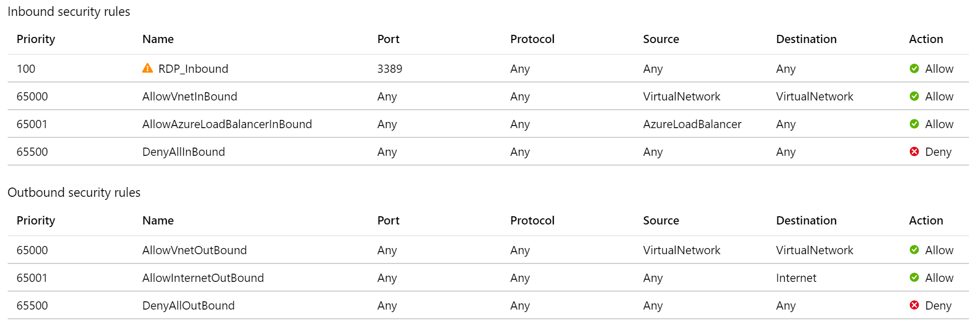
Determine NSG Rules
Security rules in NSGs enable you
to filter network traffic that can flow
in and out of virtual network subnets and network interfaces
There are default security rules.
You cannot delete the default rules,
but you can add other rules with
a higher priority
Notes:
Create, change, or delete a network security group -https://docs.microsoft.com/azure/virtual-network/manage-network-security-group

Slide 18
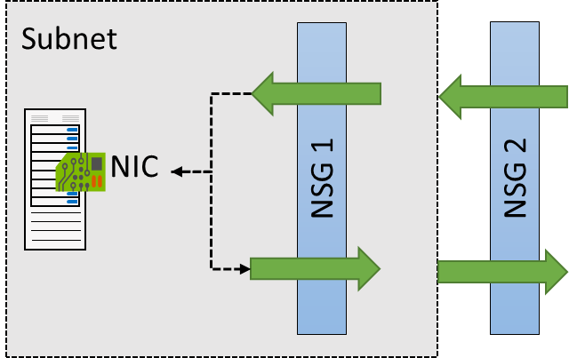
Determine NSG Effective Rules
NSGs are evaluated independently for the
subnet and NIC
An “allow” rule must exist
at both levels for traffic to
be admitted
Use the Effective Rules link if you are not sure which security rules are being applied

Slide 19
Create NSG rules
Source (Any, IP addresses, service tags, application security group)
Destination (Any, IP addresses, virtual network, application security group)
Service (HTTPS, SSH, RDP, DNS, POP3, custom, …)
Priority – The lower the number, the higher
the priority
Notes:
Tutorial: Filter network traffic with a network security group using the Azure portal - https://docs.microsoft.com/azure/virtual-network/tutorial-filter-network-traffic
Secure and isolate access to Azure resources by using network security groups and service endpoints - https://docs.microsoft.com/learn/modules/secure-and-isolate-with-nsg-and-service-endpoints/

Slide 20





Implement Application Security Groups
Extends your application's structure
ASGs logically group virtual machines – web servers, application servers
WebServers
AppLServers
Define rules to control the traffic flow
Wrap the ASG with an NSG for added security
Source | Destination | Port
Internet | WebServers | 80, 443
WebServers | SQLServers | 1533
Notes:
There is no associated student material.
Application Security Groups - https://docs.microsoft.com/azure/virtual-network/application-security-groups

Slide 21
Demonstration – Network Security Groups
Access the NSGs blade
Add a new NSG
Explore inbound and outbound rules
Notes:
✔ Always consider having students walk-through the demonstrations themselves. Also, consider the overlap with the formal labs and your best use of time.

Slide 22
Configure Azure DNS

Slide 23
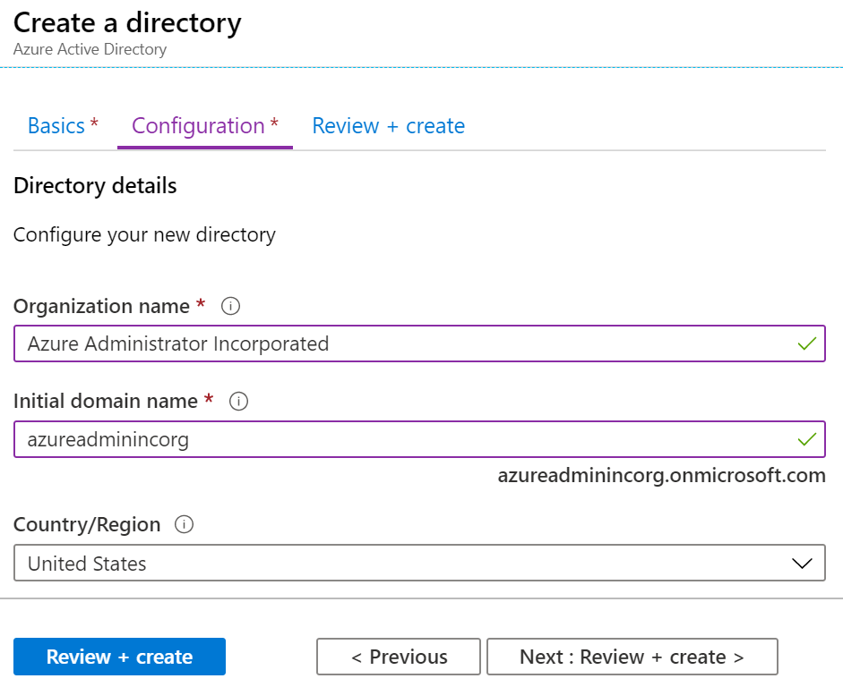
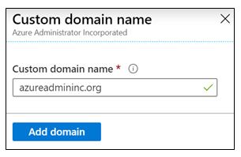
Identity Domains and Custom Domains
When you create an Azure subscription an Azure AD domain is created for you
The domain has initial domain name in the form domainname.onmicrosoft.com
You can customize/change the name
After the custom name is added it must be verified – this demonstrates ownership of the domain
Notes:
What is Azure DNS? - https://docs.microsoft.com/azure/dns/dns-overview

Slide 24
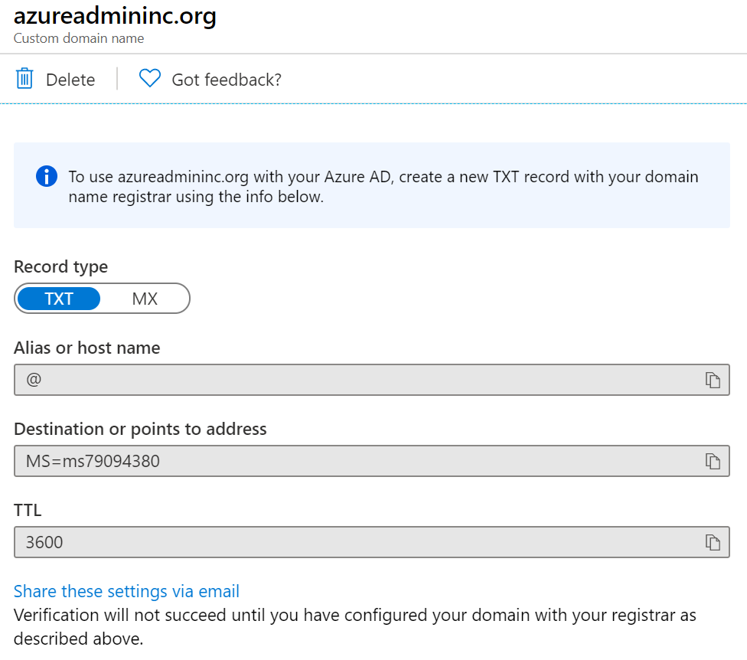
Verify Custom Domain Names
Verification demonstrates ownership of the domain name
Add a DNS record (MX or TXT) that is provided by Azure into your company’s DNS zone
Azure will query the DNS domain for the presence of the record
This could take several minutes or several hours
Notes:
QuickStart: Create an Azure DNS zone and record using the Azure portal - https://docs.microsoft.com/azure/dns/dns-getstarted-portal

Slide 25
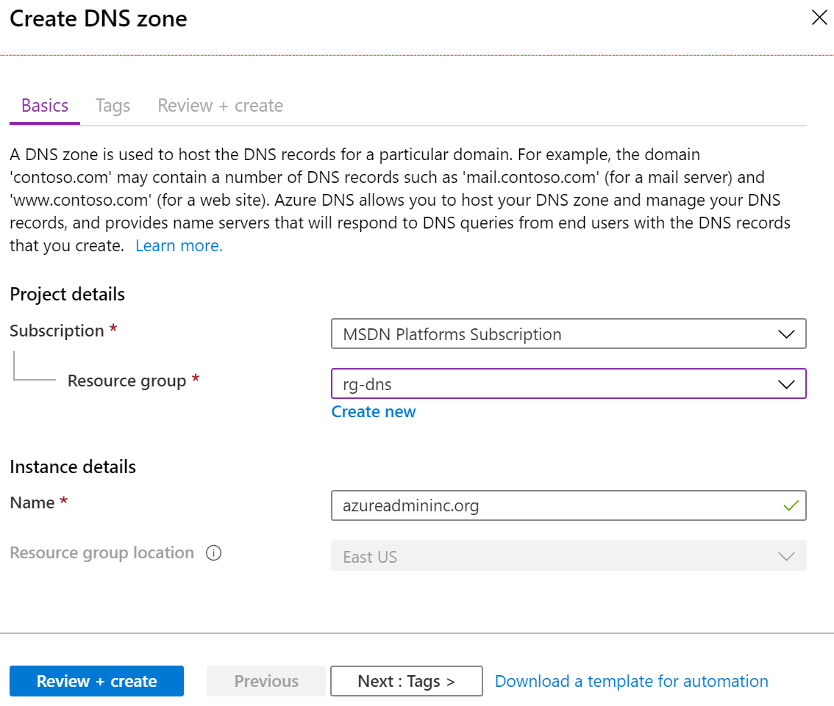
Create Azure DNS Zones
A DNS zone hosts the DNS records for a domain
Where multiple zones share the same name,
each instance is assigned different name server addresses
Root/Parent domain is registered at the registrar and pointed to Azure NS
Notes:
DNS Zones - https://docs.microsoft.com/azure/dns/dns-zones-records#dns-zones
✔️ You do not have to own a domain name to create a DNS zone with that domain name in Azure DNS. However, you do need to own the domain to configure the domain.

Slide 26
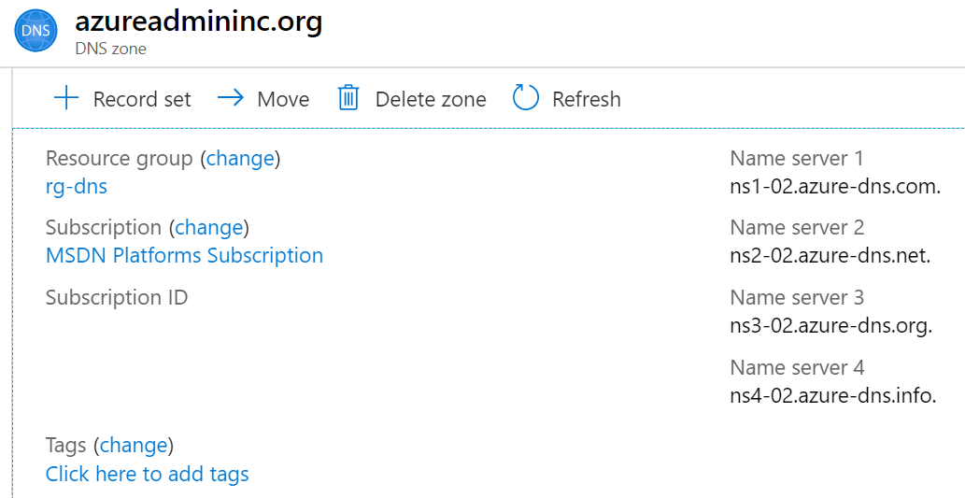
Delegate DNS Domains
When delegating a domain to Azure DNS, you must use the name server names provided by Azure DNS – use all four
Once the DNS zone is created, update the parent registrar
For child zones, register the NS records in the parent domain
Notes:
Host your domain on Azure DNS - https://docs.microsoft.com/learn/modules/host-domain-azure-dns/

Slide 27
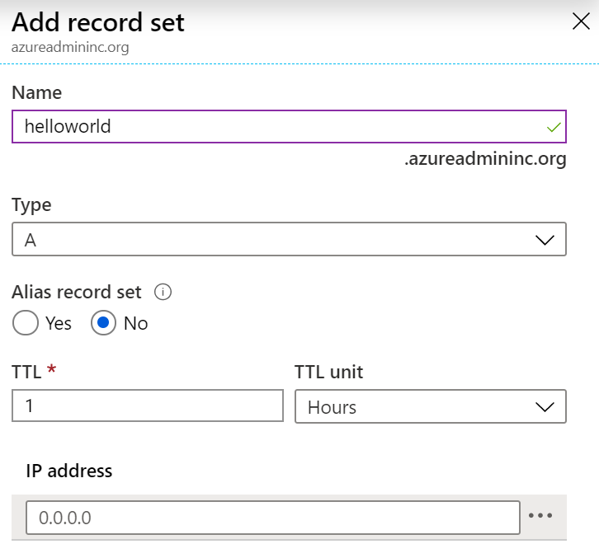
Add DNS Record Sets
A record set is a collection of records in a zone
that have the same name and are the same type
You can add up to 20 records to any record set
A record set cannot contain two identical records
Changing the drop-down Type, changes the information required

Slide 28
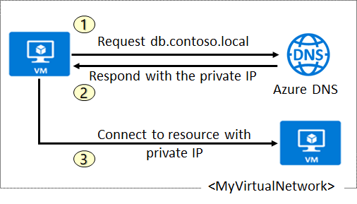
Plan for Private DNS Zones
Use your own custom domain names
Provides name resolution for VMs within a VNet and between VNets
db.contoso.lab
Automatic hostname record management
Removes the need for custom DNS solutions
Use all common DNS records types
Available in all Azure regions
Notes:
QuickStart: Create an Azure private DNS zone using the Azure portal - https://docs.microsoft.com/azure/dns/private-dns-getstarted-portal

Slide 29
Determine Private Zone Scenarios
Query:VM2.contoso.lab
Response:VM1.contoso.lab
DNS resolution in VNet1 is private and not accessible from the Internet
DNS queries across
the virtual networks
are resolved
Reverse DNS queries are scoped to the same virtual network

Slide 30
Demonstration - DNS
Create a DNS zone
Add a DNS record set
Use PowerShell to view DNS information
View your name servers
Test the resolution
Explore DNS metrics
Notes:
✔ Always consider having students walk-through the demonstrations themselves. Also, consider the overlap with the formal labs and your best use of time.

Slide 31
Lab – Implement Virtual Networks
Notes:
https://mslabs.cloudguides.com/en-us/guides/AZ-104%20Exam%20Guide%20-%20Microsoft%20Azure%20Administrator%20Exercise%208
AZ-104 Module 4 lab, no azure pass needed
Estimated timing: 40 minutes

Slide 32
Lab – Implement Virtual Networking
Lab scenario
You plan to create a virtual network in Azure that will host a couple of Azure virtual machines. You will deploy them into different subnets of the virtual network. You also want to ensure that their private and public IP addresses will not change over time. To comply with Contoso security requirements, you need to protect public endpoints of Azure virtual machines accessible from Internet. Finally, you need to implement DNS name resolution for Azure virtual machines both within the virtual network and from Internet.
Objectives
Task 1:
Create and configure a
virtual network
Task 2:
Deploy virtual machines into
the virtual network
Task 3:
Configure private and public IP addresses of Azure VMs
Task 4:
Configure network
security groups
Task 5:
Configure Azure DNS for
internal name resolution
Task 6:
Configure Azure DNS for
external name resolution
Next slide for an architecture diagram
Notes:
LAB 04 - Implement Virtual Networking - ESTIMATED DURATION 40 MIN
Lab Repository - https://microsoftlearning.github.io/AZ-104-MicrosoftAzureAdministrator/

Slide 33






Lab – Architecture diagram
Task 1, Task 2
az104-04-rg1
az104-04-vnet1 10.40.0.0/20
Subnet0 10.40.0.0/24
Subnet1 10.40.1.0/24
Task 5
Private DNS zone
az104-04-vm0
az104-04-vm1
contoso.org
az104-04-nic0
10.40.0.4
az104-04-nic1
10.40.1.4
Task 3
Task 6
az104-04-pip0
az104-04-pip1
DNS zone
Task 4
az104-04-nsg01

Slide 34
Configure VNet Peering

Slide 35
Determine VNet Peering Uses
Region 1
Region 2
VNet1
Global
VNet Peering
VNet2
Regional
VNet Peering
VNet3
Two types of peering: Global and Regional
Connects two Azure virtual networks – you can peer across subscriptions and tenants
Peered networks use the Azure backbone for privacy and isolation
Easy to setup, seamless data transfer, and great performance
Notes:
Virtual network peering - https://docs.microsoft.com/azure/virtual-network/virtual-network-peering-overview

Slide 36
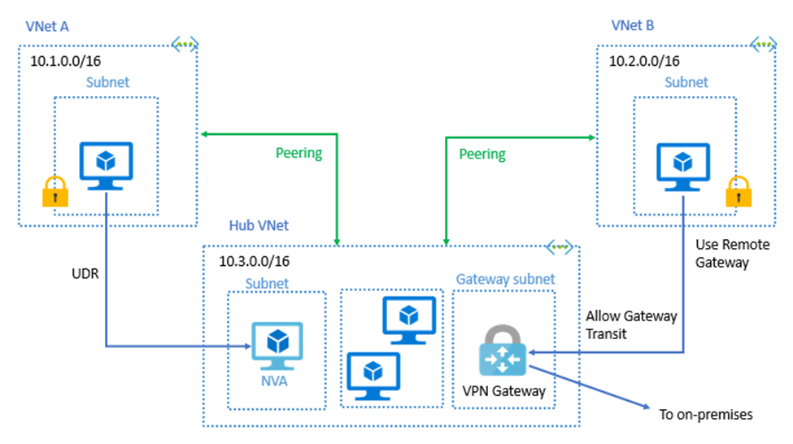

Determine Gateway Transit and Connectivity Needs
Gateway transit allows peered virtual networks to share the gateway and get access to resources
No VPN gateway is required in
the peered virtual network
Default VNet peering provides
full connectivity
IP address spaces of connected networks can't overlap
Notes:
Azure Virtual Network frequently asked questions (FAQ) VNet Peering - https://docs.microsoft.com/azure/virtual-network/virtual-networks-faq

Slide 37
Create the Gateway Subnet
When you create your gateway subnet, gateway VMs are deployed to the gateway subnet and configured with the required VPN gateway settings
The gateway subnet contains the IP addresses; if possible, use a CIDR block of /28 or /27
Never deploy other resources (for example, additional VMs) to the gateway subnet

Slide 38
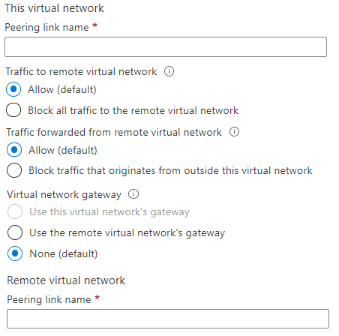
Create VNet Peering
Allow virtual network access settings
Configure forwarded traffic settings
Notes:
Create, change, or delete a virtual network peering - https://docs.microsoft.com/azure/virtual-network/virtual-network-manage-peering#requirements-and-constraints
Tutorial: Connect virtual networks with virtual network peering using the Azure portal - https://docs.microsoft.com/azure/virtual-network/tutorial-connect-virtual-networks-portal
✔️ When you add a peering on one virtual network, the second virtual network configuration is automatically added.

Slide 39
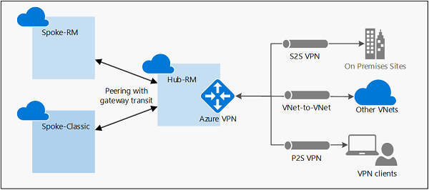
Configure VNet peering – Gateway Transit
Gateway transit allows spoke virtual networks to share the VPN gateway in the hub
Notes:
Configure VPN gateway transit for virtual network peering - Azure VPN Gateway | Microsoft Docs
https://docs.microsoft.com/azure/vpn-gateway/vpn-gateway-peering-gateway-transit
Gateway transit is a peering property that lets one virtual network use the VPN gateway in the peered virtual network for cross-premises or VNet-to-VNet connectivity.
The following diagram shows how gateway transit works with virtual network peering.
In the diagram, gateway transit allows the peered virtual networks to use the Azure VPN gateway in Hub-RM. Connectivity available on the VPN gateway, including S2S, P2S, and VNet-to-VNet connections, applies to all three virtual networks. The transit option is available for peering between the same, or different deployment models. If you are configuring transit between different deployment models, the hub virtual network and virtual network gateway must be in the Resource Manager deployment model, not the classic deployment model.

Slide 40
Determine Service Chaining Uses
Leverage user-defined routes and service chaining to implement custom routing
Implement a VNet hub with a network virtual appliance or a VPN gateway
VNet2
Hub VNet
Network Virtual Appliance or
VPN Gateway
Service chaining enables you to direct traffic from one virtual network to a virtual appliance, or virtual network gateway,
in a peered virtual network, through
user-defined routes
VNet3
Notes:
Distribute your services across Azure virtual networks and integrate them by using virtual network peering - https://docs.microsoft.com/learn/modules/integrate-vnets-with-vnet-peering

Slide 41
Lab - Implement Intersite Connectivity
Notes:
https://mslabs.cloudguides.com/en-us/guides/AZ-104%20Exam%20Guide%20-%20Microsoft%20Azure%20Administrator%20Exercise%209
AZ-104 Module 5 lab, no azure pass needed
Estimated timing: 30 minutes

Slide 42
Lab – Implement intersite connectivity
Lab scenario
Contoso has its datacenters in Boston, New York, and Seattle offices connected via a mesh wide-area network links, with full connectivity between them. You need to implement a lab environment that will reflect the topology of the Contoso's on-premises networks and verify its functionality
Objectives
Task 1:
Provision the lab environment
Task 2:
Configure local and global virtual network peering
Task 3:
Test intersite connectivity
Next slide for an architecture diagram
Notes:
LAB 05 - Implement Intersite Connectivity - ESTIMATED DURATION 30 MIN
GitHub Repository - https://microsoftlearning.github.io/AZ-104-MicrosoftAzureAdministrator/

Slide 43

Lab – Architecture diagram
Region1
Task 1
az104-05-rg1
az104-05-vnet0 10.50.0.0/22
Region2
Subnet0 10.50.0.0/24
Task 2, Task 3
az104-05-rg1
az104-05-vm0
10.50.0.4
Global Peering
az104-05-vnet2 10.52.0.0/22
Subnet0 10.52.0.0/24
az104-05-rg1
Local Peering
Global Peering
az104-05-vm2
10.52.0.4
Subnet0 10.51.0.0/24
az104-05-vm1
10.51.0.4
az104-05-vnet1 10.51.0.0/22

Slide 44
Configure VPN Connections
Notes:
AZ-700 Module 2
https://learn.microsoft.com/training/courses/AZ-700T00?WT.mc_id=ilt_partner_webpage_wwl&ocid=505933#study-guide

Slide 45




Determine VPN Gateway Uses
Azure
Point-to-Site
VNet 1
VNet 2
VNet-to-VNet
Local on-premises network
Site-to-Site
VNet-to-VNet connections connect Azure virtual networks – VNet peering or custom
Point-to-Site (User VPN) connections connect individual devices to Azure virtual networks
Site-to-Site connections connect on-premises datacenters to Azure
virtual networks
Notes:
What is VPN Gateway? - https://docs.microsoft.com/azure/vpn-gateway/vpn-gateway-about-vpngateways

Slide 46
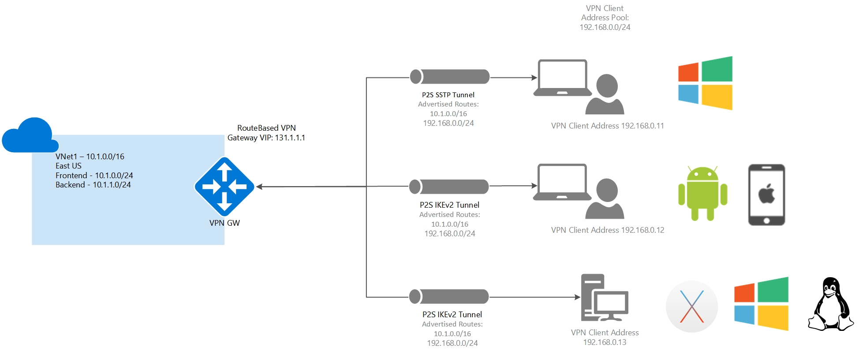
Point-to-site protocols
OpenVPN® Protocol
Secure Socket Tunneling Protocol (SSTP)
IKEv2 VPN
Notes:
Point-to-site VPN can use one of the following protocols:
OpenVPN® Protocol, an SSL/TLS based VPN protocol. A TLS VPN solution can penetrate firewalls, since most firewalls open TCP port 443 outbound, which TLS uses. OpenVPN can be used to connect from Android, iOS (versions 11.0 and above), Windows, Linux, and Mac devices (macOS versions 10.13 and above).
Secure Socket Tunneling Protocol (SSTP), a proprietary TLS-based VPN protocol. A TLS VPN solution can penetrate firewalls, since most firewalls open TCP port 443 outbound, which TLS uses. SSTP is only supported on Windows devices. Azure supports all versions of Windows that have SSTP (Windows 7 and later).
IKEv2 VPN, a standards-based IPsec VPN solution. IKEv2 VPN can be used to connect from Mac devices (macOS versions 10.11 and above).

Slide 47
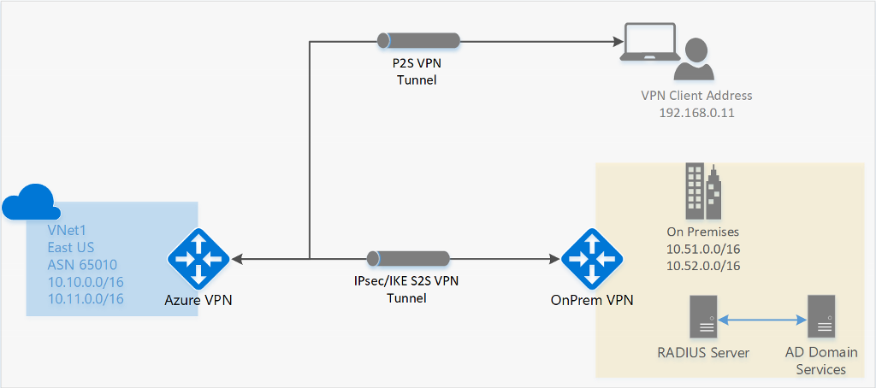
Point-to-site authentication methods
Azure certificate authentication
Native Azure Active Directory authentication
Active Directory (AD) Domain Server
Notes:
https://docs.microsoft.com/azure/vpn-gateway/point-to-site-about#authentication
Authenticate using native Azure certificate authentication
When using the native Azure certificate authentication, a client certificate on the device is used to authenticate the connecting user. Client certificates are generated from a trusted root certificate and then installed on each client computer. You can use a root certificate that was generated using an Enterprise solution, or you can generate a self-signed certificate.
The validation of the client certificate is performed by the VPN gateway and happens during establishment of the P2S VPN connection. The root certificate is required for the validation and must be uploaded to Azure.
Authenticate using native Azure Active Directory authentication
Azure AD authentication allows users to connect to Azure using their Azure Active Directory credentials. Native Azure AD authentication is only supported for OpenVPN protocol and Windows 10 and requires the use of the Azure VPN Client.
With native Azure AD authentication, you can leverage Azure AD's conditional access as well as Multi-Factor Authentication (MFA) features for VPN.
At a high level, you need to perform the following steps to configure Azure AD authentication:
Configure an Azure AD tenant
Enable Azure AD authentication on the gateway
Download and configure Azure VPN Client
Authenticate using Active Directory (AD) Domain Server
AD Domain authentication is a popular option because it allows users to connect to Azure using their organization domain credentials. It requires a RADIUS server that integrates with the AD server. Organizations can also leverage their existing RADIUS deployment.
The RADIUS server is deployed either on-premises or in your Azure VNet. During authentication, the Azure VPN Gateway passes authentication messages back and forth between the RADIUS server and the connecting device. Thus, the Gateway must be able to communicate with the RADIUS server. If the RADIUS server is present on-premises, then a VPN S2S connection from Azure to the on-premises site is required for reachability.
The RADIUS server can also integrate with AD certificate services. This lets you use the RADIUS server and your enterprise certificate deployment for P2S certificate authentication as an alternative to the Azure certificate authentication. Integrating the RADIUS server with AD certificate services means that you can do all your certificate management in AD, you don’t need to upload root certificates and revoked certificates to Azure.
A RADIUS server can also integrate with other external identity systems. This opens many authentication options for P2S VPN, including multi-factor options.

Slide 48
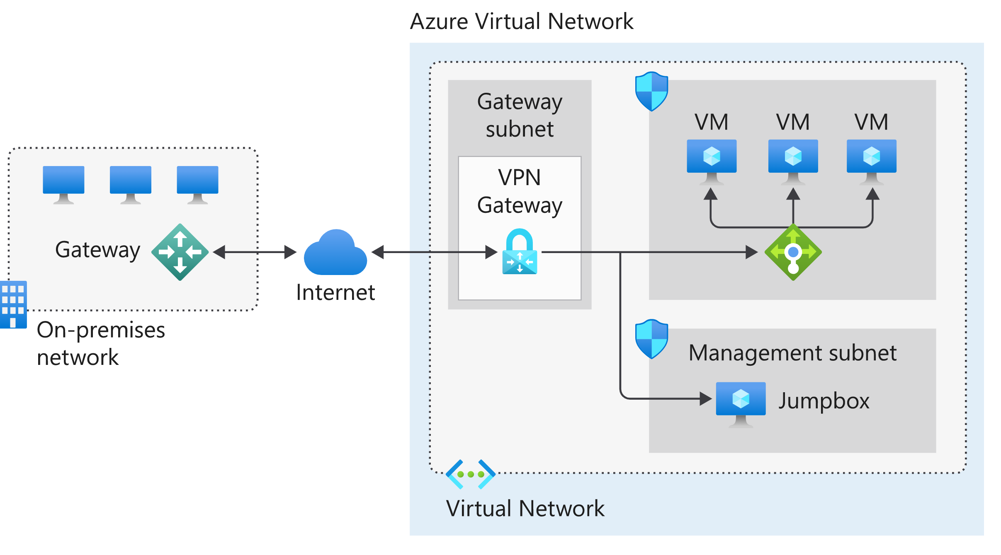
Site-to-site VPN connections
Notes:
https://azure.microsoft.com/blog/vnet-peering-and-vpn-gateways/
Choosing between Azure VNet Peering and VNet Gateways | Azure Blog and Updates | Microsoft Azure
Consider reviewing the S2S diagram in reference to what the student just created in the previous lesson before moving on to P2S
In the diagram:
The on-premises network represents your on-premises Active Directory and any data or resources.
The gateway is responsible for sending encrypted traffic to a virtual IP address when it uses a public connection.
The Azure virtual network holds all your cloud applications and any Azure VPN gateway components.
An Azure VPN gateway provides the encrypted link between the Azure virtual network and your on-premises network. An Azure VPN gateway is made up of these elements:
Virtual network gateway
Local network gateway
Connection
Gateway subnet
Cloud applications are the ones you've made available through Azure.
An internal load balancer, located in the front end, routes cloud traffic to the correct cloud-based application or resource.
Using this architecture offers several benefits, including:
Configuration and maintenance are simplified.
Having a VPN gateway helps ensure that all data and traffic are encrypted between the on-premises gateway and the Azure gateway.
The architecture can be scaled and extended to meet your organization's networking needs.
This architecture isn't applicable in all situations because it uses an existing internet connection as the link between the two gateway points. Bandwidth constraints can cause latency issues that result from reuse of the existing infrastructure.

Slide 49
Demonstration – VPN gateways
Explore the Gateway subnet blade
Explore the Connected Devices blade
Explore adding a virtual network gateway
Explore adding a connection between the virtual networks
Notes:
✔ Always consider having students walk-through the demonstrations themselves. Also, consider the overlap with the formal labs and your best use of time.
Either do the demonstration or walk-through the slides.

Slide 50
Create the Gateway Subnet
When you create your gateway subnet, gateway VMs are deployed to the gateway subnet and configured with the required VPN gateway settings
The gateway subnet contains the IP addresses; if possible, use a CIDR block of /28 or /27
Never deploy other resources (for example, additional VMs) to the gateway subnet

Slide 51
Create the VPN Gateway
Most VPN Gateways are Route-based
Your choice of gateway SKU affects the number of connections you can have and the aggregate throughput benchmark
Associate the virtual network that includes the Gateway Subnet – need a public IP address
It can take up to 45 minutes to provision the VPN gateway
Notes:
The next slide is hidden but has the SKU and Generation example table.
Route-based VPNs use routes in the IP forwarding or routing table to direct packets. Route-based has support for IKEv2 and can use dynamic routing protocols.
Policy-based VPNs encrypt and direct packets through IPsec tunnels based on the IPsec policies. Policy-based only supports IKEv1 which some legacy on-premises VPN devices still use.
Wikipedia – BGP - Border Gateway Protocol is a standardized exterior gateway protocol designed to exchange routing and reachability information among autonomous systems on the Internet.

Slide 52
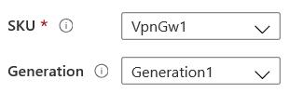
Determine Gateway SKU and Generation
Sampling of available SKUs
Gen | SKU | S2S/VNet-to-VNet Tunnels | P2S IKEv2 Connections | Throughput Benchmark
1 | VpnGw1/Az | Max. 30 | Max. 250 | 650 Mbps
1 | VpnGw2/Az | Max. 30 | Max. 500 | 1.0 Gbps
2 | VpnGw2/Az | Max. 30 | Max. 500 | 1.25 Gbps
1 | VpnGw3/Az | Max. 30 | Max. 1000 | 1.25 Gbps
2 | VpnGw3/Az | Max. 30 | Max. 1000 | 2.5 Gbps
2 | VpnGw4/Az | Max. 100 | Max. 5000 | 5.0 Gbps
2 | VpnGw5/Az | Max. 100 | Max. 10000 | 10.0 Gbps
The Gateway SKU
affects the connections
and the throughput
Resizing is allowed
within the generation
The Basic SKU
(not shown) is legacy
and should not be used
Notes:
About VPN Gateway configuration settings - https://docs.microsoft.com/azure/vpn-gateway/vpn-gateway-about-vpn-gateway-settings
Create a route-based VPN gateway using the Azure portal - https://docs.microsoft.com/azure/vpn-gateway/create-routebased-vpn-gateway-portal
This table is just a sample of the SKUs that are available. There are many more.

