Slide 1
Section 03:
Azure AD Identity, Access and Security
Notes:
Learn learning path: https://docs.microsoft.com/learn/paths/azure-fundamentals-describe-azure-architecture-services/

Slide 2

Section 03 – Outline
You will learn the following concepts:
Identity, Access, and Security
Configure Azure Active Directory (AAD)
Configure User and Group Accounts
Configure Role-Based Access Control
Notes:
Identity, Access, and Security (AZ-900)
https://learn.microsoft.com/en-us/training/modules/describe-azure-identity-access-security/
Configure Azure Active Directory (AAD) (AZ-104)
https://learn.microsoft.com/en-us/training/modules/configure-azure-active-directory/
Configure User and Group Accounts (AZ-104)
https://learn.microsoft.com/en-us/training/modules/configure-user-group-accounts/
Configure Role-Based Access Control (AZ-104)
https://learn.microsoft.com/en-us/training/modules/configure-role-based-access-control/

Slide 3

Identity, Access, and Security
Notes:
https://docs.microsoft.com/learn/modules/describe-azure-identity-access-security
Note: This content is from Learning Path 02 AZ-900

Slide 4

Azure Active Directory (AAD)
Azure Active Directory (AAD) is Microsoft Azure’s cloud-based identity and access management service.
  Authentication (employees sign-in to access resources).
  Single sign-on (SSO).
  Application management.
  Business to Business (B2B).
  Business to Customer (B2C) identity services.
  Device management.
Notes:
https://docs.microsoft.com/learn/modules/describe-azure-identity-access-security/2-directory-services
Azure AD - https://azure.microsoft.com/en-us/services/active-directory/
Azure tenant
A dedicated and trusted instance of Azure AD that's automatically created when your organization signs up for a Microsoft cloud service subscription, such as Microsoft Azure, Microsoft Intune, or Office 365. An Azure tenant represents a single organization.
Azure AD directory
Each Azure tenant has a dedicated and trusted Azure AD directory. The Azure AD directory includes the tenant's users, groups, and apps and is used to perform identity and access management functions for tenant resources.
When you secure identities on-premises with Active Directory, Microsoft doesn't monitor sign-in attempts. When you connect Active Directory with Azure AD, Microsoft can help protect you by detecting suspicious sign-in attempts at no extra cost. For example, Azure AD can detect sign-in attempts from unexpected locations or unknown devices.
Consider enabling single sign-on access. Enable SSO access for your users to connect to the cloud or use on-premises apps. Azure AD SSO supports Microsoft 365 and thousands of SaaS apps, such as UNiFlow online.

Slide 5
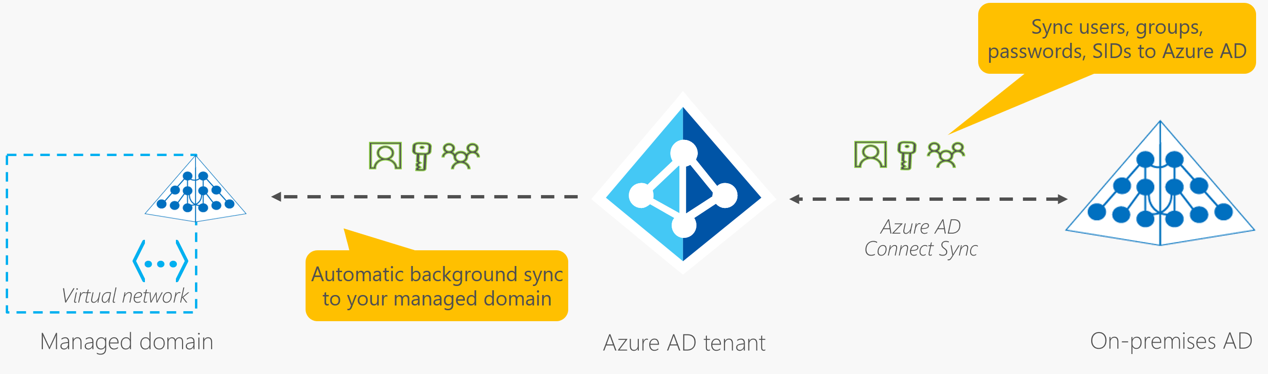
Azure Active Directory Domain Services (Azure AD DS)
Gain the benefit of cloud-based domain services without managing domain controllers
Run legacy applications (that can’t use modern auth standards) in the cloud
Automatically sync from Azure AD
Notes:
https://docs.microsoft.com/learn/modules/describe-azure-identity-access-security/2-directory-services
Azure AD - https://azure.microsoft.com/en-us/services/active-directory/
Azure Active Directory Domain Services (Azure AD DS) is a service that provides managed domain services such as domain join, group policy, lightweight directory access protocol (LDAP), and Kerberos/NTLM authentication. Just like Azure AD lets you use directory services without having to maintain the infrastructure supporting it, with Azure AD DS, you get the benefit of domain services without the need to deploy, manage, and patch domain controllers (DCs) in the cloud.
An Azure AD DS managed domain lets you run legacy applications in the cloud that can't use modern authentication methods, or where you don't want directory lookups to always go back to an on-premises AD DS environment. You can lift and shift those legacy applications from your on-premises environment into a managed domain, without needing to manage the AD DS environment in the cloud.
Azure AD DS integrates with your existing Azure AD tenant. This integration lets users sign into services and applications connected to the managed domain using their existing credentials. You can also use existing groups and user accounts to secure access to resources. These features provide a smoother lift-and-shift of on-premises resources to Azure.
When you create an Azure AD DS managed domain, you define a unique namespace. This namespace is the domain name. Two Windows Server domain controllers are then deployed into your selected Azure region. This deployment of DCs is known as a replica set.
You don't need to manage, configure, or update these DCs. The Azure platform handles the DCs as part of the managed domain, including backups and encryption at rest using Azure Disk Encryption.
A managed domain is configured to perform a one-way synchronization from Azure AD to Azure AD DS. You can create resources directly in the managed domain, but they aren't synchronized back to Azure AD. In a hybrid environment with an on-premises AD DS environment, Azure AD Connect synchronizes identity information with Azure AD, which is then synchronized to the managed domain.

Slide 6



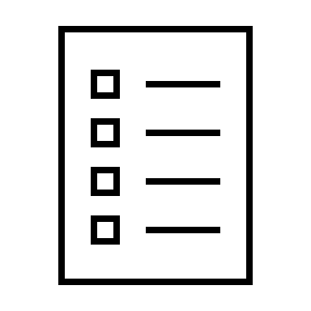





Compare Authentication and Authorization
Authentication
Identifies the person or service seeking access to a resource.
Requests legitimate access credentials.
Basis for creating secure identity and access control principles.
Authorization
Determines an authenticated person’s or service’s level of access.
Defines which data they can access, and what they can do with it.
Notes:
https://docs.microsoft.com/learn/modules/describe-azure-identity-access-security/3-authentication-methods
✔️Authentication is sometimes shortened to AuthN, and authorization is sometimes shortened to AuthZ.
Authentication
Identifies the person or service seeking access to a resource.
Requests legitimate access credentials.
Basis for creating secure identity and access control principles.
Authorization
Determines an authenticated person’s or service’s level of access.
Defines which data they can access, and what they can do with it.

Slide 7
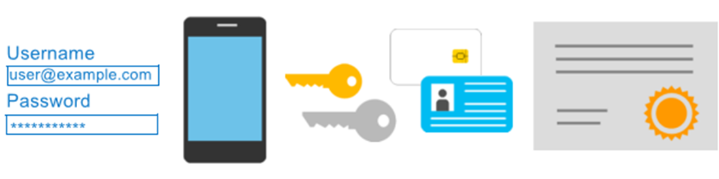
Azure Multi-Factor Authentication
Provides additional security for your identities by requiring two or more elements for full authentication.
  Something you know ←→ Something you possess ←→ Something you are
Notes:
https://docs.microsoft.com/learn/modules/describe-azure-identity-access-security/3-authentication-methods
Discuss what could qualify for each of the items listed
Something you know: This could be a password or the answer to a security question.
Something you possess: This might be a mobile app that receives a notification, or a token-generating device.
Something you are: This is typically some sort of biometric property, such as a fingerprint or face scan used on many mobile devices.
MFA - https://docs.microsoft.com/en-us/azure/active-directory/authentication/concept-mfa-howitworks
The FIDO (Fast IDentity Online) Alliance helps to promote open authentication standards and reduce the use of passwords as a form of authentication. FIDO2 is the latest standard that incorporates the web authentication (WebAuthn) standard.
FIDO2 security keys are an unphishable standards-based passwordless authentication method that can come in any form factor. Fast Identity Online (FIDO) is an open standard for passwordless authentication. FIDO allows users and organizations to leverage the standard to sign-in to their resources without a username or password by using an external security key or a platform key built into a device.
Users can register and then select a FIDO2 security key at the sign-in interface as their main means of authentication. These FIDO2 security keys are typically USB devices, but could also use Bluetooth or NFC. With a hardware device that handles the authentication, the security of an account is increased as there's no password that could be exposed or guessed.

Slide 8
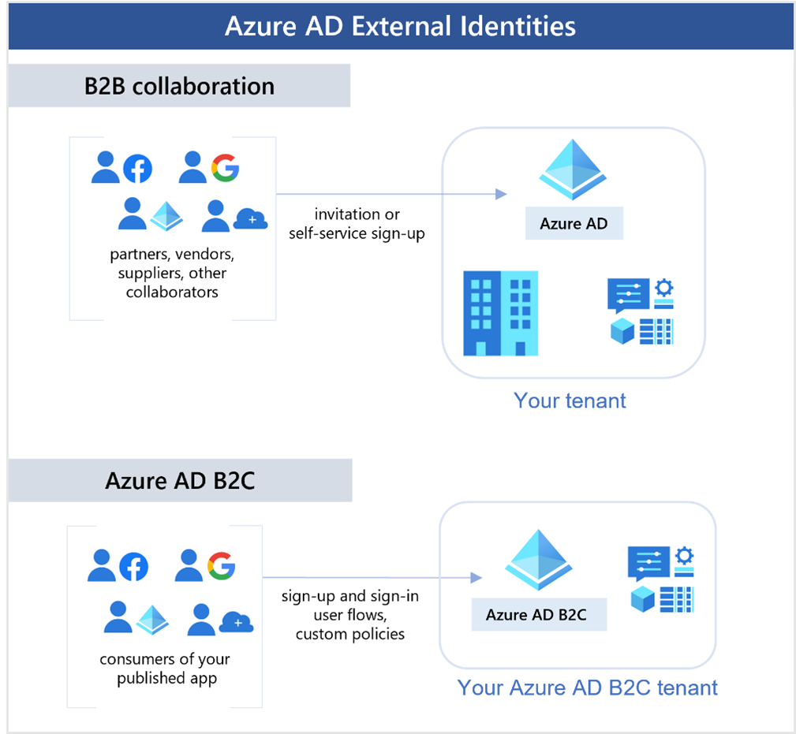
External Identities B2B
Notes:
https://docs.microsoft.com/learn/modules/describe-azure-identity-access-security/4-external-identities
Business to business (B2B) collaboration
Collaborate with external users by letting them use their preferred identity to sign-in to your Microsoft applications or other enterprise applications (SaaS apps, custom-developed apps, etc.). B2B collaboration users are represented in your directory, typically as guest users.
B2B direct connect
Establish a mutual, two-way trust with another Azure AD organization for seamless collaboration. B2B direct connect currently supports Teams shared channels, enabling external users to access your resources from within their home instances of Teams. B2B direct connect users aren't represented in your directory, but they're visible from within the Teams shared channel and can be monitored in Teams admin center reports.

Slide 9
External Identities B2C
Notes:
https://docs.microsoft.com/learn/modules/describe-azure-identity-access-security/4-external-identities
Azure AD business to customer (B2C)
Publish modern SaaS apps or custom-developed apps (excluding Microsoft apps) to consumers and customers, while using Azure AD B2C for identity and access management.

Slide 10
Azure AD SSO integration with uniFLOW Online
1. Add uniFLOW Online from the gallery
2. Configure and test Azure AD SSO for uniFLOW Online
3. Configure Azure AD SSO
4. Configure uniFLOW Online SSO
Notes:
https://learn.microsoft.com/en-us/azure/active-directory/saas-apps/uniflow-online-tutorial
Please review the document:
Azure AD SSO integration with uniFLOW Online.docx

Slide 11
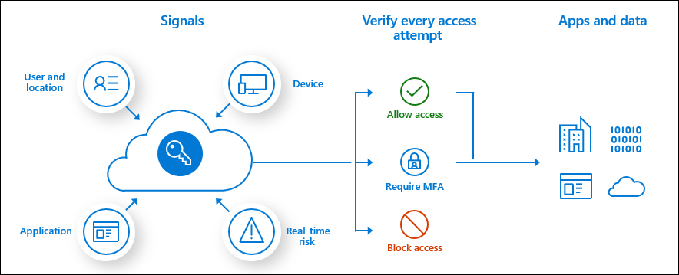
Conditional Access
Conditional Access is used by Azure Active Directory to bring signals together, to make decisions, and enforce organizational policies.
User or Group Membership
IP Location
Device
Application
Risk Detection
Notes:
https://docs.microsoft.com/learn/modules/describe-azure-identity-access-security/5-conditional-access
https://docs.microsoft.com/en-us/azure/active-directory/conditional-access/overview
Based on identity signals. These signals include who the user is, where the user is, and what device the user is requesting access from.
The modern security perimeter now extends beyond an organization's network to include user and device identity. Organizations can utilize these identity signals as part of their access control decisions.
Conditional Access is the tool used by Azure Active Directory to bring signals together, to make decisions, and enforce organizational policies. Conditional Access is at the heart of the new identity driven control plane.
Conditional Access policies at their simplest are if-then statements, if a user wants to access a resource, then they must complete an action. Example: A payroll manager wants to access the payroll application and is required to perform multi-factor authentication to access it.
Administrators are faced with two primary goals:
Empower users to be productive wherever and whenever
Protect the organization's assets
By using Conditional Access policies, you can apply the right access controls when needed to keep your organization secure and stay out of your user's way when not needed.

Slide 12






Azure role-based access control (Azure RBAC)
Fine-grained access management.
Segregate duties within the team and grant only the amount of access to users that they need to perform their jobs.
Enables access to the Azure portal and controlling access to resources.
Azure
Active Directory
Azure
subscription
User
Apps
User groups
Resource group
Resource group
Notes:
https://docs.microsoft.com/learn/modules/describe-azure-identity-access-security/6-role-based-access-control
Azure RBAC - https://docs.microsoft.com/en-us/azure/role-based-access-control/overview
Azure RBAC uses an allow model. When you're assigned a role, Azure RBAC allows you to perform actions within the scope of that role. If one role assignment grants you read permissions to a resource group and a different role assignment grants you write permissions to the same resource group, you have both read and write permissions on that resource group.

Slide 13
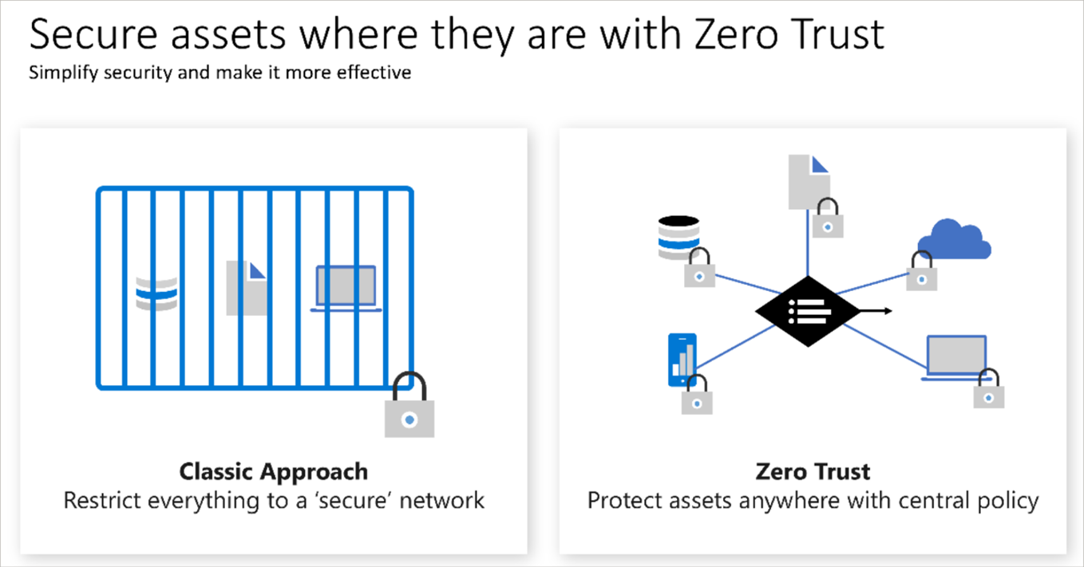
Zero Trust
Notes:
https://docs.microsoft.com/learn/modules/describe-azure-identity-access-security/7-describe-zero-trust-model
Zero Trust is a security model that assumes the worst case scenario and protects resources with that expectation. Zero Trust assumes breach at the outset, and then verifies each request as though it originated from an uncontrolled network.
Today, organizations need a new security model that effectively adapts to the complexity of the modern environment; embraces the mobile workforce: and protects people, devices, applications, and data wherever they're located.
To address this new world of computing, Microsoft highly recommends the Zero Trust security model, which is based on these guiding principles:
Verify explicitly - Always authenticate and authorize based on all available data points.
Use least privilege access - Limit user access with Just-In-Time and Just-Enough-Access (JIT/JEA), risk-based adaptive policies, and data protection.
Assume breach - Minimize blast radius and segment access. Verify end-to-end encryption. Use analytics to get visibility, drive threat detection, and improve defenses.

Slide 14
Defense in depth
Physical Security
A layered approach to securing computer systems.
Provides multiple levels of protection.
Attacks against one layer are isolated from subsequent layers.
Identity & Access
Perimeter
Network
Compute
Application
Data
Notes:
https://docs.microsoft.com/learn/modules/describe-azure-identity-access-security/8-describe-defense-depth
Physical security
Physically securing access to buildings and controlling access to computing hardware within the datacenter are the first line of defense.
With physical security, the intent is to provide physical safeguards against access to assets. These safeguards ensure that other layers can't be bypassed, and loss or theft is handled appropriately. Microsoft uses various physical security mechanisms in its cloud datacenters.
Identity and access
The identity and access layer is all about ensuring that identities are secure, that access is granted only to what's needed, and that sign-in events and changes are logged.
At this layer, it's important to:
Control access to infrastructure and change control.
Use single sign-on (SSO) and multifactor authentication.
Audit events and changes.
Perimeter
The network perimeter protects from network-based attacks against your resources. Identifying these attacks, eliminating their impact, and alerting you when they happen are important ways to keep your network secure.
At this layer, it's important to:
Use DDoS protection to filter large-scale attacks before they can affect the availability of a system for users.
Use perimeter firewalls to identify and alert on malicious attacks against your network.
Network
At this layer, the focus is on limiting the network connectivity across all your resources to allow only what's required. By limiting this communication, you reduce the risk of an attack spreading to other systems in your network.
At this layer, it's important to:
Limit communication between resources.
Deny by default.
Restrict inbound internet access and limit outbound access where appropriate.
Implement secure connectivity to on-premises networks.
Compute
Malware, unpatched systems, and improperly secured systems open your environment to attacks. The focus in this layer is on making sure that your compute resources are secure and that you have the proper controls in place to minimize security issues.
At this layer, it's important to:
Secure access to virtual machines.
Implement endpoint protection on devices and keep systems patched and current.
Application
Integrating security into the application development lifecycle helps reduce the number of vulnerabilities introduced in code. Every development team should ensure that its applications are secure by default.
At this layer, it's important to:
Ensure that applications are secure and free of vulnerabilities.
Store sensitive application secrets in a secure storage medium.
Make security a design requirement for all application development.
Data
Those who store and control access to data are responsible for ensuring that it's properly secured. Often, regulatory requirements dictate the controls and processes that must be in place to ensure the confidentiality, integrity, and availability of the data.
In almost all cases, attackers are after data:
Stored in a database.
Stored on disk inside virtual machines.
Stored in software as a service (SaaS) applications, such as Office 365.
Managed through cloud storage.

Slide 15
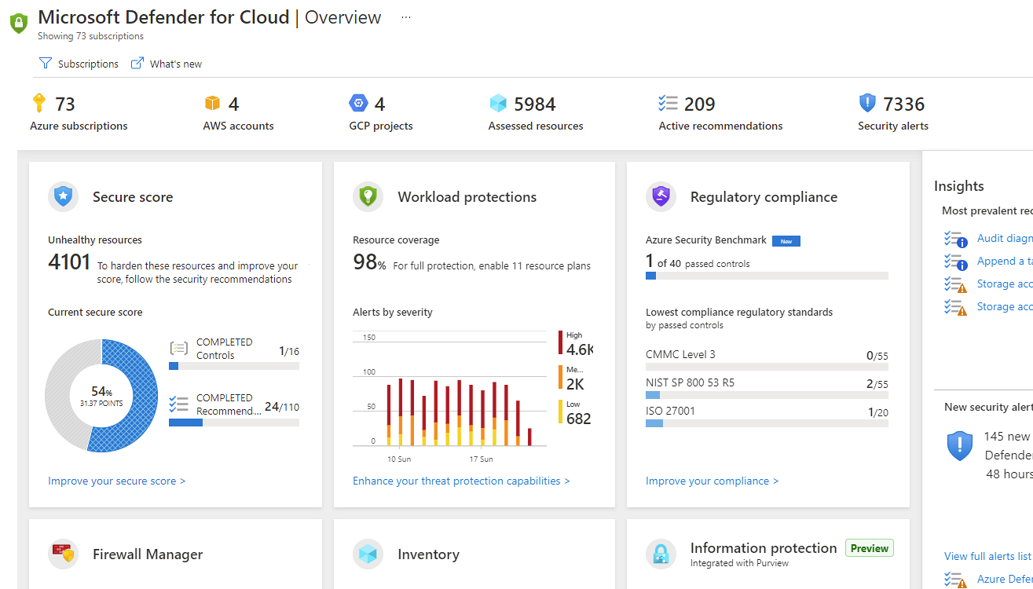
Microsoft Defender for Cloud
Microsoft Defender for Cloud is a monitoring service that provides threat protection across both Azure and on-premises datacenters.
Provides security recommendations
Detect and block malware
Analyze and identify potential attacks
Just-in-time access control for ports
Notes:
https://docs.microsoft.com/learn/modules/describe-azure-identity-access-security/9-describe-microsoft-defender-for-cloud
A monitoring tool for security posture management and threat protection. It monitors your cloud, on-premises, hybrid, and multicloud environments to provide guidance and notifications aimed at strengthening your security posture.
Microsoft Defender for Cloud is a unified infrastructure security management system that strengthens the security posture of your data centers and provides advanced threat protection across your hybrid workloads in the cloud - whether they're in Azure or not - as well as on premises.
Strengthen security posture: Defender for Cloud assesses your environment and enables you to understand the status of your resources, and whether they are secure.
Protect against threats: Defender for Cloud assesses your workloads and raises threat prevention recommendations and security alerts.
Get secure faster: In Defender for Cloud, everything is done in cloud speed. Because it is natively integrated, deployment is easy, providing you with auto-provisioning and protection with Azure services.
Policy compliance Defender for Cloud is built on top of Azure Policy controls so you can set and monitor your policies to run on management groups, across subscriptions, and even for a whole tenant.
Security alerts Defender for Cloud automatically collects, analyzes, and integrates log data from your Azure resources like firewall and endpoint protection to detect real threats. Then list of prioritized security alerts is shown in Microsoft Defender for Cloud along with the information you need to quickly investigate and remediate an attack.
Secure score Defender for Cloud continually assesses your resources for security issues; then aggregates all the findings into a single score so that you can tell your current security situation.
Microsoft Defender for Cloud - https://azure.microsoft.com/services/defender-for-cloud/

Slide 16
Configure Azure Active Directory

Slide 17



Configure Azure AD Device Identities
Azure AD registered devices | Azure AD joined devices | Hybrid Azure AD joined devices
Supports Bring Your Own Device Registered devices sign-in using a Microsoft account Attached to an Azure AD account granting access to resources Control using Mobile Device Management (MDM) tools like Microsoft Intune OS – Windows 10⁺, iOS, Android, and MacOS | Intended for cloud-first or cloud-only organizations Organization-owned devices Joined only to Azure AD - organizational account required Can use Conditional Access policies OS – Windows 10⁺ devices | You have Win32 apps deployed to these devices using Active Directory machine authentication You want to continue to use Group Policy to manage the device You want to use existing image solutions to deploy devices OS - Windows 7⁺ devices
Notes:
This slide used to just be only about Azure AD Join.
Azure AD registered devices - https://docs.microsoft.com/azure/active-directory/devices/concept-azure-ad-register
Azure AD joined devices - https://docs.microsoft.com/azure/active-directory/devices/concept-azure-ad-join
Hybrid Azure AD joined devices - https://docs.microsoft.com/azure/active-directory/devices/concept-azure-ad-join-hybrid

Slide 18
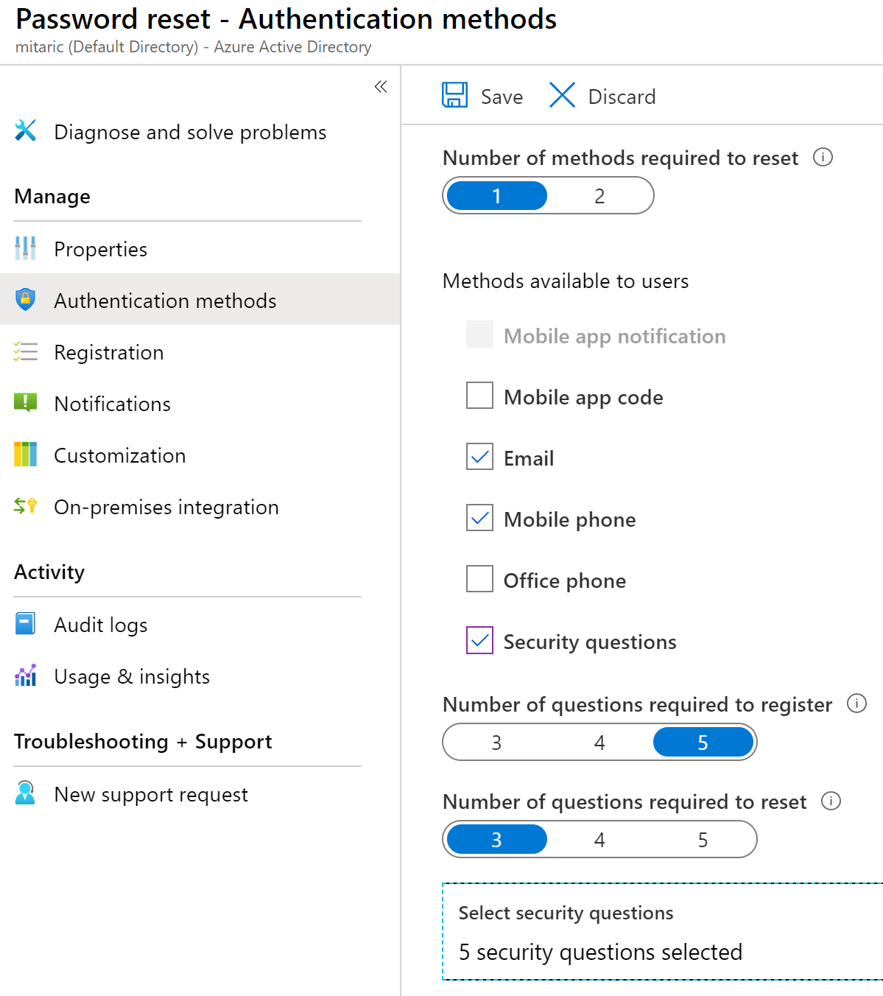
Implement Self-Service Password Reset
Determine who can use self-service password reset
1
2
Choose the number of authentication methods required and the methods available (email, phone, questions)
3
You can require users to register for SSPR (same process as MFA)
Notes:
Plan an Azure Active Directory self-service password reset deployment - https://docs.microsoft.com/azure/active-directory/authentication/howto-sspr-deployment

Slide 19
Configure User and Group Accounts

Slide 20
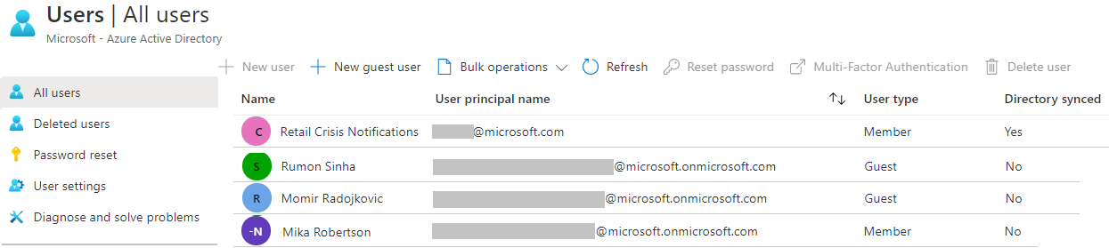
Create User Accounts
All users must
have an account
The account is used for authentication and authorization
Each user account has additional properties
Notes:
✔️ Have you given any thought as to the type of users you will need?

Slide 21
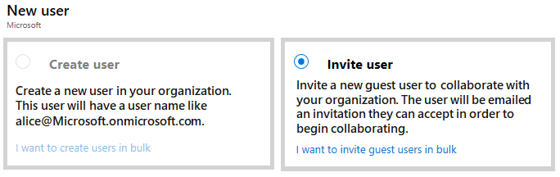
Manage User Accounts
Must be Global Administrator or User Administrator to manage users
User profile
(picture, job, contact info) is optional
Deleted users
can be restored
for 30 days
Sign in and audit
log information
is available
Notes:
Add or delete users using Azure Active Directory - https://docs.microsoft.com/azure/active-directory/fundamentals/add-users-azure-active-directory

Slide 22
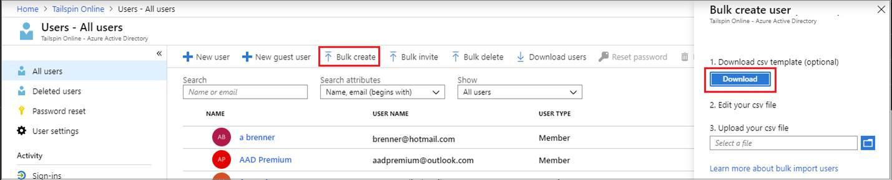
Perform bulk account updates
Azure AD supports bulk user and group member updates
Create the comma-separated values (CSV) template you can download from the Portal
Must be signed in as a Global administrator or User administrator
Notes:
The latest JTA (Jan 2022) now states, Perform bulk updates. Previously this was just bulk user accounts.
Bulk create users in Azure Active Directory - https://docs.microsoft.com/azure/active-directory/users-groups-roles/users-bulk-add
Bulk add group members in Azure Active Directory - https://docs.microsoft.com/azure/active-directory/enterprise-users/groups-bulk-import-members
✔️ Establish or implement a naming convention for usernames, display names and aliases. The password for the new users needs to conform to the password complexity rules you have set for your directory. User parameters include User Principal Name, Display Name, Given Name, Department, and Job Title.

Slide 23
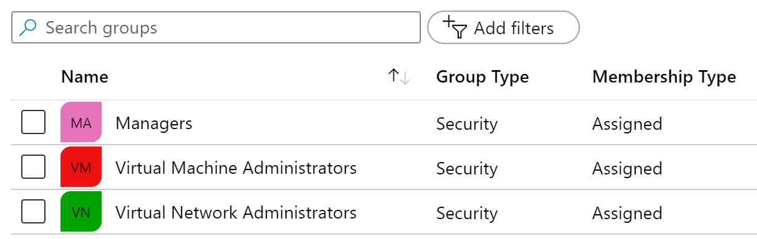
Create Group Accounts
Group Types
Security groups
Microsoft 365 groups
Assignment Types
Assigned
Dynamic User
Dynamic Device (Security groups only)
Notes:
Manage app and resource access using Azure Active Directory groups – https://docs.microsoft.com/azure/active-directory/fundamentals/active-directory-manage-groups
Quickstart: View your organization's groups and members in Azure Active Directory - https://docs.microsoft.com/azure/active-directory/fundamentals/active-directory-groups-view-azure-portal
✔️ Have you given any thought to which groups you need to create? How will you assign users to groups?

Slide 24
Demonstration – Users and Groups
Determine domain information
Explore user accounts
Explore group accounts
Explore PowerShell for group management
Notes:
✔ Always consider having students walk-through the demonstrations themselves. Also, consider the overlap with the formal labs and your best use of time.
Use the Demonstration in the MCT DLC, or one of the Quickstart tutorials.
Add or delete users using Azure Active Directory - https://docs.microsoft.com/azure/active-directory/fundamentals/add-users-azure-active-directory
Create a basic group and add members using Azure Active Directory - https://docs.microsoft.com/azure/active-directory/fundamentals/active-directory-groups-create-azure-portal

Slide 25
Lab - Manage Azure Active Directory Identities
Notes:
https://mslabs.cloudguides.com/en-us/guides/AZ-104%20Exam%20Guide%20-%20Microsoft%20Azure%20Administrator%20Exercise%201
AZ-104 Module 1 lab, no azure pass needed
Estimated timing: 30 minutes

Slide 26
Lab – Manage Azure Active Directory Identities
Lab scenario
In order to allow Contoso users to authenticate by using Azure AD, you have been tasked with provisioning users and group accounts. Membership of the groups should be updated automatically based on the user job titles. You also need to create a test Azure AD tenant with a test user account and grant that account limited permissions to resources in the Contoso Azure subscription.
Objectives
Task 1:
Create and configure Azure AD users
Task 2:
Create Azure AD groups with assigned and dynamic membership
Task 3:
Create an Azure Active Directory (AD) tenant
Task 4:
Manage Azure AD guest users
Next slide for an architecture diagram
Notes:
LAB 01 - Manage Azure Active Directory Identities -
AZ-104 Lab Repository - https://microsoftlearning.github.io/AZ-104-MicrosoftAzureAdministrator/

Slide 27


Lab – Architecture diagram
Task 1, Task 2
Task 3
Default Azure AD tenant
IT Cloud Administrators
Membership type: Dynamic User
IT System Administrators
Membership type: Dynamic User
New Azure AD tenant
Contoso Lab
Cloud user
Cloud user
az104-01a-aaduser1
Role: User administrator
Job title: Cloud Administrator
Department: IT
az104-01a-aaduser2
Job title: System Administrator
Department: IT
Cloud user
az104-01b-aaduser1
Job title: System Administrator
Department: IT
IT Lab Administrators
Membership type: Assigned
Task 4
Guest user
az104-01b-aaduser1
Job title: Lab Administrator
Department: IT

Slide 28
Configure Role-Based Access Control

Slide 29

Compare Azure RBAC Roles to Azure AD Roles
RBAC roles provide fine-grained access management
Azure RBAC roles | Azure AD roles
Manage access to Azure resources | Manage access to Azure AD objects
Scope can be specified at multiple levels | Scope is at the tenant level
Role information can be accessed in the Azure portal, Azure CLI, Azure PowerShell, Azure Resource Manager templates, REST API | Role information can be accessed in Azure portal, Microsoft 365 admin portal, Microsoft Graph, Azure Active Directory PowerShell for Graph
There are many built-in roles, or you can create your own custom role

Slide 30
Implement Role-Based Access Control
Provides fine-grained access management
of resources in Azure​
Concepts​
Built on Azure Resource Manager
Segregate duties within your team ​
Grant only the amount of access to users that they need to perform their jobs​
Security principal. Object that represents something that is requesting access to resources​
Role definition. Collection of permissions that lists the operations that can be performed​
Scope. Boundary for the level of access that is requested​
  Assignment. Attaching a role definition to a security principal at a particular scope​:
    Users can grant access described in a role definition by creating an assignment​
    Deny assignments are currently read-only and are set by Azure Blueprints and Azure Managed Apps
Notes:
What is role-based access control (RBAC) for Azure resources? - https://docs.microsoft.com/azure/role-based-access-control/overview

Slide 31
Determine Azure RBAC Roles
RBAC role in Azure | Permissions | Notes
Owner | Has full access to all resources and can delegate access to others | The Service Administrator and Co-Administrators are assigned the Owner role at the subscription scope. This applies to all resource types
Contributor | Creates and manages all types of Azure resources but cannot grant access to others | This applies to all resource types
Reader | Views Azure resources | This applies to all resource types
User Access Administrator | Manages user access to Azure resources | This applies to managing access, rather than to managing resources
Notes:
Custom roles for Azure resources - https://docs.microsoft.com/azure/role-based-access-control/custom-roles

Slide 32
Create a Role Definition
Collection of permissions that lists the operations that can be performed
Contributor
Owner
Contributor
Reader
…
Backup Operator
Security Reader
User Access Administrator
Virtual Machine Contributor
"Actions": [
"*"
],
"NotActions" : [
"Authorization/*/Delete",
"Authorization/*/Write",
"Authorization/elevateAccess/Action"
],
"DataActions" : [],
"NotDataActions": [],
"AssignableScopes" : [
"/"
]
Built-in
Reader Support Tickets
Virtual Machine Operator
Custom
Notes:
List role definitions in Azure RBAC - https://docs.microsoft.com/azure/role-based-access-control/role-definitions-list
Create custom roles for Azure resources with role-based access control - https://docs.microsoft.com/learn/modules/create-custom-azure-roles-with-rbac/

Slide 33
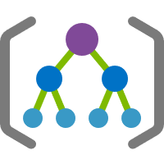



Create a Role Assignment
Process of binding a role definition to a user, group, or service principal at a
scope for the purpose of granting access
1
Security principal
User
Group
Service principal
2
Role definition
Role assignment
3
Scope
Owner
Contributor
Reader
…
Backup Operator
Security Reader
Contributor
"Actions": [
"*"
],
"NotActions": [
"Auth/*/Delete",
"Auth/*/Write",
"Auth/elevate"
]
Management group
Marketing group
Subscription
Resource group
Pharma-sales
Resource group
Reader Support Tickets
Virtual Machine Operator
Contributor
Resource
Notes:
Add or remove role assignments using Azure RBAC and the Azure portal - https://docs.microsoft.com/azure/role-based-access-control/role-assignments-portal
Explain that the role assignment completes the process of implementing RBAC and combining service principals, a role definition, and a scope.

Slide 34





Apply RBAC Authentication
Azure AD
Admin roles
Azure Active
Directory tenant
Global admin
Application admin
Application developer
Billing admin
…
Global admin/User access admin (elevated access)
Root
Azure RBAC
roles
Root management group
Owner
Contributor
Reader
User access admin
…
Management
group
Subscription
Azure RBAC
roles
Resource group
Azure account
Owner
Contributor
Reader
User access admin
…
Resource
Notes:
Manage access to an Azure subscription by using Azure role-based access control - https://docs.microsoft.com/learn/modules/manage-subscription-access-azure-rbac/3-elevate-your-access-user-access-admin

Slide 35
Demonstration – Azure RBAC
Locate the Access Control blade
Review role permissions
Add a role assignment
Explore PowerShell commands
Notes:
✔ Always consider having students walk-through the demonstrations themselves. Also, consider the overlap with the formal labs and your best use of time.
Use the Demonstration in the MCT DLC or one of the tutorials.
Tutorial: Grant a user access to Azure resources using the Azure portal - https://docs.microsoft.com/azure/role-based-access-control/quickstart-assign-role-user-portal
Quickstart: Check access for a user to Azure resources - https://docs.microsoft.com/azure/role-based-access-control/check-access

Slide 36
Lab - Manage Subscriptions and RBAC
Notes:
https://mslabs.cloudguides.com/en-us/guides/AZ-104%20Exam%20Guide%20-%20Microsoft%20Azure%20Administrator%20Exercise%202
AZ-104 Module 2a lab, no azure pass needed
Estimated timing: 30 minutes

Slide 37
Lab – Manage Subscriptions and Azure RBAC
Lab scenario
To improve the management of Azure resources in Contoso, you have been tasked with implementing the following functionality:
Using management groups for the Contoso’s Azure subscriptions
Granting user permissions for submitting support requests. This user would only be able to create support request tickets and view resource groups
Objectives
Task 1:
Implement Management Groups
Task 2:
Create custom RBAC roles
Task 3:
Assign RBAC roles
Next slide for an architecture diagram
Notes:
LAB 02a - Manage Subscriptions and RBAC - ESTIMATED DURATION 30 MIN
Lab Repository - https://microsoftlearning.github.io/AZ-104-MicrosoftAzureAdministrator/

Slide 38



Lab – Architecture diagram
Task 1
Tenant Root Group
Default Azure AD tenant
az104-02-rg1
Task 2
Task 3
az104-02a-customRoleDefinition.json
{
"Name": "Support Request Contributor (Custom)",
"IsCustom": true,
"Description": "Allows to create support requests",
"Actions": [
"Microsoft.Resources/subscriptions/resourceGroups/read",
"Microsoft.Support/*"
],
"NotActions": [
],
"AssignableScopes": [
"/providers/Microsoft.Management/managementGroups/az104-02-mg1",
"/subscriptions/SUBSCRIPTION_ID"
]
}
Azure pass subscription
az104-02-aaduser1
customRoleDefinition

