Slide 1
Section 02: Azure Architecture and Services
Notes:
Learn learning path: https://docs.microsoft.com/learn/paths/azure-fundamentals-describe-azure-architecture-services/

Slide 2
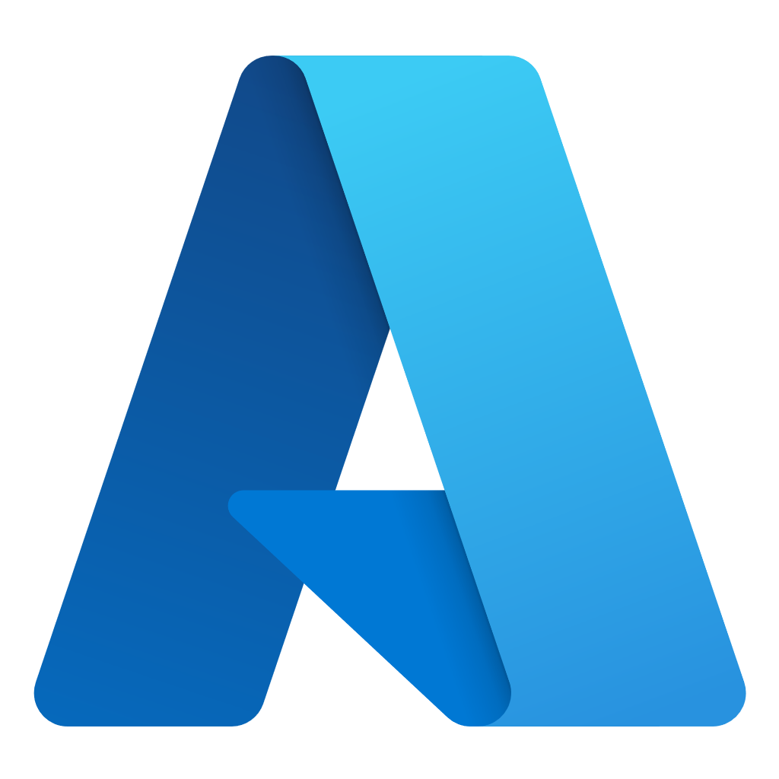
Section 02 – Outline
You will learn the following concepts:
Azure Architectural Components
Compute and Networking
Storage
Monitoring Tools
Management and Deployment Tools
Notes:
Azure Architectural Components (AZ-900)
https://learn.microsoft.com/en-us/training/modules/describe-core-architectural-components-of-azure/
Compute and Networking (AZ-900)
https://learn.microsoft.com/en-us/training/modules/describe-azure-compute-networking-services/
Storage (AZ-900)
https://learn.microsoft.com/en-us/training/modules/describe-azure-storage-services/
Monitoring Tools (AZ-900)
https://learn.microsoft.com/en-us/training/modules/describe-monitoring-tools-azure/
Management and Deployment Tools (AZ-900)
https://learn.microsoft.com/en-us/training/modules/describe-features-tools-manage-deploy-azure-resources/2-describe-interacting-azure

Slide 3
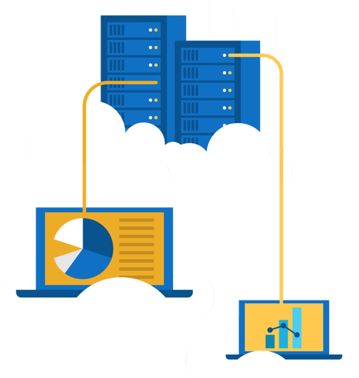
Exercise – Explore the Learn sandbox
Explore the Learn sandbox
Activate the sandbox
Use PowerShell
Shift to BASH
Shift to Azure Interactive mode
Navigate the portal
Notes:
https://docs.microsoft.com/learn/modules/describe-core-architectural-components-of-azure/4-exercise-explore-learn-sandbox
NOTE: The Learn Sandbox doesn’t require an Azure account, it will work with a Microsoft Account, if you skipped the previous walkthrough.
Az interactive

Slide 4
Azure architectural components
Notes:
https://docs.microsoft.com/learn/modules/describe-core-architectural-components-of-azure/1-introduction

Slide 5
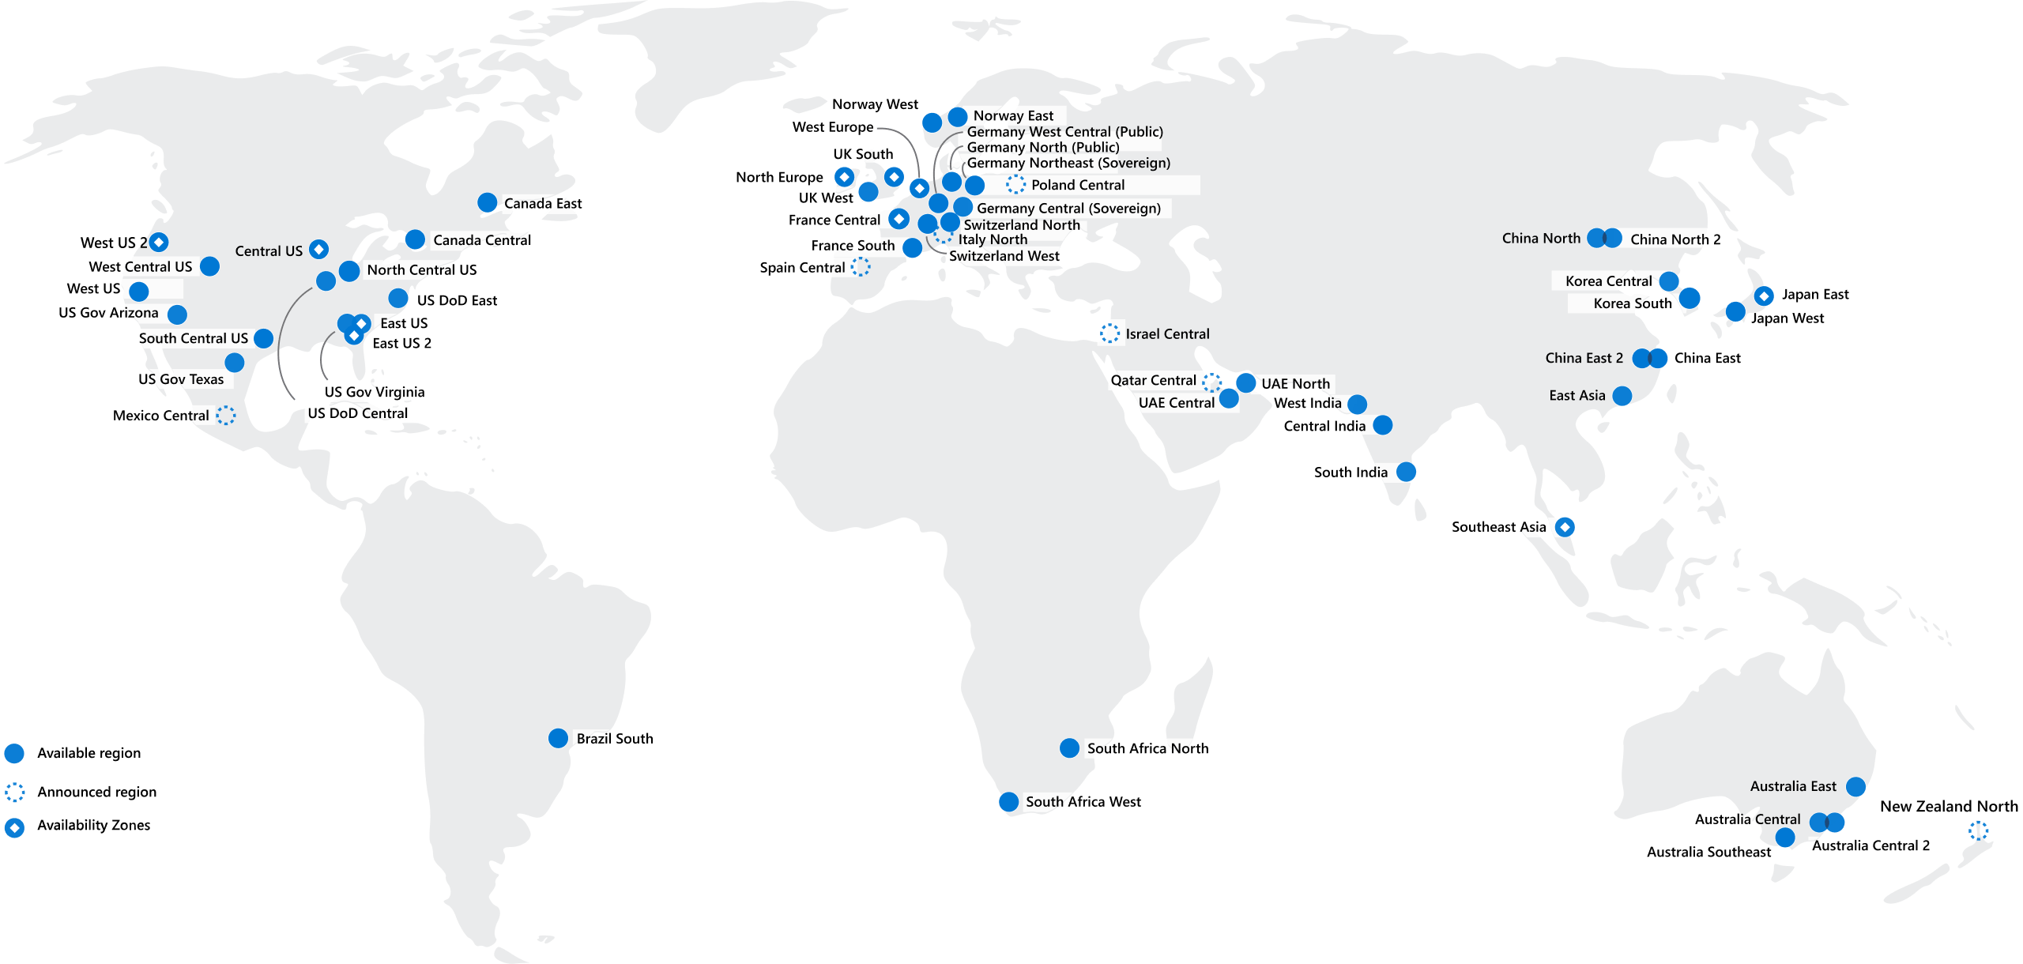
Regions
Azure offers more global regions than any other cloud provider with 60+ regions representing over 140 countries
Regions are made up of one or more datacenters in close proximity.
Provide flexibility and scale to reduce customer latency.
Preserve data residency with a comprehensive compliance offering.
© Copyright Microsoft Corporation. All rights reserved.
Notes:
https://docs.microsoft.com/en-us/learn/modules/describe-core-architectural-components-of-azure/5-describe-azure-physical-infrastructure
A region represents a collection of datacenters.
Provide flexibility and scale.
Preserve data residency.
Select regions close to your users.
Be aware of region deployment availability.
There are global services that are region independent.
A list of regions and their locations is available at https://azure.microsoft.com/en-us/global-infrastructure/locations/
Learn and SkillPipe content order note:
Slides 6-10
https://docs.microsoft.com/en-us/learn/modules/azure-architecture-fundamentals/regions-availability-zones

Slide 6
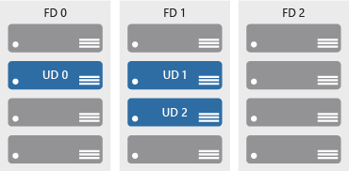
Availability zones
Azure Region
Provide protection against downtime due to datacenter failure.
Physically separate datacenters within the same region.
Each datacenter is equipped with independent power, cooling, and networking.
Connected through private fiber-optic networks.
Availability Zone 1
Availability Zone 2
Availability Zone 3
© Copyright Microsoft Corporation. All rights reserved.
Notes:
https://docs.microsoft.com/learn/modules/describe-core-architectural-components-of-azure/5-describe-azure-physical-infrastructure
Physically separate locations within an Azure region.
Takes availability sets to the next level
Includes one or more datacenters, equipped with independent power, cooling, and networking.
Acts as an isolation boundary.
If one availability zone goes down, the other continues working.
More details about Availability Zones in Azure are available at https://docs.microsoft.com/en-us/azure/availability-zones/az-overview

Slide 7
Region Pairs
Region
North Central US​
East US​
West US 2​
US East 2​
Canada Central​
North Europe​
UK West​
Germany Central​
South East Asia​
East China​
Japan East​
Australia Southeast​
India South​
Brazil South (Primary)​
Region
South Central US​
West US​
West Central US​
Central US​
Canada East​
West Europe​
UK South​
Germany Northeast​
East Asia​
North China​
Japan West​
Australia East​
India Central​
South Central US ​
At least 300 miles of separation between region pairs.
Automatic replication for some services.
Prioritized region recovery in the event of outage.
Updates are rollout sequentially to minimize downtime.
Web Link: https://aka.ms/PairedRegions
© Copyright Microsoft Corporation. All rights reserved.
Notes:
https://docs.microsoft.com/learn/modules/describe-core-architectural-components-of-azure/5-describe-azure-physical-infrastructure
Each Azure region is paired with another region.
Azure prefers at least 300 miles of separation between datacenters in a regional pair.
Some services provide automatic replication to the paired region.
In an outage, recovery of one region is prioritized out of every pair.
Azure system updates are rolled out to paired regions sequentially (not at the same time).
List of geographies, regions, region-pairs, and other details -https://azure.microsoft.com/en-us/global-infrastructure/geographies/
A full list of region pairs is available at https://docs.microsoft.com/en-us/azure/best-practices-availability-paired-regions#what-are-paired-regions

Slide 8
Walkthrough – Explore the Azure Global infrastructure
Explore the Azure global infrastructure
Select Explore the Globe (after intro).
Notice the different icons (geography, regions, points of presence (PoP), and so on).
Find your location on the globe, then find the nearest PoP and region to your location.
Notes:
You can, alternatively hit Skip Intro (top corner directly under the Microsoft Azure logo)
https://infrastructuremap.microsoft.com/

Slide 9
Azure Resources
Azure resources are components like storage, virtual machines, and networks that are available to build cloud solutions.
Virtual Machines
Storage Accounts
Virtual Networks
App Services
SQL Databases
Functions
Notes:
https://docs.microsoft.com/learn/modules/describe-core-architectural-components-of-azure/6-describe-azure-management-infrastructure

Slide 10
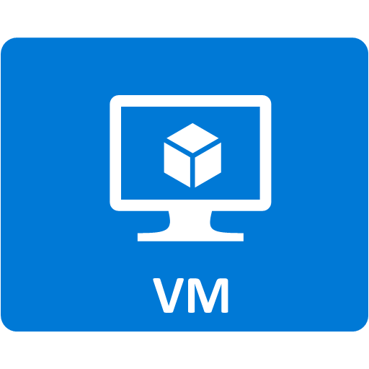
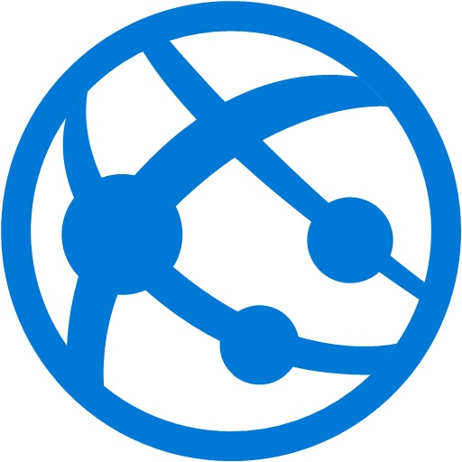
Resource groups
Resource groups (web + DB, VM, Storage) in one group
A resource group is a container to manage and aggregate resources in a single unit.
Resources can exist in only one resource group.
Resources can exist in different regions.
Resources can be moved to different resource groups.
Applications can utilize multiple resource groups.
OR
Web and DB resource group
Virtual machine resource group
Storage resource group
© Copyright Microsoft Corporation. All rights reserved.
Notes:
https://docs.microsoft.com/learn/modules/describe-core-architectural-components-of-azure/6-describe-azure-management-infrastructure
Containers for multiple resources that share the same life cycle.
Aggregates resources into a single manageable unit.
Every Azure resource must exist in one (and only one) resource group.
Secure at the resource group (or resource) level - using role-based access control (RBAC).

Slide 11
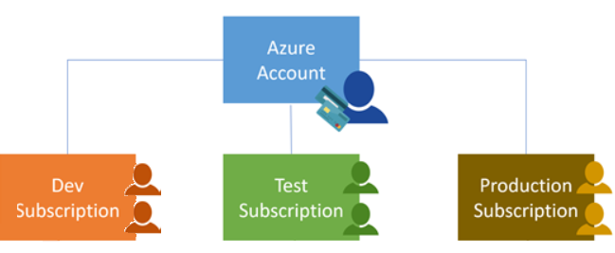
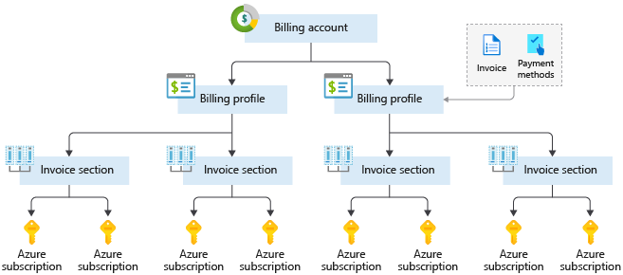
Azure Subscriptions
An Azure subscription provides you with authenticated and authorized access to Azure accounts.
Billing boundary: generate separate billing reports and invoices for each subscription.
Access control boundary: manage and control access to the resources that users can provision with specific subscriptions.
Notes:
https://docs.microsoft.com/learn/modules/describe-core-architectural-components-of-azure/6-describe-azure-management-infrastructure
An account can have one subscription or multiple subscriptions.
Azure subscription offers - https://azure.microsoft.com/en-us/support/legal/offer-details/

Slide 12
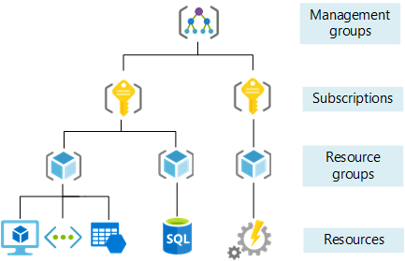
Management Groups
Management groups can include multiple Azure subscriptions.
Subscriptions inherit conditions applied to the management group.
10,000 management groups can be supported in a single directory.
A management group tree can support up to six levels of depth.
Notes:
https://docs.microsoft.com/learn/modules/describe-core-architectural-components-of-azure/6-describe-azure-management-infrastructure
Management groups can include multiple Azure subscriptions.
Subscriptions inherit conditions applied to the management group.
10,000 management groups can be supported in a single directory.
A management group tree can support up to six levels of depth.
Management groups - https://docs.microsoft.com/en-us/azure/governance/management-groups/

Slide 13
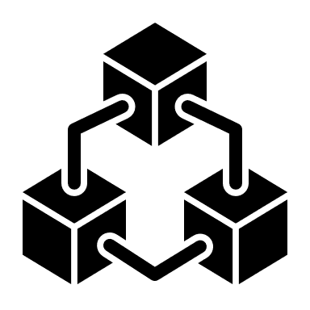
Compute and Networking
Notes:
https://docs.microsoft.com/learn/modules/describe-azure-compute-networking-services/

Slide 14
Azure compute services
Azure compute is an on-demand computing service that provides computing resources such as disks, processors, memory, networking, and operating systems.
Virtual
Machines
App
Services
Container Instances
Azure Kubernetes Services (AKS)
Azure Virtual Desktop
Notes:
https://azure.microsoft.com/products/category/compute/

Slide 15
Azure virtual machines
Azure Virtual Machines (VM) are software emulations of physical computers.
Includes virtual processor, memory, storage, and networking.
IaaS offering that provides total control and customization.
© Copyright Microsoft Corporation. All rights reserved.
Notes:
https://docs.microsoft.com/learn/modules/describe-azure-compute-networking-services/2-virtual-machines
Development and test – Azure VMs offer a quick and easy way to create a computer with specific configurations required to code and test an application.
Applications in the cloud – Because demand for your application can fluctuate, it might make economic sense to run it on a VM in Azure. You pay for extra VMs when you need them and shut them down when you don’t.
Extended datacenter – Virtual machines in an Azure virtual network can easily be connected to your organization’s network.
Azure virtual machines - https://azure.microsoft.com/en-us/services/virtual-machines/

Slide 16
VM scale sets
Scale sets provide a load-balanced opportunity to automatically scale resources.
Scale out when resource needs increase.
Scale in when resource needs are lower.
© Copyright Microsoft Corporation. All rights reserved.
Notes:
https://docs.microsoft.com/learn/modules/describe-azure-compute-networking-services/2-virtual-machines

Slide 17
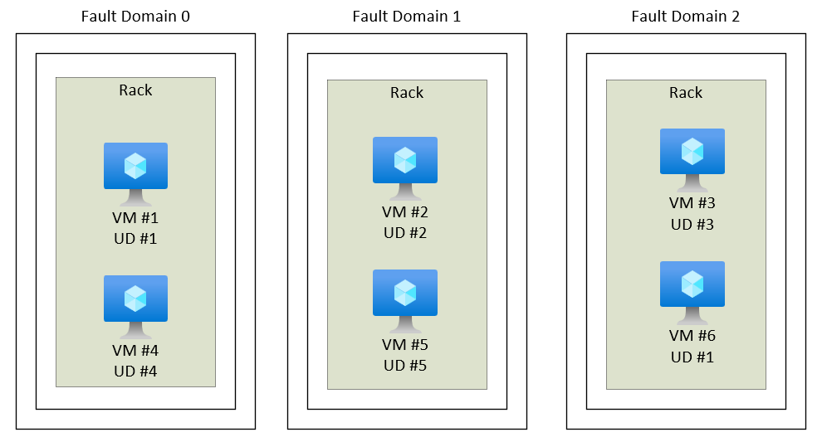
VM availability sets
© Copyright Microsoft Corporation. All rights reserved.
Notes:
https://docs.microsoft.com/learn/modules/describe-azure-compute-networking-services/2-virtual-machines
Update domain keeps VMs grouped if they can be rebooted at the same time without causing an outage.
Fault domains group VMs based on common power and networking.

Slide 18
Azure Virtual Desktop
Azure Virtual Desktop is a desktop and app virtualization that runs in the cloud.
Create a full desktop virtualization environment without having to run additional gateway servers.
Reduce risk of resource being left behind.
True multi-session deployments.
© Copyright Microsoft Corporation. All rights reserved.
Notes:
https://docs.microsoft.com/learn/modules/describe-azure-compute-networking-services/4-virtual-desktop
https://docs.microsoft.com/en-us/azure/virtual-desktop/overview
PaaS
It enables you to use a cloud-hosted version of Windows from any location. Azure Virtual Desktop works across devices and operating systems, and works with apps that you can use to access remote desktops or most modern browsers.
The actual desktop and apps are running in the cloud, meaning the risk of confidential data being left on a personal device is reduced. Additionally, user sessions are isolated in both single and multi-session environments.

Slide 19
Azure Container Services
Azure Containers are a light-weight, virtualized environment that does not require operating system management, and can respond to changes on demand.
Azure Container Instances: a PaaS offering that runs a container in Azure without the need to manage a virtual machine or additional services.
Azure Kubernetes Service: an orchestration service for containers with distributed architectures and large volumes of containers.
© Copyright Microsoft Corporation. All rights reserved.
Notes:
https://docs.microsoft.com/learn/modules/describe-azure-compute-networking-services/5-containers
Containers are a virtualization environment. However, unlike virtual machines, you do not manage an operating system. Containers are meant to be lightweight, and are designed to be created, scaled out, and stopped dynamically.
Azure Container Instances - https://azure.microsoft.com/en-us/services/container-instances/
Azure Kubernetes Service - https://azure.microsoft.com/en-us/services/kubernetes-service/

Slide 20
Comparing Azure compute options
Virtual machines
Virtual Desktop
Containers
Cloud based server that supports either Windows or Linux environments.
Provides a cloud based personal computer Windows desktop experience.
Lightweight, miniature environment well suited for running microservices.
Useful for lift-and-shift migrations to the cloud.
Dedicated applications to connect and use, or accessible from any modern browser.
Designed for scalability and resiliency through orchestration.
Complete operating system package, including the host operating system.
Multi-client login allows multiple users to log into the same machine at the same time.
Applications and services are packaged in a container that sits on-top of the host operating system. Multiple containers can sit on one host OS.

Slide 21
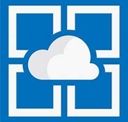
Azure App Services
Azure App Services is a fully managed platform to build, deploy, and scale web apps and APIs quickly.
Works with .NET, .NET Core, Node.js, Java, Python, or php.
PaaS offering with enterprise-grade performance, security, and compliance requirements.
© Copyright Microsoft Corporation. All rights reserved.
Notes:
https://docs.microsoft.com/learn/modules/describe-azure-compute-networking-services/7-describe-application-hosting-options
With App Service, you can host most common app service styles like:
Web apps
API apps
WebJobs
Mobile apps
Web apps
App Service includes full support for hosting web apps by using ASP.NET, ASP.NET Core, Java, Ruby, Node.js, PHP, or Python. You can choose either Windows or Linux as the host operating system.
API apps
Much like hosting a website, you can build REST-based web APIs by using your choice of language and framework. You get full Swagger support and the ability to package and publish your API in Azure Marketplace. The produced apps can be consumed from any HTTP- or HTTPS-based client.
WebJobs
You can use the WebJobs feature to run a program (.exe, Java, PHP, Python, or Node.js) or script (.cmd, .bat, PowerShell, or Bash) in the same context as a web app, API app, or mobile app. They can be scheduled or run by a trigger. WebJobs are often used to run background tasks as part of your application logic.
Mobile apps
Use the Mobile Apps feature of App Service to quickly build a back end for iOS and Android apps. With just a few actions in the Azure portal, you can:
Store mobile app data in a cloud-based SQL database.
Authenticate customers against common social providers, such as MSA, Google, Twitter, and Facebook.
Send push notifications.
Execute custom back-end logic in C# or Node.js.
On the mobile app side, there's SDK support for native iOS and Android, Xamarin, and React native apps.
It enables automated deployments from GitHub, Azure DevOps, or any Git repo to support a continuous deployment model.

Slide 22
Azure networking services
Azure Virtual Network (VNet) enables Azure resources to communicate with each other, the internet, and on-premises networks.
Public endpoints, accessible from anywhere on the internet
Private endpoints, accessible only from within your network
Virtual subnets, segment your network to suit your needs
Network peering, connect your private networks directly together
Notes:
https://docs.microsoft.com/learn/modules/describe-azure-compute-networking-services/8-virtual-networking

Slide 23
Azure networking services
Virtual Private Network Gateway (VPN) is used to send encrypted traffic between an Azure virtual network and an on-premises location over the public internet.
Notes:
https://docs.microsoft.com/learn/modules/describe-azure-compute-networking-services/10-virtual-private-networks

Slide 24
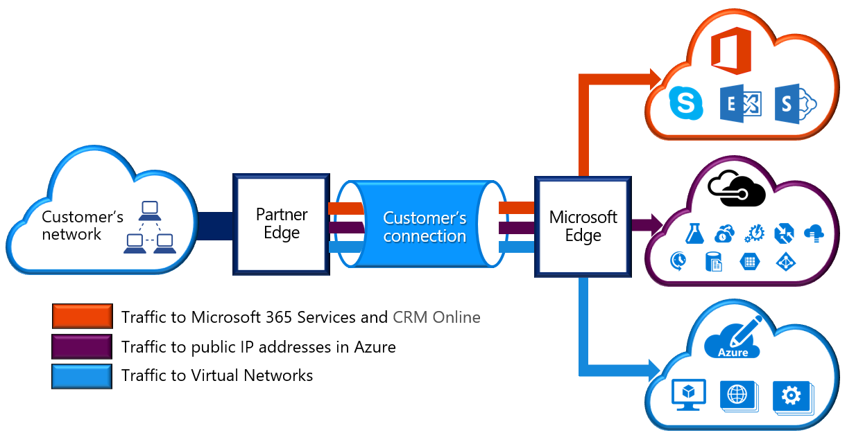
Azure networking services
Azure Express Route extends on-premises networks into Azure over a private connection that is facilitated by a connectivity provider.
Notes:
https://docs.microsoft.com/learn/modules/describe-azure-compute-networking-services/11-expressroute/
Connectivity can be from an any-to-any (IP VPN) network, a point-to-point Ethernet network, or a virtual cross-connection through a connectivity provider at a colocation facility. ExpressRoute connections don't go over the public Internet. This allows ExpressRoute connections to offer more reliability, faster speeds, consistent latencies, and higher security than typical connections over the Internet.
There are several benefits to using ExpressRoute as the connection service between Azure and on-premises networks.
Connectivity to Microsoft cloud services across all regions in the geopolitical region.
Global connectivity to Microsoft services across all regions with the ExpressRoute Global Reach.
Dynamic routing between your network and Microsoft via Border Gateway Protocol (BGP).
Built-in redundancy in every peering location for higher reliability.
Global connectivity
You can enable ExpressRoute Global Reach to exchange data across your on-premises sites by connecting your ExpressRoute circuits. For example, say you had an office in Asia and a datacenter in Europe, both with ExpressRoute circuits connecting them to the Microsoft network. You could use ExpressRoute Global Reach to connect those two facilities, allowing them to communicate without transferring data over the public internet.
ExpressRoute connectivity models
ExpressRoute supports four models that you can use to connect your on-premises network to the Microsoft cloud:
CloudExchange colocation
Point-to-point Ethernet connection
Any-to-any connection
Directly from ExpressRoute sites
Co-location at a cloud exchange
Co-location refers to your datacenter, office, or other facility being physically co-located at a cloud exchange, such as an ISP. If your facility is co-located at a cloud exchange, you can request a virtual cross-connect to the Microsoft cloud.
Point-to-point Ethernet connection
Point-to-point ethernet connection refers to using a point-to-point connection to connect your facility to the Microsoft cloud.
Any-to-any networks
With any-to-any connectivity, you can integrate your wide area network (WAN) with Azure by providing connections to your offices and datacenters. Azure integrates with your WAN connection to provide a connection like you would have between your datacenter and any branch offices.
Directly from ExpressRoute sites
You can connect directly into the Microsoft's global network at a peering location strategically distributed across the world. ExpressRoute Direct provides dual 100 Gbps or 10-Gbps connectivity, which supports Active/Active connectivity at scale.
Security considerations
With ExpressRoute, your data doesn't travel over the public internet, so it's not exposed to the potential risks associated with internet communications. ExpressRoute is a private connection from your on-premises infrastructure to your Azure infrastructure. Even if you have an ExpressRoute connection, DNS queries, certificate revocation list checking, and Azure Content Delivery Network requests are still sent over the public internet.

Slide 25
Exercise – Create an Azure resource
Create an Azure resource, monitor the resource group for needed resources being created in the same group
Create a virtual machine.
Monitor the resource group.
Notes:
https://docs.microsoft.com/learn/modules/describe-core-architectural-components-of-azure/7-exercise-create-azure-resource/
Lab to create an Azure resource. A key component of this lab is noticing that when a VM is created, Azure automatically creates the necessary components (network, storage, etc) and groups them automatically in the same resource group.
Check your knowledge
1. How many resource groups can a resource be in at the same time?
One
Two
Three
(A resource can only be in one group at a time.)
2. What happens to the resources within a resource group when an action or setting at the Resource Group level is applied?
Current resources inherit the setting, but future resources don't.
Future resources inherit the setting, but current ones don't.
The setting is applied to current and future resources.
(Resources inherit permissions from their resource group.)
3. What Azure feature replicates resources across regions that are at least 300 miles away from each other?
Region pairs
Availability Zones
Sovereign regions
(Most Azure regions are paired with another region within the same geography (such as US, Europe, or Asia) at least 300 miles away.)

Slide 26
Exercise – Create a Virtual Machine
Create a virtual machine in the Azure Portal, connect to the virtual machine, install the web server role, and test.
Create the virtual machine.
Install the web server package.
Notes:
https://docs.microsoft.com/learn/modules/describe-azure-compute-networking-services/3-exercise-create-azure-virtual-machine

Slide 27
Walkthrough – Configure network access
Configure public access to the virtual machine created earlier.
Verify currently open ports.
Create a network security group
Configure HTTP access (port 80)
Test the connection.
Notes:
https://docs.microsoft.com/learn/modules/describe-azure-compute-networking-services/9-exercise-configure-network-access/
EXERCISE FAILS !!!!!!

Slide 28
Storage
Notes:
https://docs.microsoft.com/learn/modules/describe-azure-storage-services/

Slide 29
Storage accounts
Must have a globally unique name
Provide over-the-internet access worldwide
Determine storage services and redundancy options
Notes:
https://docs.microsoft.com/learn/modules/describe-azure-storage-services/2-accounts
One of the benefits of using an Azure Storage Account is having a unique namespace in Azure for your data. In order to do this, every storage account in Azure must have a unique-in-Azure account name. The combination of the account name and the Azure Storage service endpoint forms the endpoints for your storage account.
When naming your storage account, keep these rules in mind:
Storage account names must be between 3 and 24 characters in length and may contain numbers and lowercase letters only.
Your storage account name must be unique within Azure. No two storage accounts can have the same name. This supports the ability to have a unique, accessible namespace in Azure.

Slide 30
Storage redundancy
Redundancy configuration | Deployment | Durability
Locally redundant storage (LRS) | Single datacenter in the primary region | 11 nines
Zone-redundant storage (ZRS) | Three availability zones in the primary region | 12 nines
Geo-redundant storage (GRS) | Single datacenter in the primary and secondary region | 16 nines
Geo-zone-redundant-storage (GZRS) | Three availability zones in the primary region and a single datacenter in secondary region | 16 nines
Notes:
https://docs.microsoft.com/learn/modules/describe-azure-storage-services/3-redundancy
LRS is the lowest-cost redundancy option and offers the least durability compared to other options. LRS protects your data against server rack and drive failures. However, if a disaster such as fire or flooding occurs within the data center, all replicas of a storage account using LRS may be lost or unrecoverable. To mitigate this risk, Microsoft recommends using zone-redundant storage (ZRS), geo-redundant storage (GRS), or geo-zone-redundant storage (GZRS).
For Availability Zone-enabled Regions, zone-redundant storage (ZRS) replicates your Azure Storage data synchronously across three Azure availability zones in the primary region. ZRS offers durability for Azure Storage data objects of at least 12 nines (99.9999999999%) over a given year. With ZRS, your data is still accessible for both read and write operations even if a zone becomes unavailable. No remounting of Azure file shares from the connected clients is required. If a zone becomes unavailable, Azure undertakes networking updates, such as DNS repointing. These updates may affect your application if you access data before the updates have completed. Microsoft recommends using ZRS in the primary region for scenarios that require high availability. ZRS is also recommended for restricting replication of data within a country or region to meet data governance requirements.
When you create a storage account, you select the primary region for the account. The paired secondary region is based on Azure Region Pairs, and can't be changed.
Azure Storage offers two options for copying your data to a secondary region: geo-redundant storage (GRS) and geo-zone-redundant storage (GZRS). GRS is similar to running LRS in two regions, and GZRS is similar to running ZRS in the primary region and LRS in the secondary region.
By default, data in the secondary region isn't available for read or write access unless there's a failover to the secondary region. If the primary region becomes unavailable, you can choose to fail over to the secondary region. After the failover has completed, the secondary region becomes the primary region, and you can again read and write data.
GRS copies your data synchronously three times within a single physical location in the primary region using LRS. It then copies your data asynchronously to a single physical location in the secondary region (the region pair) using LRS. GRS offers durability for Azure Storage data objects of at least 16 nines (99.99999999999999%) over a given year.
GZRS combines the high availability provided by redundancy across availability zones with protection from regional outages provided by geo-replication. Data in a GZRS storage account is copied across three Azure availability zones in the primary region (similar to ZRS) and is also replicated to a secondary geographic region, using LRS, for protection from regional disasters. Microsoft recommends using GZRS for applications requiring maximum consistency, durability, and availability, excellent performance, and resilience for disaster recovery.
Geo-redundant storage (with GRS or GZRS) replicates your data to another physical location in the secondary region to protect against regional outages. However, that data is available to be read only if the customer or Microsoft initiates a failover from the primary to secondary region. However, if you enable read access to the secondary region, your data is always available, even when the primary region is running optimally. For read access to the secondary region, enable read-access geo-redundant storage (RA-GRS) or read-access geo-zone-redundant storage (RA-GZRS).

Slide 31
Azure storage services
Container storage (blob) is optimized for storing massive amounts of unstructured data, such as text or binary data.
Disk storage provides disks for virtual machines, applications, and other services to access and use.
Azure Files sets up a highly available network file shares that can be accessed by using the standard Server Message Block (SMB) protocol.
Notes:
https://docs.microsoft.com/learn/modules/describe-azure-storage-services/4-describe-azure-storage-services

Slide 32
Storage service public endpoints
Storage service | Public endpoint
Blob Storage | https://<storage-account-name>.blob.core.windows.net
Azure Files | https://<storage-account-name>.file.core.windows.net
Queue Storage | https://<storage-account-name>.queue.core.windows.net
Table Storage | https://<storage-account-name>.table.core.windows.net

Slide 33
Azure storage access tiers
Hot | Cool | Archive
Optimized for storing data that is accessed frequently. | Optimized for storing data that is infrequently accessed and stored for at least 30 days. | Optimized for storing data that is rarely accessed and stored for at least 180 days with flexible latency requirements.
You can switch between these access tiers at any time.
Notes:
https://docs.microsoft.com/learn/modules/describe-azure-storage-services/4-describe-azure-storage-services
Azure Storage offers different access tiers for your blob storage, helping you store object data in the most cost-effective manner. The available access tiers include:
Hot access tier: Optimized for storing data that is accessed frequently (for example, images for your website).
Cool access tier: Optimized for data that is infrequently accessed and stored for at least 30 days (for example, invoices for your customers).
Archive access tier: Appropriate for data that is rarely accessed and stored for at least 180 days, with flexible latency requirements (for example, long-term backups).
The following considerations apply to the different access tiers:
Only the hot and cool access tiers can be set at the account level. The archive access tier isn't available at the account level.
Hot, cool, and archive tiers can be set at the blob level, during or after upload.
Data in the cool access tier can tolerate slightly lower availability, but still requires high durability, retrieval latency, and throughput characteristics similar to hot data. For cool data, a slightly lower availability service-level agreement (SLA) and higher access costs compared to hot data are acceptable trade-offs for lower storage costs.
Archive storage stores data offline and offers the lowest storage costs, but also the highest costs to rehydrate and access data.

Slide 34
Azure monitoring tools
Notes:
https://docs.microsoft.com/learn/modules/describe-monitoring-tools-azure/
Check your knowledge
1. What service helps you manage your Azure, on-premises, and multi-cloud environments?
Azure Arc
Azure Policy
Azure Cloud Manager
Azure Arc, working with Azure Resource Manager, lets you extend your Azure compliance and monitoring to your hybrid and multi-cloud configurations.
2. What two components could you use to implement a “infrastructure as code” deployment?
Azure Blueprints and ARM Templates
Azure Policy and Azure Arc
Azure Monitor and Azure Arc
Azure Blueprints applies policies in an automated fashion and ARM Templates allow you to deploy your resource as code. Using the two together helps ensure that you’re deploying consistent, compliant resources.

Slide 35
Azure Advisor
Azure Advisor analyzes deployed Azure resources and makes recommendations based on best practices to optimize Azure deployments.
Reliability
Security
Performance
Cost
Operational Excellence
© Copyright Microsoft Corporation. All rights reserved.
Notes:
https://docs.microsoft.com/learn/modules/describe-monitoring-tools-azure/2-describe-purpose-of-azure-advisor
Get proactive, actionable, and personalized best practice recommendations.
Improve the performance, security, and availability of your resources.
Identify opportunities to reduce your Azure costs.
Azure Advisor - https://docs.microsoft.com/azure/advisor/advisor-overview

Slide 36
Azure Service Health
Azure Service Health is a collection of services that keep you informed of general Azure status, service status that may impact you, and specific resource status that is impacting you.
Azure Status: global view of the health of all Azure services across all Azure regions
Service Health: focused view on only the services and regions that you’re using. If a service is experiencing a problem in a region you’re not using, it won’t show up here.
Resource Health: tailored view of your actual Azure resources. It provides information about the health of your individual cloud resources
Notes:
https://docs.microsoft.com/learn/modules/describe-monitoring-tools-azure/3-describe-azure-service-health

Slide 37
Azure Monitor
Azure Monitor maximizes the availability and performance of applications and services by collecting, analyzing, and acting on telemetry from cloud and on-premises environments.
Application Insights
Log Analytics
Smart Alerts
Automation Actions
Customized Dashboards
Notes:
https://docs.microsoft.com/learn/modules/describe-monitoring-tools-azure/4-describe-azure-monitor

Slide 38
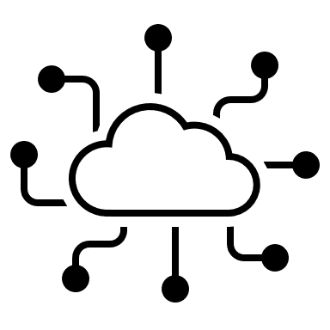
Management and deployment tools
Notes:
https://docs.microsoft.com/learn/modules/describe-features-tools-manage-deploy-azure-resources/

Slide 39
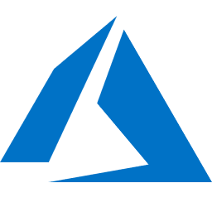
Tools for interacting with Azure
Azure Portal
Azure PowerShell
Command-Line Interface (CLI)
Azure Cloud Shell
Notes:
https://docs.microsoft.com/learn/modules/describe-features-tools-manage-deploy-azure-resources/2-describe-interacting-azure

Slide 40
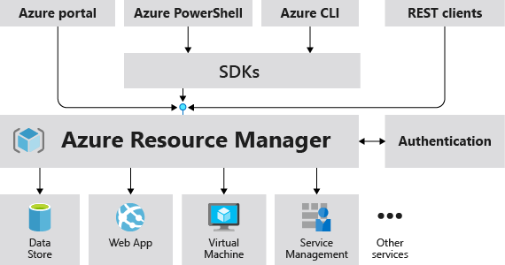
Azure Resource Manager
The Azure Resource Manager (ARM) provides a management layer that enables you to create, update, and delete resources in your Azure subscription.
© Copyright Microsoft Corporation. All rights reserved.
Notes:
https://docs.microsoft.com/learn/modules/describe-features-tools-manage-deploy-azure-resources/4-describe-azure-resource-manager-azure-arm-templates
Provides a management layer that enables you to create, update, and delete resources in your Azure subscription.
Create, configure, manage and delete resources and resource groups.
Organizes resources.
Controls access and resources.
Automates using different tools and SDKs.
Stores layouts in JSON files.
You can view more details about Azure Resource Manager at https://docs.microsoft.com/en-us/azure/azure-resource-manager

Slide 41
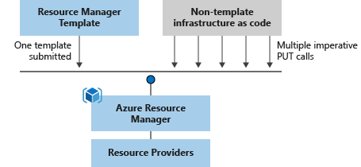
Azure Resource Manager (ARM) templates
Azure Resource Manager (ARM) templates are JavaScript Object Notation (JSON) files that can be used to create and deploy Azure infrastructure without having to write programing commands.
Declarative syntax
Repeatable results
Orchestration
Modular files
Built-in validation
Exportable code
Notes:
https://docs.microsoft.com/learn/modules/describe-features-tools-manage-deploy-azure-resources/4-describe-azure-resource-manager-azure-arm-templates
https://azure.microsoft.com/en-us/features/resource-manager/
https://docs.microsoft.com/en-us/azure/azure-resource-manager/management/overview
https://docs.microsoft.com/en-us/azure/azure-resource-manager/templates/overview
Deploy app resources Azure Resource Manager enables you to repeatedly deploy your app and have confidence your resources are deployed in a consistent state. You define the infrastructure and dependencies for your app in a single declarative template. This template is flexible enough to use for all of your environments such as test, staging or production. If you create a solution from the Azure Marketplace, the solution will automatically include a template that you can use for your app.
Organize resources
Azure Resource Manager makes it easy for you to manage and visualize resources in your app. You no longer have to deploy parts of your app separately and then manually stitch them together. You put resources with a common lifecycle into a resource group that can be deployed or deleted in a single action. You can see which resources are linked by a dependency. You can apply tags to resources to categorize them for management tasks, such as billing.
Control access to resources
With Azure Resource Manager, you can control who in your organization can perform actions on the resources. You manage permissions by defining roles and adding users or groups to the roles. For critical resources, you can apply an explicit lock that prevents users from deleting or modifying the resource. Azure Resource Manager logs all user actions so you can audit those actions. For each action, the audit log contains information about the user, time, events, and status.

