Slide 1
Section 01:
Cloud concepts
Notes:
https://docs.microsoft.com/learn/paths/microsoft-azure-fundamentals-describe-cloud-concepts/
The notes section of the PPT will call out any free Learn sandbox exercises available and provide direct links that can be shared with students.

Slide 2
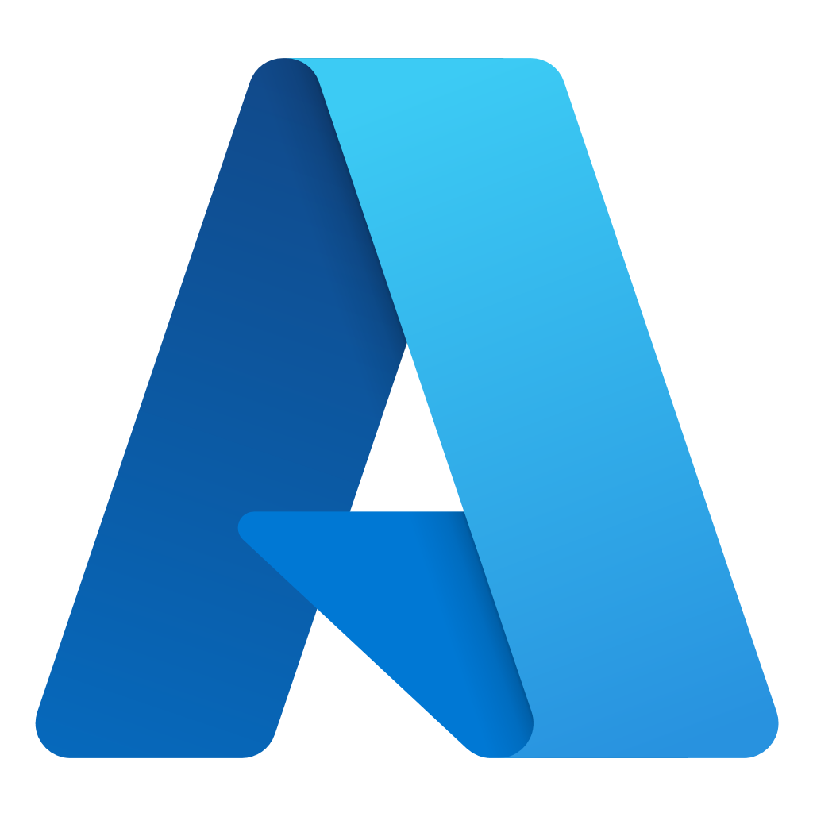
Section 01 - Outline
You will learn the following concepts:
Cloud Computing
Cloud Benefits
Cloud Service Types
Notes:
Cloud Computing (AZ-900)
https://learn.microsoft.com/en-us/training/modules/describe-cloud-compute/
Cloud Benefits (AZ-900)
https://learn.microsoft.com/en-us/training/modules/describe-benefits-use-cloud-services/
Cloud Service Types (AZ-900)
https://learn.microsoft.com/en-us/training/modules/describe-cloud-service-types/

Slide 3
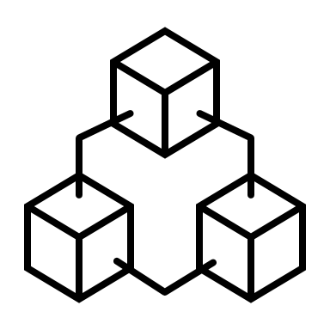
Cloud Computing
Notes:
https://docs.microsoft.com/learn/modules/describe-cloud-compute/

Slide 4
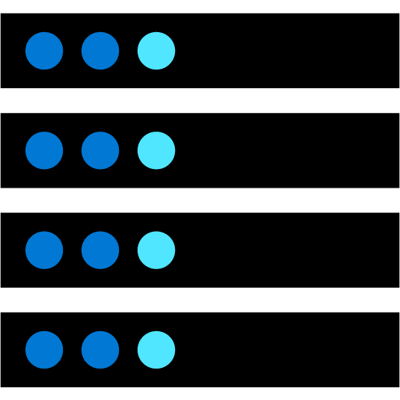
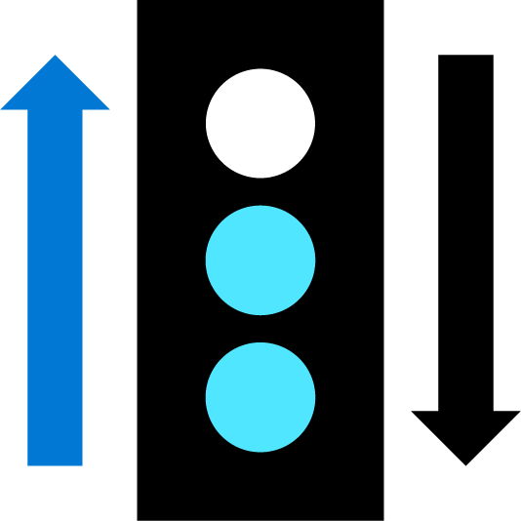
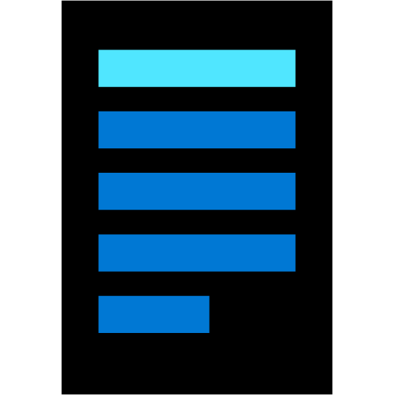
What is cloud computing?
Cloud Computing is the delivery of computing services over the internet, enabling faster innovation, flexible resources, and economies of scale.
Compute
Networking
Storage
Notes:
https://docs.microsoft.com/learn/modules/describe-cloud-compute/3-what-cloud-compute
Cloud Computing is:
A model for enabling on-demand access to a shared pool of configurable computing resources – servers, network, storage, applications, and services
Ubiquitous, convenient, on-demand network access
Rapidly provisioned and released with minimal management effort or service provider interaction
Definitions found at:
NIST definition - https://csrc.nist.gov/publications/detail/sp/800-145/final

Slide 5
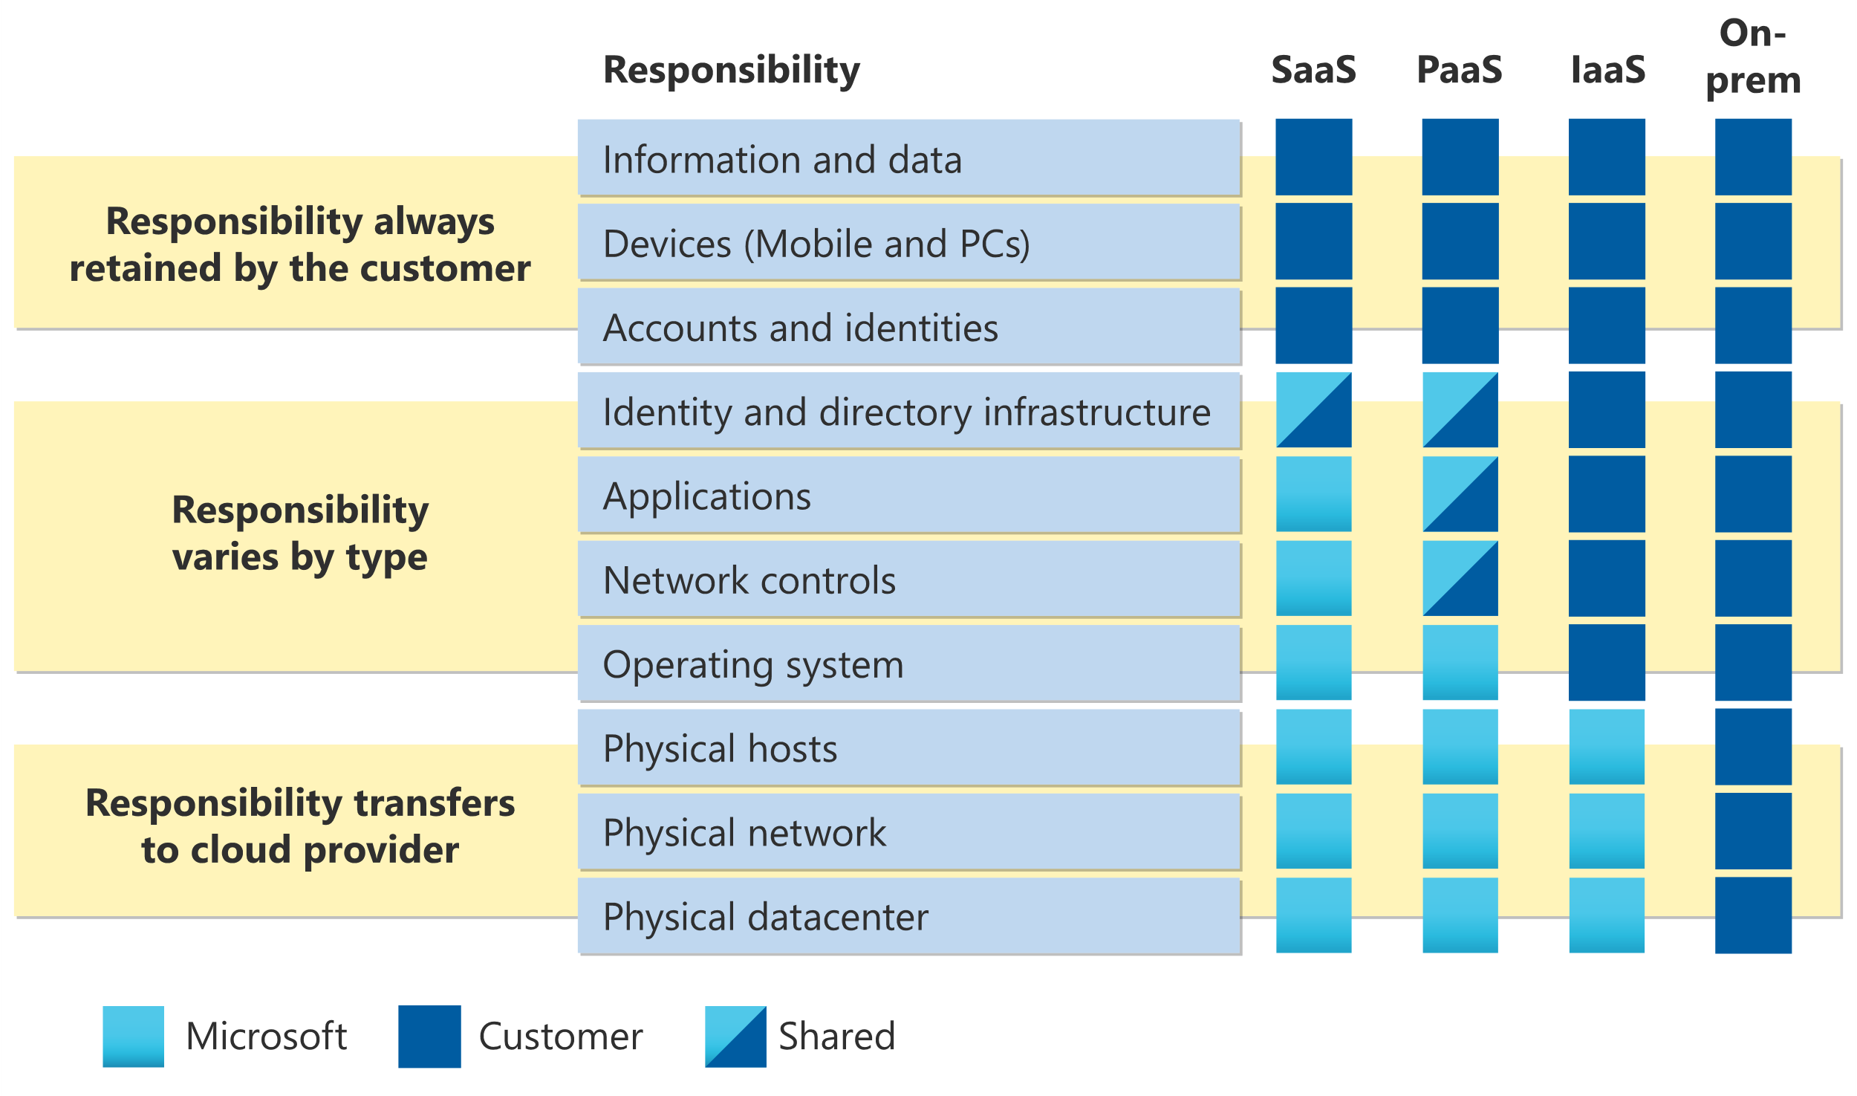
Shared responsibility model
Notes:
https://docs.microsoft.com/learn/modules/describe-cloud-compute/4-describe-shared-responsibility-model
IaaS, PaaS, and SaaS have dedicated topics, coming up.

Slide 6
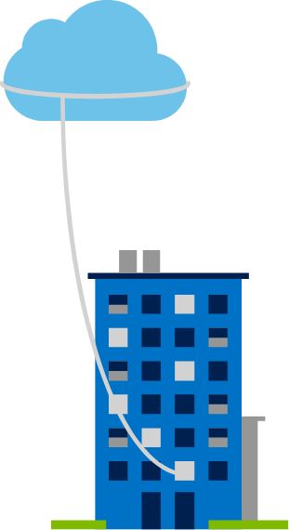
Private cloud
Organizations create a cloud environment in their datacenter.
Organization is responsible for operating the services they provide.
Does not provide access to users outside of the organization.
Notes:
https://docs.microsoft.com/learn/modules/describe-cloud-compute/5-define-cloud-models
Owned and operated by the organization that uses cloud resources.
Organizations create a cloud environment in their datacenter.
Self-service access to compute resources provided to users within the organization.
Organization is responsible for operating the services they provide.
You’ll always be responsible for:
The information and data stored in the cloud
Devices that are allowed to connect to your cloud (cell phones, computers, and so on)
The accounts and identities of the people, services, and devices within your organization
The cloud provider is always responsible for:
The physical datacenter
The physical network
The physical hosts
Your service model will determine responsibility for things like:
Operating systems
Network controls
Applications
Identity and infrastructure

Slide 7
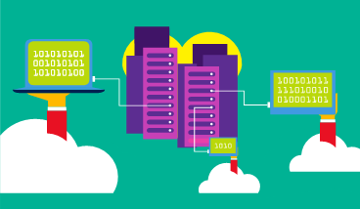
Public cloud
Owned by cloud services or hosting provider.
Provides resources and services to multiple organizations and users.
Accessed via secure network connection (typically over the internet).
Notes:
https://docs.microsoft.com/learn/modules/describe-cloud-compute/5-define-cloud-models
What are public, private, and hybrid clouds? - https://azure.microsoft.com/en-us/overview/what-are-private-public-hybrid-clouds/

Slide 8
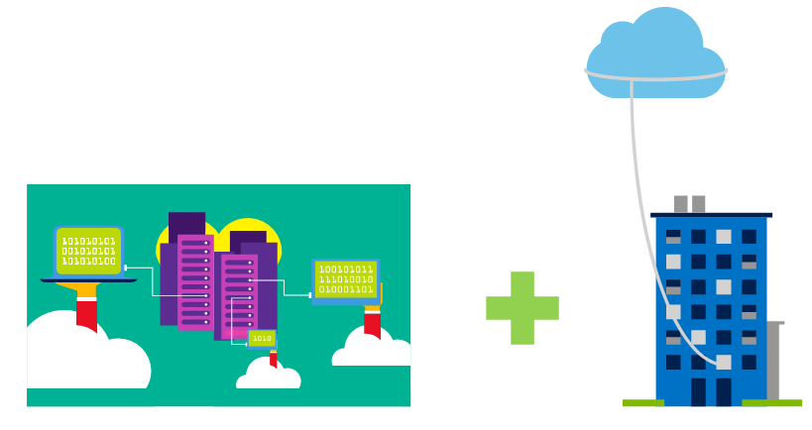
Hybrid cloud
Combines Public and Private clouds to allow applications to run in the
most appropriate location.
Notes:
https://docs.microsoft.com/learn/modules/describe-cloud-compute/5-define-cloud-models
Hybrid cloud models have the following characteristics:
Resource location. Specific resources run or are used in a public cloud, and others run or are used in a private cloud.
Cost and efficiency. Hybrid cloud models allow an organization to leverage some of the benefits of cost, efficiency, and scale that are available with a public cloud model.
Control. Organizations retain management control in private clouds.
Skills. Technical skills are still required to maintain the private cloud and ensure both cloud models can operate together.

Slide 9
Cloud model comparison
Public Cloud
No capital expenditures to scale up.
Applications can be quickly provisioned and deprovisioned.
Organizations pay only for what they use.
Private Cloud
Organizations have complete control over resources and security.
Hybrid Cloud
Provides the most flexibility.
Organizations determine where to run their applications.
Organizations control security, compliance, or legal requirements.
Organizations are responsible for hardware maintenance and updates.
Hardware must be purchased for start-up and maintenance.
Notes:
https://docs.microsoft.com/learn/modules/describe-cloud-compute/5-define-cloud-models
Multi-cloud
A fourth, and increasingly likely scenario is a multi-cloud scenario. In a multi-cloud scenario, you use multiple public cloud providers. Maybe you use different features from different cloud providers. Or maybe you started your cloud journey with one provider and are in the process of migrating to a different provider. Regardless, in a multi-cloud environment you deal with two (or more) public cloud providers and manage resources and security in both environments.
Azure Arc
Azure Arc is a set of technologies that helps manage your cloud environment. Azure Arc can help manage your cloud environment, whether it's a public cloud solely on Azure, a private cloud in your datacenter, a hybrid configuration, or even a multi-cloud environment running on multiple cloud providers at once.

Slide 10
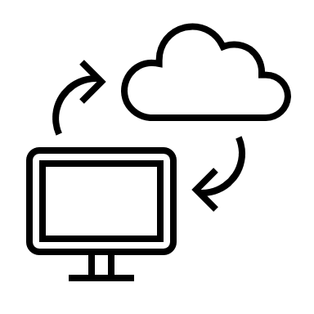
Cloud benefits
Notes:
https://docs.microsoft.com/en-us/learn/modules/describe-benefits-use-cloud-services/

Slide 11
Cloud Benefits
High availability
Elasticity
Scalability
Reliability
Predictability
Security
Governance
Manageability
Notes:
https://docs.microsoft.com/learn/modules/describe-benefits-use-cloud-services/2-high-availability-scalability-cloud
https://docs.microsoft.com/learn/modules/describe-benefits-use-cloud-services/3-reliability-predictability-cloud
https://docs.microsoft.com/learn/modules/describe-benefits-use-cloud-services/4-security-governance-cloud
https://docs.microsoft.com/learn/modules/describe-benefits-use-cloud-services/5-manageability-cloud
Vertical scaling
With vertical scaling, if you were developing an app and you needed more processing power, you could vertically scale up to add more CPUs or RAM to the virtual machine. Conversely, if you realized you had over-specified the needs, you could vertically scale down by lowering the CPU or RAM specifications.
Horizontal scaling
With horizontal scaling, if you suddenly experienced a steep jump in demand, your deployed resources could be scaled out (either automatically or manually). For example, you could add additional virtual machines or containers, scaling out. In the same manner, if there was a significant drop in demand, deployed resources could be scaled in (either automatically or manually), scaling in.
Reliability
Reliability is the ability of a system to recover from failures and continue to function. It's also one of the pillars of the Microsoft Azure Well-Architected Framework.
The cloud, by virtue of its decentralized design, naturally supports a reliable and resilient infrastructure. With a decentralized design, the cloud enables you to have resources deployed in regions around the world. With this global scale, even if one region has a catastrophic event other regions are still up and running. You can design your applications to automatically take advantage of this increased reliability. In some cases, your cloud environment itself will automatically shift to a different region for you, with no action needed on your part. You’ll learn more about how Azure leverages global scale to provide reliability later in this series.
Predictability
Predictability in the cloud lets you move forward with confidence. Predictability can be focused on performance predictability or cost predictability. Both performance and cost predictability are heavily influenced by the Microsoft Azure Well-Architected Framework. Deploy a solution that’s built around this framework and you have a solution that’s cost and performance are predictable.
Performance
Performance predictability focuses on predicting the resources needed to deliver a positive experience for your customers. Autoscaling, load balancing, and high availability are just some of the cloud concepts that support performance predictability. If you suddenly need more resources, autoscaling can deploy additional resources to meet the demand, and then scale back when the demand drops. Or if the traffic is heavily focused on one area, load balancing will help redirect some of the overload to less stressed areas.
Cost
Cost predictability is focused on predicting or forecasting the cost of the cloud spend. With the cloud, you can track your resource use in real time, monitor resources to ensure that you’re using them in the most efficient way, and apply data analytics to find patterns and trends that help better plan resource deployments. By operating in the cloud and using cloud analytics and information, you can predict future costs and adjust your resources as needed. You can even use tools like the Total Cost of Ownership (TCO) or Pricing Calculator to get an estimate of potential cloud spend.
A major benefit of cloud computing is the manageability options. There are two types of manageability for cloud computing that you’ll learn about in this series, and both are excellent benefits.
Management of the cloud
Management of the cloud speaks to managing your cloud resources. In the cloud, you can:
Automatically scale resource deployment based on need.
Deploy resources based on a preconfigured template, removing the need for manual configuration.
Monitor the health of resources and automatically replace failing resources.
Receive automatic alerts based on configured metrics, so you’re aware of performance in real time.
Management in the cloud
Management in the cloud speaks to how you’re able to manage your cloud environment and resources. You can manage these:
Through a web portal.
Using a command line interface.
Using APIs.
Using PowerShell.
Check your knowledge
1. Which type of scaling involves adding or removing resources (such as virtual machines or containers) to meet demand?
Vertical scaling
Horizontal scaling
Direct scaling
(Horizontal scaling is adding or subtracting the number of resources.)
2. What is characterized as the ability of a system to recover from failures and continue to function?
Reliability
Predictability
Scalability
(Reliability is the ability of a system to recover from failures and continue to function, and it is one of the pillars of the Microsoft Azure Well-Architected Framework.)

Slide 12
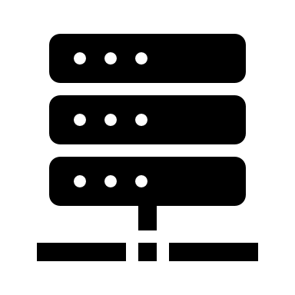
Cloud service types
Notes:
https://docs.microsoft.com/learn/modules/describe-cloud-service-types

Slide 13
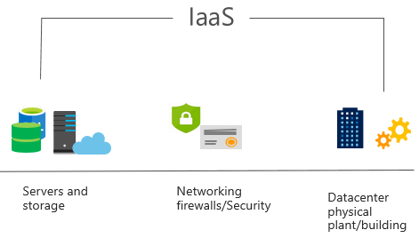
Infrastructure as a Service (IaaS)
Build pay-as-you-go IT infrastructure by renting servers, virtual machines, storage, networks, and operating systems from a cloud provider.
Notes:
https://docs.microsoft.com/learn/modules/describe-cloud-service-types/2-describe-infrastructure-service
For more information on IaaS, visit https://azure.microsoft.com/en-us/overview/what-is-iaas/
Most basic cloud computing services category.
Build pay-as-you-go IT infrastructure by renting servers, virtual machines, storage, networks, and operating systems from a cloud provider.
Instant computing infrastructure, provisioned and managed over the internet.
Infrastructure as a service (IaaS) is the most flexible category of cloud services, as it provides you the maximum amount of control for your cloud resources. In an IaaS model, the cloud provider is responsible for maintaining the hardware, network connectivity (to the internet), and physical security. You’re responsible for everything else: operating system installation, configuration, and maintenance; network configuration; database and storage configuration; and so on. With IaaS, you’re essentially renting the hardware in a cloud datacenter, but what you do with that hardware is up to you.

Slide 14
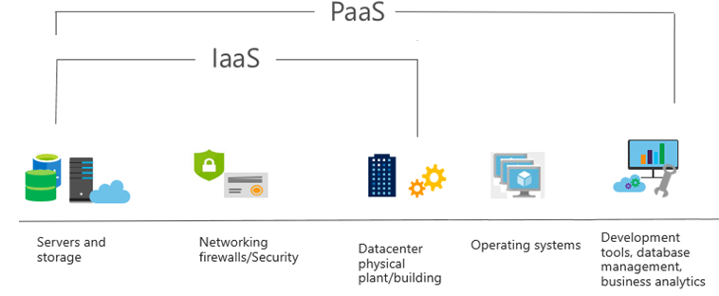
Platform as a Service (PaaS)
Provides environment for building, testing, and deploying software applications; without focusing on managing underlying infrastructure.
Notes:
https://docs.microsoft.com/learn/modules/describe-cloud-service-types/3-describe-platform-service
For more information on PaaS, see https://azure.microsoft.com/en-us/overview/what-is-paas/
Provides environment for building, testing, and deploying software applications.
Helps create applications quickly, without focusing on managing underlying infrastructure.
Platform as a service (PaaS) is a middle ground between renting space in a datacenter (infrastructure as a service) and paying for a complete and deployed solution (software as a service). In a PaaS environment, the cloud provider maintains the physical infrastructure, physical security, and connection to the internet. They also maintain the operating systems, middleware, development tools, and business intelligence services that make up a cloud solution. In a PaaS scenario, you don't have to worry about the licensing or patching for operating systems and databases.
PaaS is well suited to provide a complete development environment without the headache of maintaining all the development infrastructure.

Slide 15
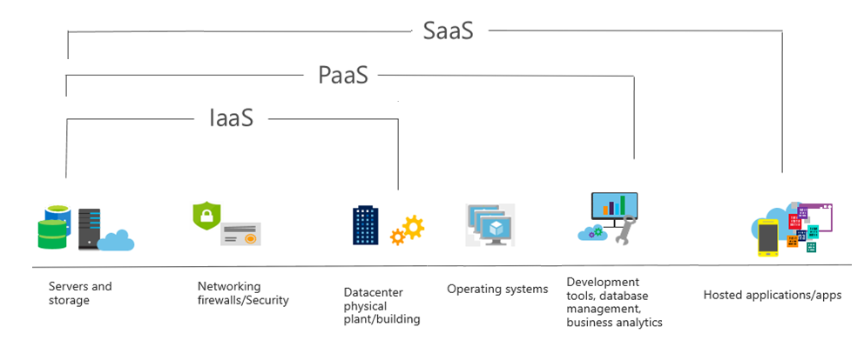
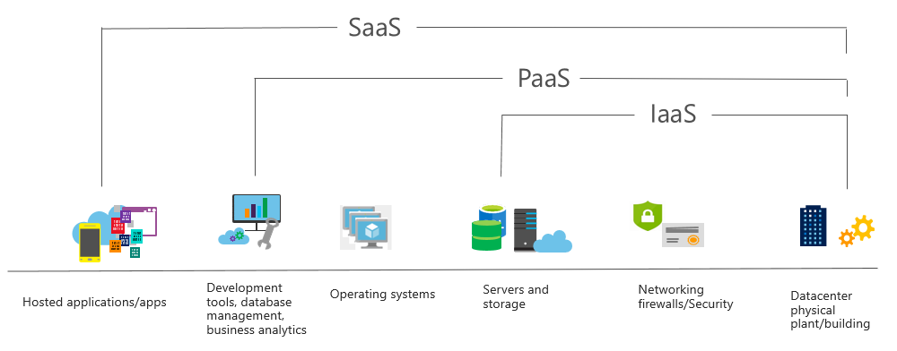
Software as a Service (SaaS)
Users connect to and use cloud-based apps over the internet: for example, Microsoft Office 365, email, and calendars.
Notes:
https://docs.microsoft.com/learn/modules/describe-cloud-service-types/4-describe-software-service
Common usage scenarios:
Examples of Microsoft SaaS services include Microsoft Office 365, Skype, and Microsoft Dynamics CRM Online.
For more information on SaaS, see https://azure.microsoft.com/en-us/overview/what-is-saas/
Software as a service (SaaS) is the most complete cloud service model from a product perspective. With SaaS, you’re essentially renting or using a fully developed application. Email, financial software, messaging applications, and connectivity software are all common examples of a SaaS implementation.
While the SaaS model may be the least flexible, it’s also the easiest to get up and running. It requires the least amount of technical knowledge or expertise to fully employ.

Slide 16
Cloud service comparison
IaaS
PaaS
SaaS
The most flexible cloud service.
Focus on application development.
Pay-as-you-go pricing model.
You configure and manage the hardware for your application.
Platform management is handled by the cloud provider.
Users pay for the software they use on a subscription model.

Slide 17

Azure Active Directory

Slide 18
Describe Azure Active Directory Benefits and Features
A cloud-based suite of identity management capabilities that enables you to securely manage access to Azure services and resources for your users
Provides application
management, authentication, device management, and hybrid identity
Notes:
What is Azure Active Directory? - https://docs.microsoft.com/azure/active-directory/fundamentals/active-directory-whatis

Slide 19
Describe Azure AD Concepts
Concept | Description
Identity | An object that can be authenticated
Account | An identity that has data associated with it
Azure AD account | An identity created through Azure AD or another Microsoft cloud service
Azure AD tenant/directory | A dedicated and trusted instance of Azure AD, a Tenant is automatically created when your organization signs up for a Microsoft cloud service subscription​ ​ Additional instances of Azure AD can be created​ Azure AD is the underlying product providing the identity service​ The term Tenant means a single instance of Azure AD representing a single organization​ The terms Tenant and Directory are often used interchangeably​
Azure subscription | Used to pay for Azure cloud services
Notes:
Azure AD Terminology - https://docs.microsoft.com/azure/active-directory/fundamentals/active-directory-whatis#terminology

Slide 20
Compare AD DS to Azure Active Directory
Azure AD is primarily an identity solution, and designed for HTTP and HTTPS communications
Queried using the REST API over HTTP and HTTPS. Instead of LDAP
Uses HTTP and HTTPS protocols such as SAML, WS-Federation, and OpenID Connect for authentication (and OAuth for authorization). Instead of Kerberos
Includes federation services, and many third-party services (such as Facebook)
Azure AD users and groups are created in a flat structure, and there are no Organizational Units (OUs) or Group Policy Objects (GPOs)
Notes:
Compare Active Directory to Azure Active Directory - https://docs.microsoft.com/azure/active-directory/fundamentals/active-directory-compare-azure-ad-to-ad
✔️ Azure AD is a managed service. You only manage the users, groups, and policies. Deploying AD DS with virtual machines using Azure means that you manage the deployment, configuration, virtual machines, patching, and other backend tasks. Do you see the difference? How are they similar?

Slide 21
Select Azure Active Directory Editions
Feature | Free | Microsoft 365 Apps | Premium P1 | Premium P2
Directory Objects | 500,000 objects | No object limit | No object limit | No object limit
Single Sign-On | Unlimited | Unlimited | Unlimited | Unlimited
Core Identity and Access | X | X | X | X
B2B Collaboration | X | X | X | X
Identity & Access for O365 |  | X | X | X
Premium Features |  |  | X | X
Hybrid Identities |  |  | X | X
Advanced Group Access |  |  | X | X
Conditional Access |  |  | X | X
Identity Protection |  |  |  | X
Identity Governance |  |  |  | X
Notes:
Azure AD Pricing Editions - https://azure.microsoft.com/pricing/details/active-directory/
✔️ Did you look through the pricing list to determine which features your organization needs and to compare edition capabilities?

